Slide 1
The Consequences of Plate Geometry on Plasma Activated Media*
Soheila Mohades, Amanda M. Lietz, Juliusz Kruszelnicki and Mark J. Kushner
University of Michigan
Ann Arbor, MI 48109-2122 USA
smohades@umich.edu
International Conference on Plasma Medicine
June 2018
* Work supported by National Science Foundation and Department of Energy Office of Fusion Energy Science
ICPM_2018
Notes:
1

Slide 2
AGENDA
Plasma Activation of Liquids in Well Plates
Model Description: nonPDPSIM
Flow with Plate Geometry
RONS in Gas and Liquid phase
Multipulse Effects on RONS
Concluding Remarks
University of Michigan
Institute for Plasma Science & Engr.
ICPM_2018
Notes:
2

Slide 3
ATMOSPHERIC PRESSURE PLASMA JETS
Atmospheric Pressure Plasma Jets (APPJs) are used in plasma medicine in several modes:
Direct treatment of cells and tissues.
Activation of liquid for plasma activation of media (PAM).
APPJ operation with rare gas (helium or argon) having small air impurities generates reactive oxygen and nitrogen species (RONS).
Solvation or transport of gas phase species into liquid and chemical reactions in liquid are two pathways of RONS generation in liquid phase.
K. Tominami, et al. Japn. J. Appl. Phys. 55. 01AF03 (2016).
University of Michigan
Institute for Plasma Science & Engr.
ICPM_2018
Notes:
3

Slide 4
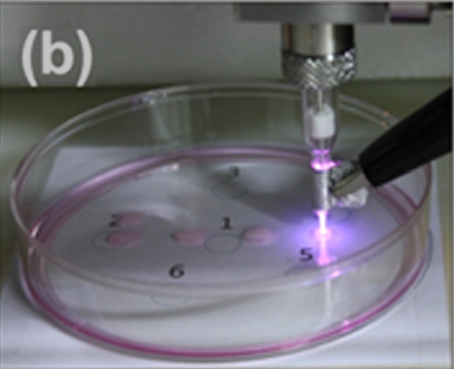
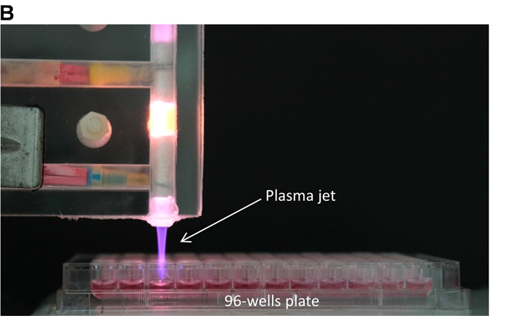
TREATMENT OF LIQUID IN WELL PLATES
Plasma activation of liquids in biological studies is often conducted with a well plate.
The characteristics of the well plate and height of the plate wall can affect gas dynamics, mixture, and discharge above the liquid:
Large surface/ volume plate: petri dishes or 6-well plate
Small surface/ volume plates: Eppendorf tube or 96-well plate
In this talk I will discuss results from computational investigation on the effect of well plate geometry on gas flow and RONS production.
Joh, H. et al. Applied Phys. Letters, 5, 101 (2012)
• Joseph-Marie Plewa et al 2014 New J Phys. 16 043027
University of Michigan
Institute for Plasma Science & Engr.
ICPM_2018
Notes:
4

Slide 5
MODEL: nonPDPSIM
Plasma Hydrodynamics
Poisson’s Equation
Gas Phase Plasma
2-D unstructured mesh
Time slicing algorithms between plasma and fluid timescales.
Poisson’s equation is solved throughout the computational domain during voltage pulse.
Liquid Phase Plasma
Bulk Electron Energy
Transport
Kinetic “Beam”
Electron Transport
Neutral Transport
Navier-Stokes
Neutral and Plasma
Chemistry
Radiation Transport
Diffusion into/out of liquid limited by Henry’s law equilibrium at the surface.
Liquid evaporates into gas with vapor pressure source.
Neutral plasma during afterglow.
University of Michigan
Institute for Plasma Science & Engr.
ICPM_2018

Slide 6
MODEL: nonPDPSIM
Plasma Hydrodynamics
Poisson’s Equation
Gas Phase Plasma
2-D unstructured mesh
Time slicing algorithms between plasma and fluid timescales.
Poisson’s equation is solved throughout the computational domain during voltage pulse.
Liquid Phase Plasma
Bulk Electron Energy
Transport
Kinetic “Beam”
Electron Transport
Neutral Transport
Navier-Stokes
Neutral and Plasma
Chemistry
Radiation Transport
Diffusion into/out of liquid limited by Henry’s law equilibrium at the surface.
Liquid evaporates into gas with vapor pressure source.
Neutral plasma during afterglow.
University of Michigan
Institute for Plasma Science & Engr.
ICPM_2018
Notes:
6
6

Slide 7
nonPDPSIM: TREATMENT OF LIQUID
Evaporation
Liquid plasma is treated identically to gas as a partially ionized substance.
Surface tension is addressed by specifying species able to pass through vapor/liquid interface.
Neutrals: Diffusion across interface is limited by Henry’s law equilibrium at the surface layer.
Ions and photons: All enter into liquid.
Liquid evaporates into gas with source given by its vapor pressure.
Henry's Law
Ions, Photons
Dissolved
gases
Solvated
Liquid
Low h: density in water saturates (O_{3aq}, N₂O_{aq}, H_{2aq})
High h: solvation depletes gas (H₂O_{2aq}, HO₂NO_{2aq},)
University of Michigan
Institute for Plasma Science & Engr.
ICPM_2018
Notes:
7
Liquid plasma is treated identically to gas as a partially ionized substance with Higher density and Specified permittivity
Surface tension is addressed by specifying species able to pass through vapor/liquid interface.
Diffusion into water is limited by Henry’s law equilibrium at the surface layer.
Solvated species “stay in liquid”, cannot go back to gas phase.
Liquid evaporates into gas with source given by its vapor pressure.

Slide 8
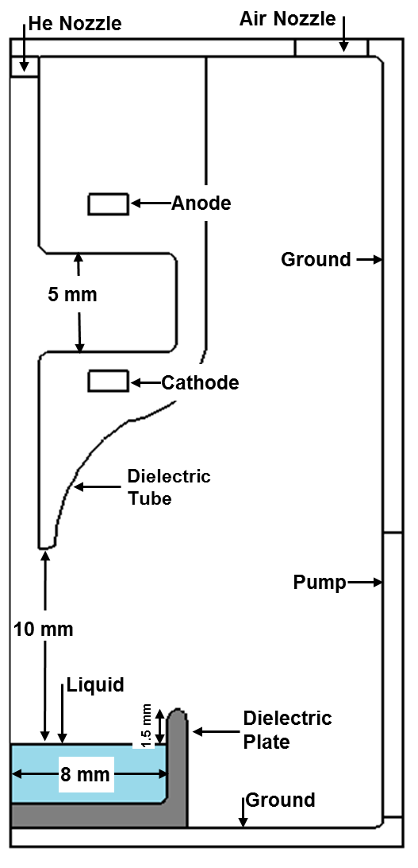
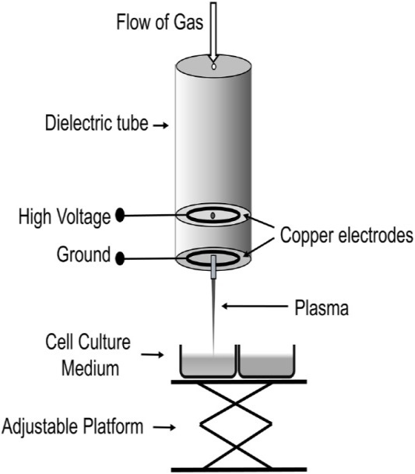
HE PLASMA JET SCHEMATIC
+30 kV (350 ns) on top electrode, grounded bottom electrode
Alumina reactor tube, 1 mm nozzle radius
1 cm between nozzle tip to 3 mm water in dielectric plate
Rim height: 0 to 5 mm
Feed gas: He = 99.97% + O₂/N₂ (63/237 ppm), 4 slm
Humid ambient air (O₂/N₂/H₂O = 79.5/20/0.5), 1 atm
Liquid: H₂O + 8 ppm O_{2aq}
S. Mohades, M. Laroussi, V. Maruthamuthu, J. Phys. D 50, 285205 (2017)
University of Michigan
Institute for Plasma Science & Engr.
ICPM_2018
Notes:
8
cylindrically symmetric

Slide 9
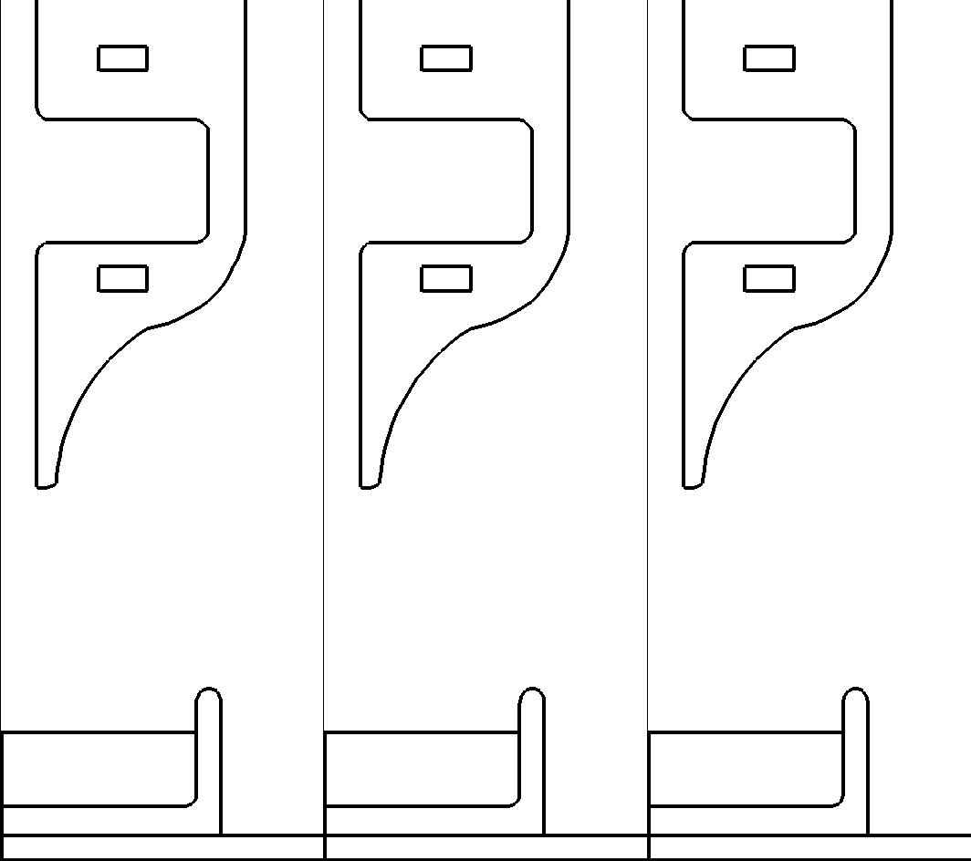
GAS FLOW AND DISCHARGE: BASE CASE
He
N₂
H₂O
O₂
POT +30kV S_{e} 1×10²² n_{e} 5×10¹⁴ cm⁻³s⁻¹ cm⁻³
2.6 ×10¹⁹ 2×10¹⁹ 5.8×10¹⁸ 5×10¹⁸ cm⁻³
2-dec
(linear)
(4-dec)
(4-dec)
Steady-state flow established before plasma initiated.
+30 kV, 350 ns pulse width; 370 ns animated
Discharge initiates in electrodes gap and propagates through nozzle
~ 1.5 mm plate rim
University of Michigan
Institute for Plasma Science & Engr.
Animation Slide
ICPM_2018
Notes:
9
ADD ANIMATION

Slide 10
He
N₂
H₂O
O₂
GAS DYNAMICS
High rim
Geometry of plate changes the gas composition above liquid.
High rim produces stagnation above liquid. Low rim produces cross flow over liquid.
Higher He density and water vapor in high rim plate while gas density of N₂ and O₂ is lower above the liquid.
Feed gas: He = 99.97% + O₂/N₂ (63/237 ppm), 4 slm
2-dec
2.4 ×10¹⁹ 2×10¹⁹ 5.8×10¹⁷ 5×10¹⁸ cm⁻³
Flat rim
2.6 ×10¹⁹ 2×10¹⁹ 5.8×10¹⁸ 5×10¹⁸ cm⁻³
University of Michigan
Institute for Plasma Science & Engr.
ICPM_2018
Notes:
10

Slide 11
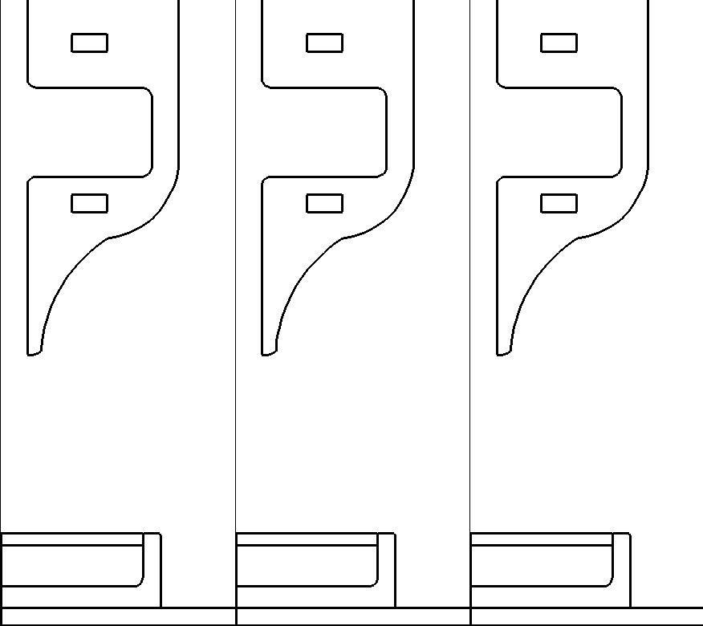
JET INTERACTING WITH FLAT RIM PLATE
POT +30kV S_{e} 1×10²² cm⁻³s⁻¹ n_{e} 5×10¹⁴ cm⁻³
+30 kV, 350 ns, 370 ns animated
Flush (flat) rim
He plume is surrounded by air as in a conventional APPJ.
Ionization wave is confined to He, and propagates across water layer.
IW speed lower than with high rim.
MIN MAX
Animation Slide
Log scale
University of Michigan
Institute for Plasma Science & Engr.
ICPM_2018
Notes:
Not v2

Slide 12
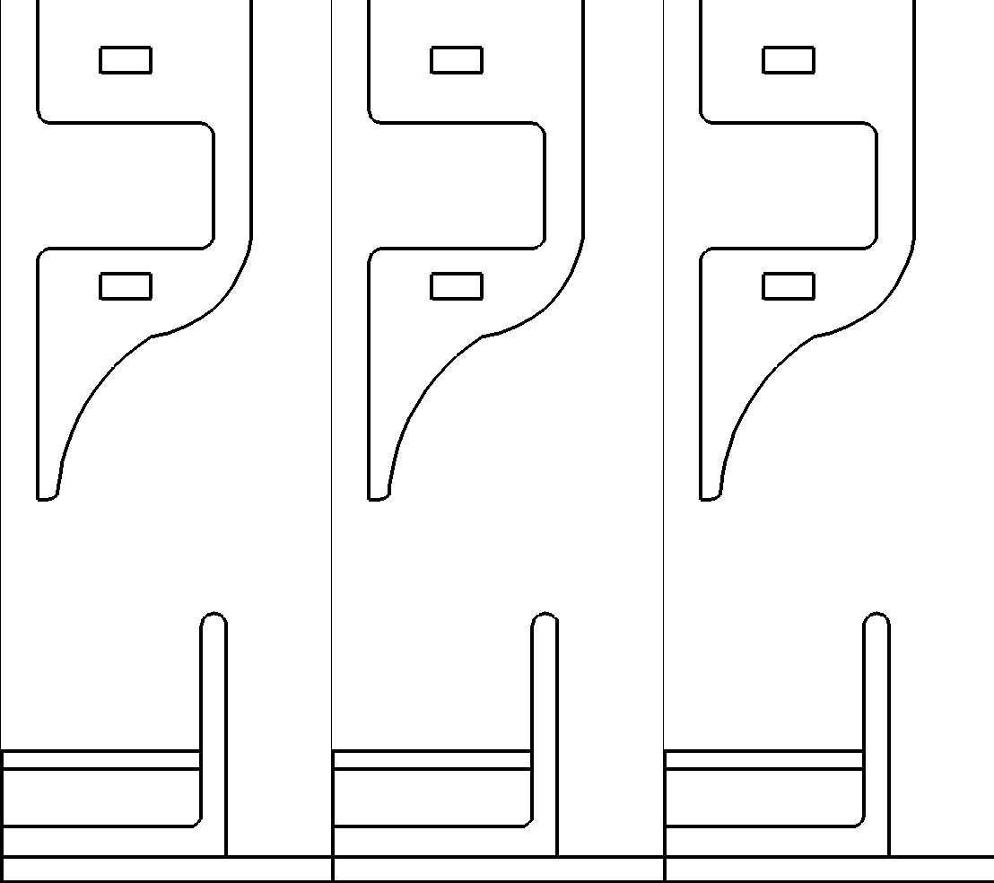
JET INTERACTING WITH HIGH RIM PLATE
POT +30kV S_{e} 1×10²² cm⁻³s⁻¹ n_{e} 5×10¹⁴ cm⁻³
+30 kV, 350 ns, 360 ns animated
~5 mm plate rim
Well is largely filled with He – lacks confinement of He plume by air.
Ionization wave spreads volumetrically above the liquid in He rich environment
MIN MAX
Animation Slide
Log scale
University of Michigan
Institute for Plasma Science & Engr.
ICPM_2018
Notes:
Humidity:

Slide 13
Effect of plate Geometry: ROS
High Rim
Base Case
Flat Rim
O
O₃
O
O₃
O
O₃
4×10¹⁴
1×10¹⁰
4×10¹⁴
3×10¹⁰
4×10¹⁴
6×10¹⁰
Densities of O and O₃ above liquid are both higher for flat and low rim due to proximity (and diffusion) of O₂ into ionization wave.
O₃ production depends on O density in high ambient of O₂.
Densities (cm⁻³, 3-dec) at 370 ns after pulse.
University of Michigan
Institute for Plasma Science & Engr.
ICPM_2018
Notes:
Slightly higher O and O3 gas in flat rim but lower density in liquid. It can be due to higher residence time of RONS high rim plate

Slide 14
Effect of plate Geometry: ROS
High Rim
Flat Rim
HO₂
OH
H₂O₂
HO₂
OH
H₂O₂
4-dec, cm⁻³
2×10¹²
6×10¹⁴
1×10¹²
7×10¹²
2×10¹⁴
3×10¹¹
Flat Rim: Greater penetration of ambient gases enable production of ROS close to and liquid.
Density of OH is higher in the high rim due to “trapping” of evaporated water and results in higher H₂O₂ production.
OH + OH + M → H₂O₂ + M e + H₂O → OH + H + e
HO₂ + HO₂ → H₂O₂ + O₂
University of Michigan
Institute for Plasma Science & Engr.
ICPM_2018
Notes:
Check volave OH and OHL for the base case

Slide 15
plate Geometry: after glow
High Rim
Flat Rim
O
OH
NO
O₃
O
OH
NO
O₃
5×10¹³
5×10¹¹
3×10¹²
7×10¹²
5×10¹³
1×10¹¹
3×10¹²
2×10¹³
10 ms after pulse, 3-decades, cm⁻³
High rim plate produces recirculation and vortices that traps, produces and enhances mixing resulting in higher O₃ density.
Flat rim having He cross flow blows out RONS during afterglow.
University of Michigan
Institute for Plasma Science & Engr.
ICPM_2018
Notes:
Creat gif for O3 50 ms duration

Slide 16
ROS in Liquid
• High Rim
• Flat Rim
H₂O_{2aq}
OH_{aq}
O_{3aq}
O₂⁻_{aq}
2×10¹⁵
4×10¹⁴
700 μm
2×10¹³
8×10¹²
80 ms after pulse
4-dec, cm⁻³
1×10¹⁵
3×10¹⁴
3×10¹²
7×10¹¹
8 mm
8 mm
Higher H₂O_{2,aq} and OH_{aq} with high rim due to higher water vapor density in well.
O_{3,aq} higher in high rim due to higher O_{aq} reacting with dissolved O₂ even though O_{3(g)} is lower .
O₂⁻ more uniformly distributed and higher density with flat rim due to IW across liquid, though high peak density in corner of high rim.
University of Michigan
Institute for Plasma Science & Engr.
ICPM_2018
Notes:
Initially higher H2O2 in high-wall plate which can be from higher H2O vapor
@100ms slightly higher H2O2 in gas phase and liquid phase in high-well plate
O3 Initially higher in flush-well
Eventually higher in gas phase and liquid @ 100 ms in flush-well plate
Density of OH in both gas and liquid phase is similar
No2 Higher in gas and liquid phase in high well plate
Slightly higher O2- in high-well
***********
240 ms in high wall and 210 ms in flush well => 140 ms after pulse
NO2L: 9e9
1.5e10 high-wall

Slide 17
RNS in Liquid
• High Rim
• Flat Rim
1×10⁹
2×10¹⁰
NO_{aq}
ONOO⁻_{aq}
NO_{2,aq}
700 μm
1×10¹¹
5×10¹⁰
80 ms after pulse
4 dec, cm⁻³
3×10⁹
6×10¹⁰
8 mm
8 mm
Lower NO_{x} with high rim in afterglow due to ambient dominated by He. However, higher ONOO⁻ relates to higher OH. (NO_{2aq} + OH_{aq} → ONOOH_{aq}).
NO_{x(g)} accumulation above liquid with flat rim facilitates solvation.
NO_{aq} should depend on O₂ penetration to where N is large which is slightly higher in flat rim.
University of Michigan
Institute for Plasma Science & Engr.
ICPM_2018
Notes:
Slightly higher NO in v2 f17
Higher peroxinitrite and NO2
After glow:
NO2 slightly higher in gas and liquid in high rim
NO in gas equal in both plate
NOL slightly higher in flat rim

Slide 18
AFTER GLOW RONS: HIGH VS. FLAT
• High Rim
• Flat Rim
O_{3aq}
H₂O_{2aq}
O_{3aq}
H₂O_{2aq}
OH_{aq}
OH_{aq}
O₂⁻_{aq}
Number particles (inv.)
O₂⁻_{aq}
ONOO⁻_{aq}
NO_{2aq}
NO_{2aq}
NO_{aq}
ONOO⁻_{aq}
NO_{aq}
Time After Plasma (s)
Time After Plasma (s)
After glow starts at end of the pulse, 130 ms is plotted.
H₂O_{2aq}, O₃ and OH_{aq} higher in high rim after glow from a single pulse
NO_{x} higher in flat rim.
ONOO⁻ and O₂ slightly higher in high rim.
University of Michigan
Institute for Plasma Science & Engr.
ICPM_2018
Notes:
Slightly higher NO in v2 f17
Higher peroxinitrite and NO2
After glow:
NO2 slightly higher in gas and liquid in high rim
NO in gas equal in both plate
NOL slightly higher in flat rim

Slide 19
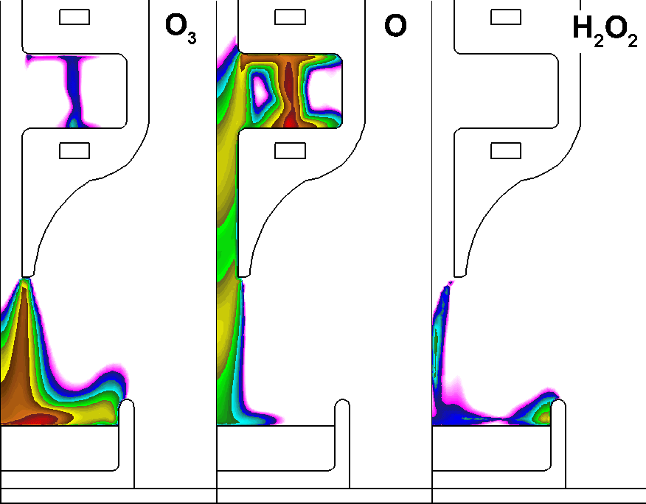
MULTIPLE PULSES: BASE CASE
10 pulses, 1 kHz
Multiple pulses increases densities of longer lived species (H₂O₂ and O₃) aided by recirculation from non-flux rim.
O and N are dominant inside the discharge gap.
H₂O₂ and OH formation follow water vapor.
5×10¹³, 2-dec
3×10¹⁴, 3-dec
1×10¹², 3-dec
Animation Slide
University of Michigan
Institute for Plasma Science & Engr.
ICPM_2018
Notes:
Initially higher H2O2 in high-wall plate which can be from higher H2O vapor
@100ms slightly higher H2O2 in gas phase and liquid phase in high-well plate
O3 Initially higher in flush-well
Eventually higher in gas phase and liquid @ 100 ms in flush-well plate
Density of OH in both gas and liquid phase is similar
No2 Higher in gas and liquid phase in high well plate
Slightly higher O2- in high-well
***********
240 ms in high wall and 210 ms in flush well => 140 ms after pulse
NO2L: 9e9
1.5e10 high-wall

Slide 20
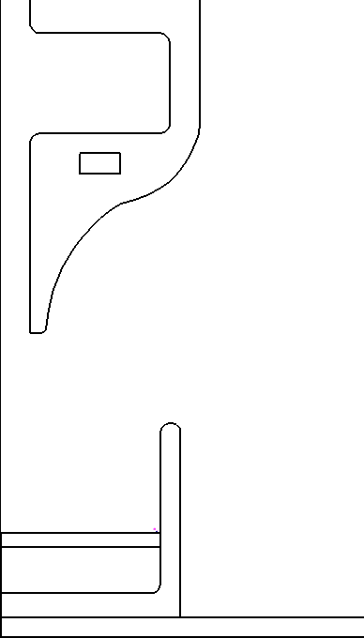
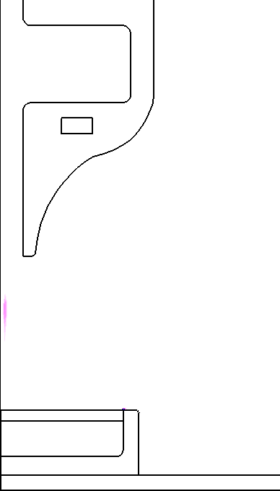
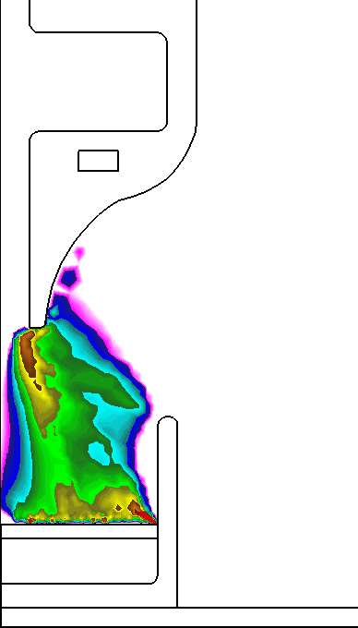
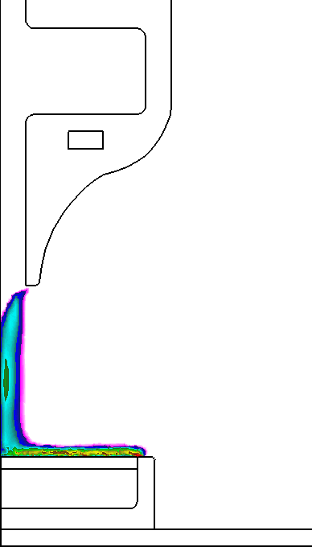
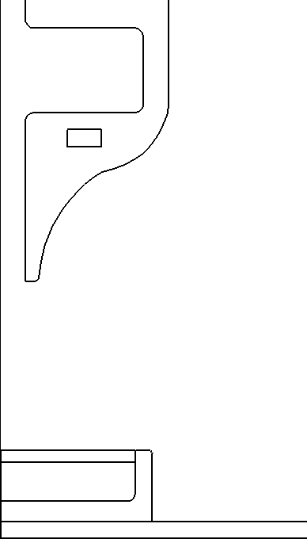
MULTIPLE PULSES: High vs. flat
H₂O₂
OH
O₃
4×10¹⁴
5×10¹³
8×10¹³
3×10¹³
5×10¹³
4×10¹⁴
10 KHz with 100 pulses, 3-dec cm⁻³
Higher H₂O₂ and OH and lower O₃ with high rim as in a single pulse.
H₂O₂ and O₃ production rate followed input energy in multiple pulses.
Animation Slide
University of Michigan
Institute for Plasma Science & Engr.
ICPM_2018
Notes:
Frames outputed at 0.09 ms

Slide 21
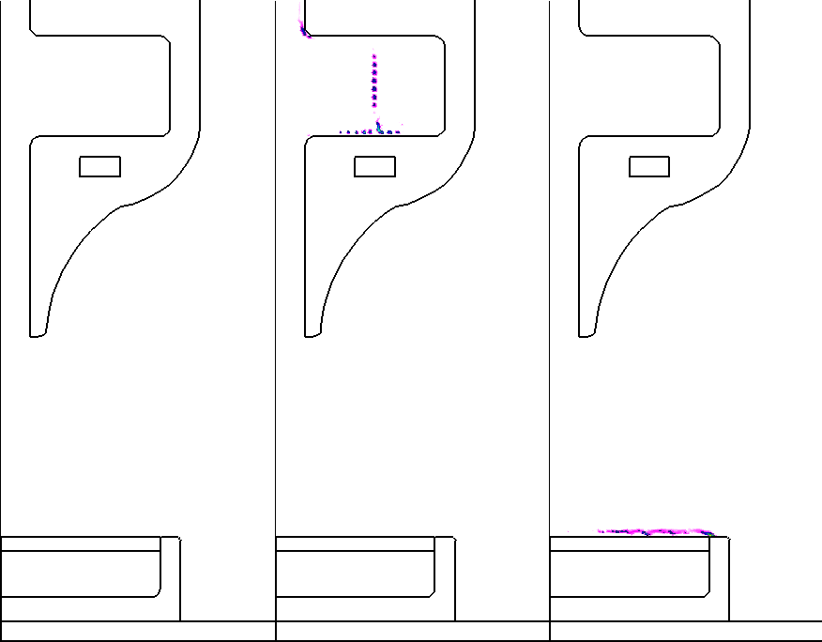
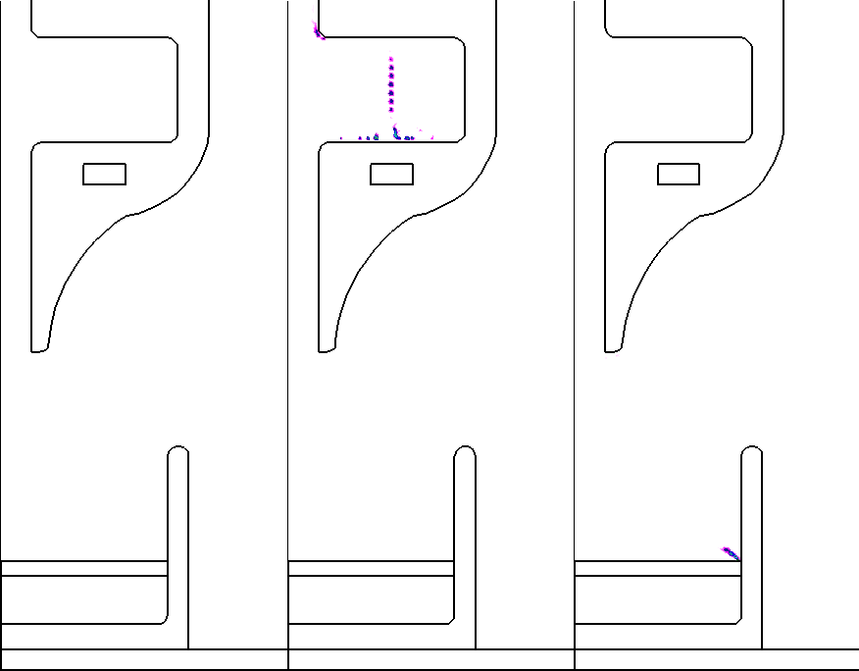
MULTIPLE PULSES: RONS
NO
NO₂
HO₂
NO
NO₂
HO₂
8×10¹³
2×10¹³
5×10¹³
8×10¹³
2×10¹³
5×10¹³
10 KHz with 100 pulses, scaled density (cm⁻³, 3-dec)
Recirculation in high rim returns RNS into liquid surface increases their density.
Animation Slide
University of Michigan
Institute for Plasma Science & Engr.
ICPM_2018
Notes:
Frames outputed at 0.09 ms

Slide 22
MULTIPLE PULSES: ROS in gas
High rim
Flat rim
O
O
O
O₃
OH
H₂O₂
O₃
Average density (cm⁻³)
HO₂
OH
H₂×10⁻¹
HO₂
H₂O₂
H₂
Time (s)
Time (s)
10 ms pulsed plasma treatment (100 pulses).
Density of vapor dependent species (H₂O₂, OH, H₂ and HO₂) is higher with high rim.
O is produced inside reactor independent of plate geometry.
University of Michigan
Institute for Plasma Science & Engr.
ICPM_2018
Notes:
100 pulses
10 KHz

Slide 23
MULTIPLE PULSES: ROS in LIQUID
High rim
Flat rim
H₂O_{2aq}
H₂O_{2aq}
O₂⁻_{aq}
OH_{aq}
OH_{aq}
HO_{2aq}
O_{3aq}×10⁻¹
O₂⁻_{aq}
Number particles (inv.)
O_{3aq}×10⁻¹
HO_{2aq}
H_{2aq}
O_{aq}
O_{aq}
H_{2aq}
Time (s)
Time (s)
ROS_{aq} is relatively higher in high rim.
Noticeable increase in HO_{2aq} and H_{2aq} with high rim.
High O_{3aq} in High rim is due to higher O_{aq} (O_{aq} + O_{2aq} → O_{3aq}).
University of Michigan
Institute for Plasma Science & Engr.
ICPM_2018
Notes:
Initially higher H2O2 in high-wall plate which can be from higher H2O vapor
@100ms slightly higher H2O2 in gas phase and liquid phase in high-well plate
O3 Initially higher in flush-well
Eventually higher in gas phase and liquid @ 100 ms in flush-well plate
Density of OH in both gas and liquid phase is similar
No2 Higher in gas and liquid phase in high well plate
Slightly higher O2- in high-well
***********
240 ms in high wall and 210 ms in flush well => 140 ms after pulse
NO2L: 9e9
1.5e10 high-wall

Slide 24
MULTIPLE PULSES: RNS in gas
High rim
Flat rim
N
N
NO
N₂O
Average density (cm⁻³)
N₂O
NO
NO₂
NO₂
Time (s)
Time (s)
N production is inside reactor and independent of plate geometry.
RNS density is similar in both plate geometries.
NO₂ density is slightly higher (3x) in high rim can be due to higher OH and HO_{2.} HO₂ + NO → OH + NO₂
University of Michigan
Institute for Plasma Science & Engr.
ICPM_2018
Notes:
N2O depends on O => same
NO2 max in flash but vol_ave high in high
NO max in flash but vol_ave high in high
Higher H₂O_{2,aq} (1log) and OH_{aq} in high rim plate due to higher water vapor
There is higher O_{3aq} in high rim.
O₂⁻ is the same (H2OEL),
Noaq, NO2-, NO2 is the same
NO3- is higher (1-log) and HNO3L

Slide 25
MULTIPLE PULSES: RNS in LIQUID
High rim
Flat rim
ONOOH_{aq}
ONOOH_{aq}
NO₃⁻_{aq}
NO₃⁻_{aq}
HNO_{2aq}
Number particles (inv.)
NO_{aq}
HNO_{2aq}
NO_{aq}
NO_{2aq}
NO_{2aq}
HNO_{3aq}
HNO_{3aq}
Time (s)
Time (s)
ONOOH is the dominant RNS.
RNS_{aq} is slightly higher in the high rim.
Solvated N_{x}O_{y} are the main source of RNS in liquid and then hydrolysis of acids: HNO_{x} + H₂O → NO_{x}⁻ + H⁺ .
University of Michigan
Institute for Plasma Science & Engr.
ICPM_2018
Notes:
Higher H₂O_{2,aq} (1log) and OH_{aq} in high rim plate due to higher water vapor
There is higher O_{3aq} in high rim.
O₂⁻ is the same (H2OEL),
Noaq, NO2-, NO2 is the same
NO3- is higher (1-log) and HNO3L

Slide 26
CONCLUDING REMARKS
Height of the well plate changes gas mixture and dynamics of gas flow above liquid including water vapor.
Propagation of the IW out of the nozzle follows He gas channel and changes with the plate geometry:
Narrow IW distribution in flat rim due to penetration of ambient gas.
Volumetric IW propagation in high rim plate.
Recirculation and vortices during the after glow in high rim plate enhances gas mixing and residence time of RONS which enhances solvation of species.
High density He and water vapor in the high rim with minor diffused air results in higher OH and H₂O₂ production.
Multiple pulses (10 KHz) enhances production of RNS_{aq} in high rim plate.
University of Michigan
Institute for Plasma Science & Engr.
ICPM_2018
Notes:
26

