Slide 1
IONIZATION WAVE PROPAGATION AND SURFACE INTERACTIONS IN A HE PLASMA JET*
Amanda M. Lietz¹, Edward V. Barnat², John E. Foster¹ and Mark J. Kushner¹
¹University of Michigan
Ann Arbor, MI 48109-2122 USA
lietz@umich.edu
²Sandia National Laboratories
Albuquerque, NM
45th International Conference on Plasma Science
Denver, CO, USA.
June 2018
* Work supported by the US Dept. of Energy Office of Fusion Energy Science and National Science Foundation.
Notes:
1
1

Slide 2
AGENDA
Laser Collisional Induced Fluorescence (LCIF)
Experimental Setup
Pure He Base Case
Pressure
Humid He Shrouded Jet
University of Michigan
Institute for Plasma Science & Engr.
ICOPS_2018

Slide 3
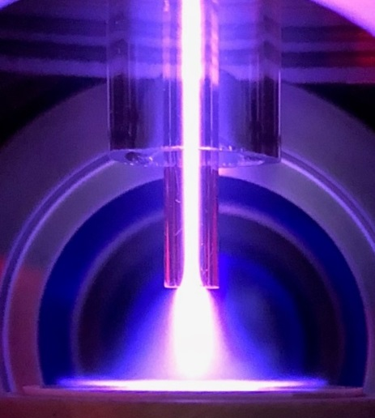
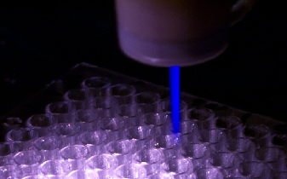
ATMOSPHERIC PRESSURE PLASMA JETS
Atmospheric pressure plasma jets (APPJs) are a popular source of chemistry for biomedical applications.
The plasma propagates as an ionization wave (IW) that is repetitively pulsed.
The IW gives rise to reactive oxygen and nitrogen species (RONS) which produce the biological effect.
Objective: Study the IW dynamics in a plasma jet in a well controlled environment.
S. Mohades, et al., Physics of Plasmas 22, 122001 (2015).
University of Michigan
Institute for Plasma Science & Engr.
ICOPS_2018

Slide 4
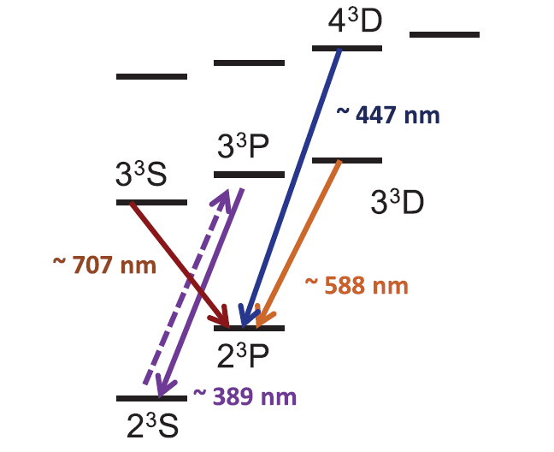
LASER COLLISIONAL INDUCED FLUORESCENCE (LCIF)
An ultrafast laser (<100 fs) is used to measure the electron density with a high time resolution.
Electrons collide with laser excited He(3³P)
e + He(3³P) → He(3³D) + e
n_{e} ~ 588 nm / 389 nm
Sufficient He(2³S) density is critical for accurate LCIF data.
LCIF was developed for a pure He environment, but extending this diagnostic to mixtures is important for APPJs.
Barnat and Fierro, J. Phys. D: Appl. Phys., 50, 14LT01 (2017).
University of Michigan
Institute for Plasma Science & Engr.
ICOPS_2018

Slide 5
EXPERIMENTAL SETUP
Annular powered electrode within the center tube.
Placing the APPJ in a vacuum chamber - consistent and controlled chemistry, ground planes, and gas flow.
Coaxial tube allows a gas shroud – control environment independently of gas in main jet.
University of Michigan
Institute for Plasma Science & Engr.
ICOPS_2018

Slide 6
BASE CASE
+6 kV
430 ns pulse, 100 ns rise
200 Torr
Faster dynamics (for modeling)
Lower background LCIF signal (for experiment)
500 sccm He in center tube
Base pressure 20 mTorr
Gap to target = 7.5 mm
650 µm thick alumina disk
Current measured at ground electrode under the alumina.
Shroud Tube
Central Tube
Imaging Region
Alumina
University of Michigan
Institute for Plasma Science & Engr.
ICOPS_2018

Slide 7
BASE CASE – PLASMA EMISSION
5 ns ICCD gate
Ionization wave expands as it exits the tube.
Approaching the alumina, it becomes more directed.
Upon contacting the alumina, forms a surface IW (SIW) and spreads, charging the surface.
As voltage falls, there a restrike occurs.
University of Michigan
Institute for Plasma Science & Engr.
ICOPS_2018
Notes:
20180313, Set 3

Slide 8
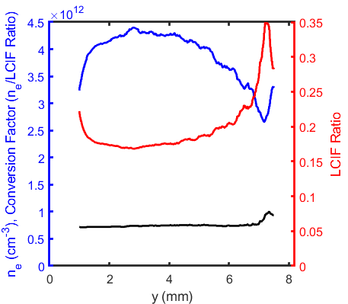
CONVERT LCIF TO n_{e}
Conversion factor
LCIF Ratio
n_{e}
Calculate n_{e} using Ohm’s law and E/N.
$$I=\frac{e^{2}}{m_{e}}\frac{N}{ν_{m}}\frac{E}{N}n_{e}A$$
An LCIF ratio of 1, is approximately 4 x 10¹² cm⁻³ electrons.
Previously, conversion factor estimated at 1.5 x 10¹³ cm⁻³ at 600 Torr.
University of Michigan
Institute for Plasma Science & Engr.
ICOPS_2018

Slide 9
BASE CASE LCIF
LCIF Ratio
(588 nm / 389 nm)
LCIF Ratio
(588 nm / 389 nm)
+6 kV, 430 ns
Pure He, 200 Torr
Before IW reaches the surface, He(2³S) densities are low.
n_{e} in the SIW is nearly double that of the bulk.
Elevated n_{e} in IW front may be due to Stark mixing.
Ratio = 1 → n_{e} ≈ 4×10¹² cm⁻³
University of Michigan
Institute for Plasma Science & Engr.
ICOPS_2018
Notes:
20180301, 20180302

Slide 10
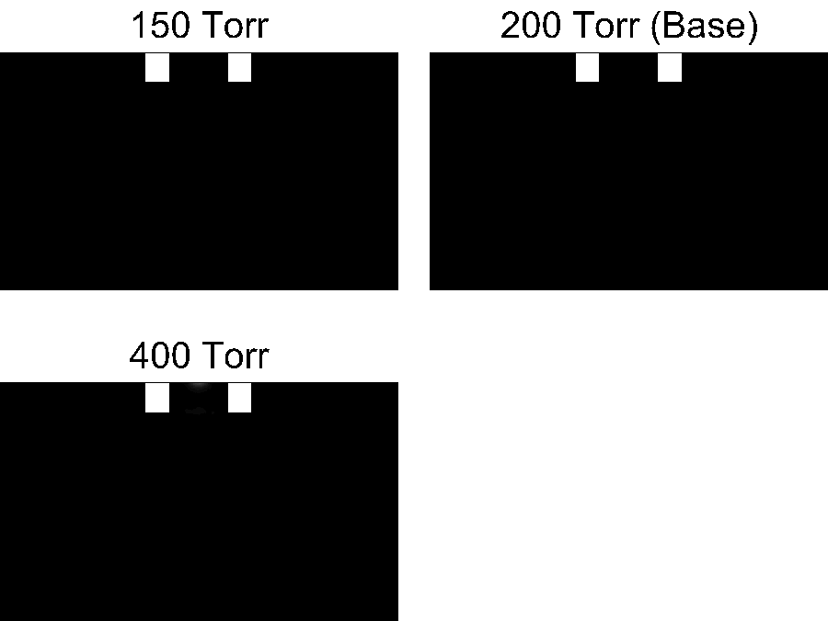
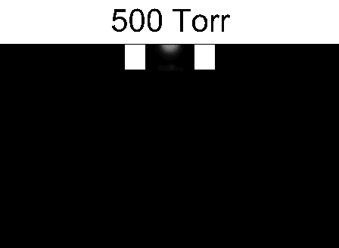
VARY PRESSURE – EMISSION
190 ns
180 ns
340 ns
520 ns
720 ns
970 ns
6 kV, 500 sccm He, 390 nm plasma emission.
350 ns animated, time of first frame indicated.
Varied pulse duration so voltage is on for 80 ns after contact.
Increasing pressure reduces electron mobility.
IW propagates slower and SIW becomes thinner for higher pressures.
University of Michigan
Institute for Plasma Science & Engr.
ICOPS_2018

Slide 11
VARY PRESSURE – n_{e}
6 kV, 500 sccm He, 30 ns after IW contacts surface.
Plasma is more confined at higher pressure, n_{e} increases.
Current and energy deposition decrease with increasing pressure.
Above 500 Torr, n_{e} is collisional enough that ionization rate drops.
Ratio = 1 → n_{e} ≈ 4×10¹² cm⁻³
University of Michigan
Institute for Plasma Science & Engr.
ICOPS_2018

Slide 12
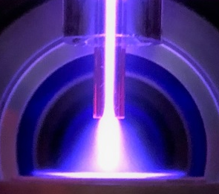
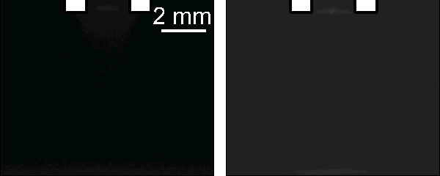
HUMID He SHROUD
2.3% H₂O
in shroud
Pure He
(base case)
MFC #1
To center of jet
MFC #2
To shroud
MFC #3
Humid He shroud allows an investigation of molecular gasses surrounding the jet, without interfering with LCIF measurements.
First bubbler oversaturates water vapor, second bubbler removes excess.
Temperature of second bubbler determines humidity of gas.
University of Michigan
Institute for Plasma Science & Engr.
ICOPS_2018

Slide 13
HUMID He SHROUD EMISSION
2.3% H₂O in shroud.
Images have not been Abel inverted.
IW reaches outlet of the tube earlier than in base case – photoionization from He₂* causes non-local seed ionization.
Photoionization and Penning ionization promote IW speed.
H_{α} emission appears more annular – dominates at the interface of the center and shroud flow.
University of Michigan
Institute for Plasma Science & Engr.
ICOPS_2018
Notes:
20180417, Set 1

Slide 14
HUMID He SHROUD
6 kV, 430 ns pulse
Center: 500 sccm He
Shroud: 500 sccm He/H₂O = 97.7/2.3
t = 230 ns, 30 ns after IW contacts surface
Moving away from He core, there are fewer He(2³S), LIF signal decreases.
He(2³S) + H₂O → He + H₂O⁺ + e
In regions of high H₂O concentration, there may be significant n_{e} which is not detectable due to low He(2³S).
Ratio = 1 → n_{e} ≈ 4×10¹² cm⁻³
University of Michigan
Institute for Plasma Science & Engr.
ICOPS_2018
Notes:
20180404, set 1

Slide 15
SHROUD HUMIDITY
30 ns after IW reaches surface.
Transition from diffuse in pure helium case to confined by humid shroud.
Higher electron energy loss rates with H₂O because of vibrational and rotational excitation.
n_{e} increases with humidity due to Penning ionization.
Ratio = 1 → n_{e} ≈ 4×10¹² cm⁻³
University of Michigan
Institute for Plasma Science & Engr.
ICOPS_2018
Notes:
20180327 and 20180328
20180404, set 1 – humid base

Slide 16
VARY He FLOW RATE - n_{e}
Vary center flow rate.
Shroud: 500 sccm, He/H₂O = 98.7/2.3
Higher He flow rates more rapidly convect in-diffusing H₂O.
Ratio = 1 → n_{e} ≈ 4×10¹² cm⁻³
University of Michigan
Institute for Plasma Science & Engr.
ICOPS_2018
Notes:
20180404, 20180409

Slide 17
CONCLUDING REMARKS
A plasma jet interacting with a dielectric surface produces a surface IW as it charges the dielectric.
Molecular gases surrounding a plasma jet confine the IW due to a lower electron mobility and higher electron energy loss rates.
In the presence of H₂O, the IW speed increases, and the plasma and electron density become more annular.
LCIF can be used in humid He, as long as the He(2³S) density is sufficient.
University of Michigan
Institute for Plasma Science & Engr.
ICOPS_2018

