Slide 1
IGNITION TIME AND TRANSPORT PROPERTIES OF INDUCTIVELY COUPLED PLASMAS USING LOW-HIGH PULSED POWER*
Chenhui Qu, Peng Tian, Steven J. Lanham and Mark J. Kushner
University of Michigan, Ann Arbor, MI 48109-2122 USA
chenqu@umich.edu, mjkush@umich.edu
Tianyu Ma, Tyler List, Priyanka Arora and Vincent M. Donnelly
University of Houston, Houston, TX 77204 USA
tma7@uh.edu, tllist@uh.edu, vmdonnelly@uh.edu
ICOPS June 2018
* Work supported by DOE Office of Fusion Energy Science, Samsung Electronics and National Science Foundation

Slide 2
AGENDA
Introduction to pulsed ICPs
Description of the model
Base case setup and analysis
Scaling of high-low ICPs
Ramping-Time
Power
Duty cycle
Pulse Repetition Frequency
Concluding Remarks
University of Michigan
Institute for Plasma Science & Engr.
ICOPS_2018

Slide 3
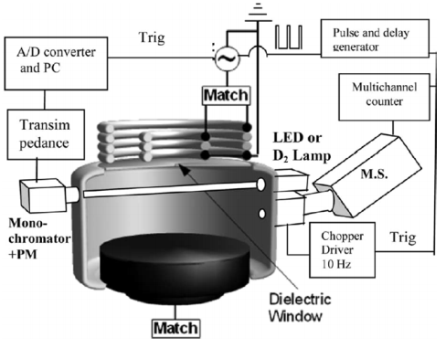
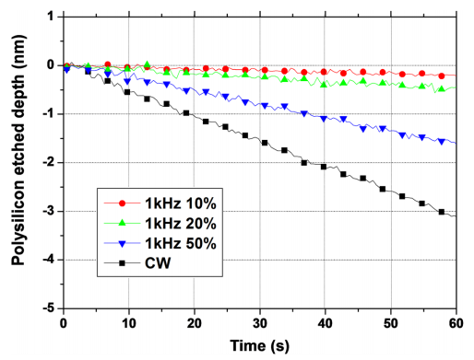
ICPs DRIVEN BY PULSED POWER
Pulsed plasma is widely implemented for high power density with moderate average power input.
Pulsed inductively coupled plasmas (ICPs) as ion source allow more control over the etching process.
Instabilities can occur during the power transition from low-to-high.
[1]
[2]
[1] E Despiau-Pujo, M Brihoum, P Bodart, M Darnon and G Cunge 2014 J. Phys. D: Appl. Phys. 47 455201
[2] Petit-Etienne C, Darnon M, Bodart P, Fouchier M, Cunge G, Pargon E, Vallier L, Joubert O and Banna S 2013 J. Vac. Sci. Technol. B 31 011201
University of Michigan
Institute for Plasma Science & Engr.
ICOPS_2018

Slide 4
MOTIVATION
Using pulsed power, instabilities can occur due to E-H transitions and longer plasma relaxation times compared to the pulsed period.
Ignition delay may occur due to the lack of “seed electrons” at the beginning of the pulse.
Changing the operating conditions, such as power during the “off-period” and duty cycle may provide a minimum electron density [e] which weakens or solves the ignition delay problem.
In this work, we discuss the influence of the operating conditions (low-power, duty cycle, pulsed repetition frequency) on plasma stability and related plasma properties.
University of Michigan
Institute for Plasma Science & Engr.
ICOPS_2018

Slide 5
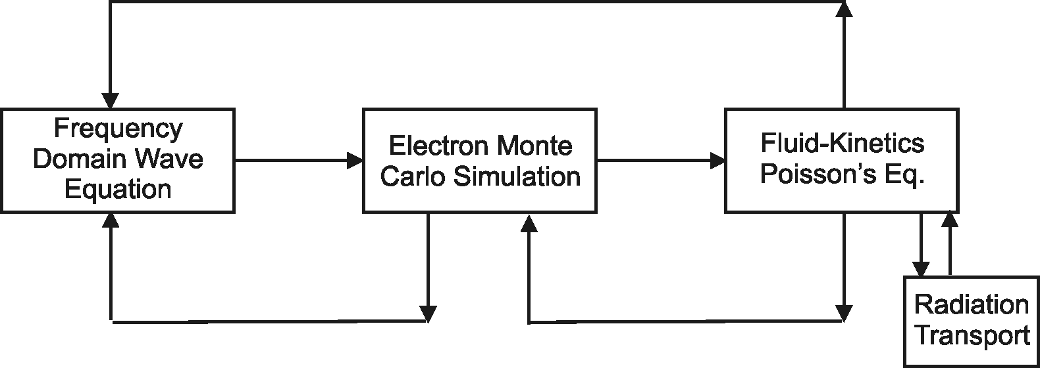
MODELING OF PULSED ICPs
The Hybrid Plasma Equipment Model (HPEM) is a modular simulator that combines fluid and kinetic approaches.
Variables are transferred between modules and updated in a time slicing manner.
Monte Carlo Ion/Neutral Transport
Surface
Chemistry
Module
Monte Carlo Radiation Transport
University of Michigan
Institute for Plasma Science & Engr.
ICOPS_2018

Slide 6
GEOMETRY
Feedstock: Ar/Cl₂ = 5/95, 22 sccm, 20 mTorr
Nozzle is 0.4 cm below the dielectric window
Pressure is recorded at the sensor, flow rates adjusted to maintain pressure.
The inner wall is coated with Y₂O₃.
Coil is 0.4 cm above the dielectric window.
Air surrounding chamber to insure accurate E field calculation.
University of Michigan
Institute for Plasma Science & Engr.
ICOPS_2018

Slide 7
PULSE POWER FROM THE COIL
High-low power is used to provide electron seed at the beginning of each pulse and improve stability.
Pulse Repetition Frequency (PRF): 5 kHz
Duty Cycle: 50%
High/Low Power: 160 W/96 W
Ramping time: 10 µs
University of Michigan
Institute for Plasma Science & Engr.
ICOPS_2018

Slide 8
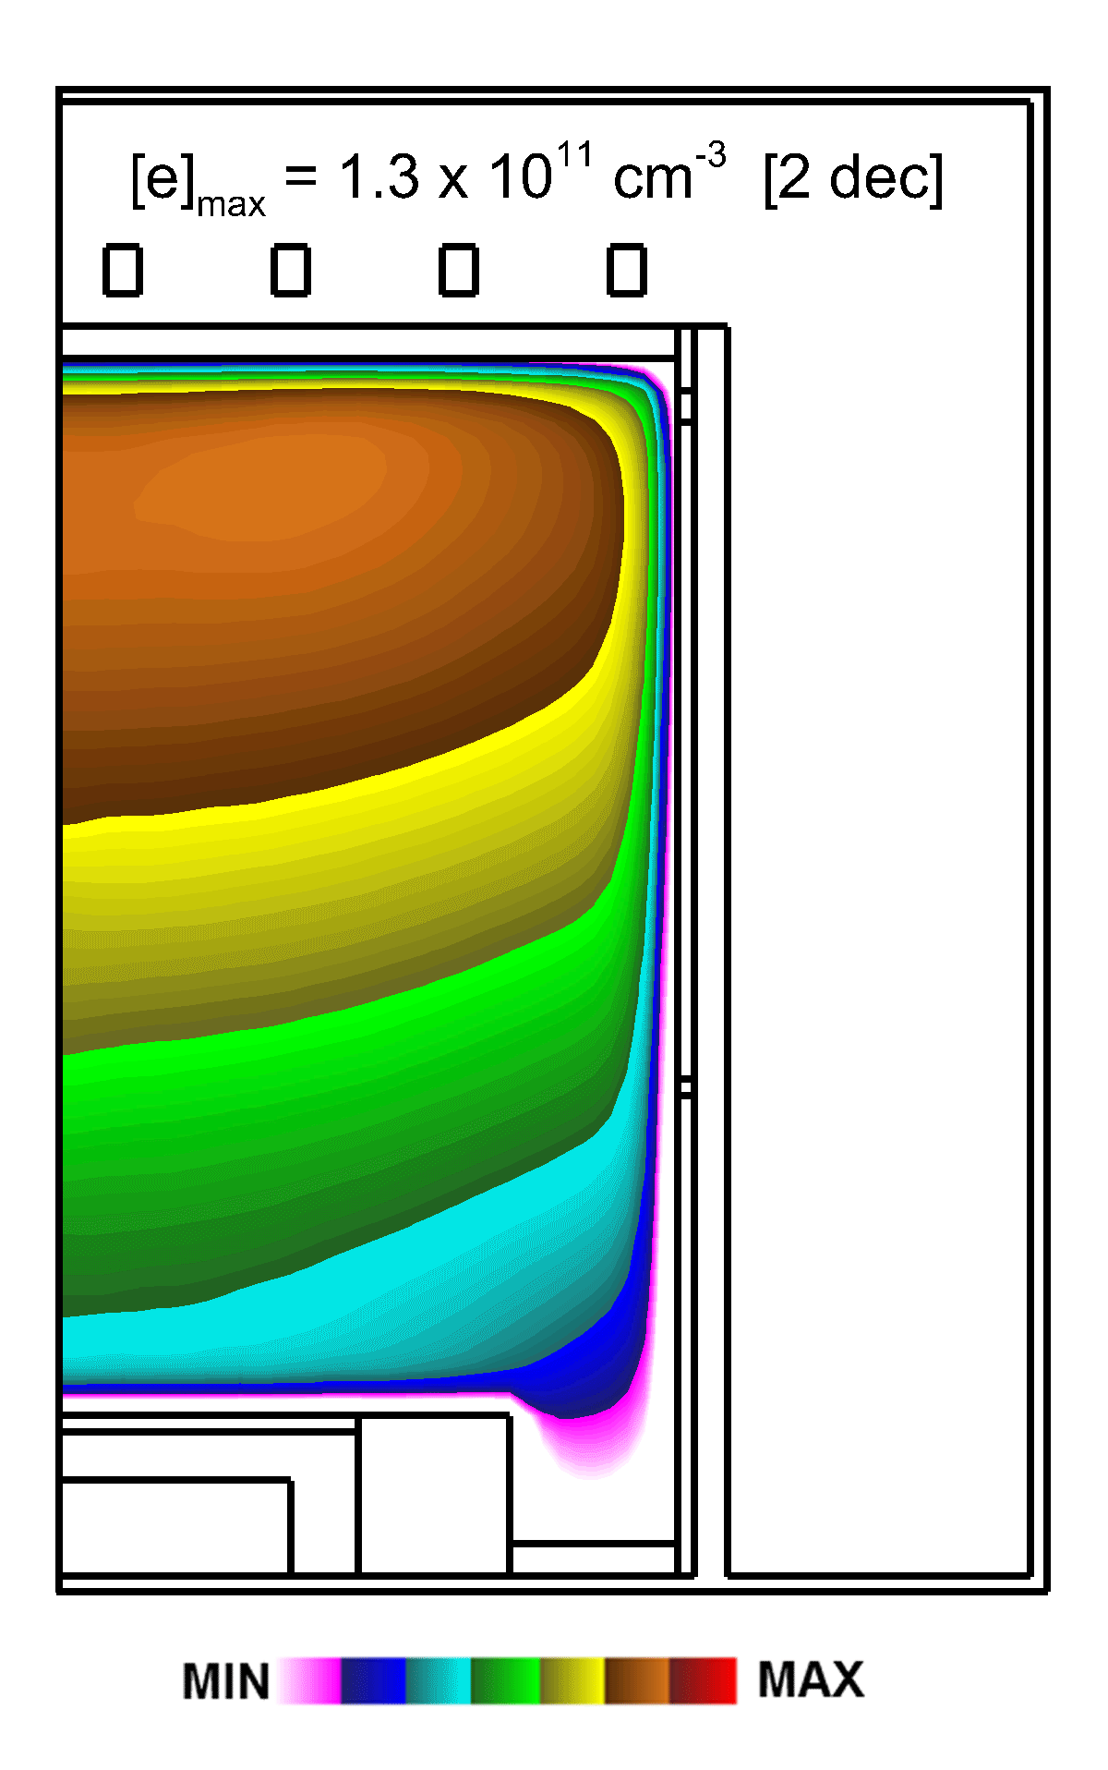
ELECTRON DENSITY
Peak electron density 1.3 x 10¹¹ cm⁻³.
Near the wafer, [e] is 10% - 20% of the peak value.
The electron temperature near the wafer is approximately ½ that at the top of the reactor (1.3 eV vs. 2.8 eV).
High plasma occupies top 1/3 of the reactor.
Approximate electron mean free path: 2.2 cm.
University of Michigan
Institute for Plasma Science & Engr.
ICOPS_2018

Slide 9
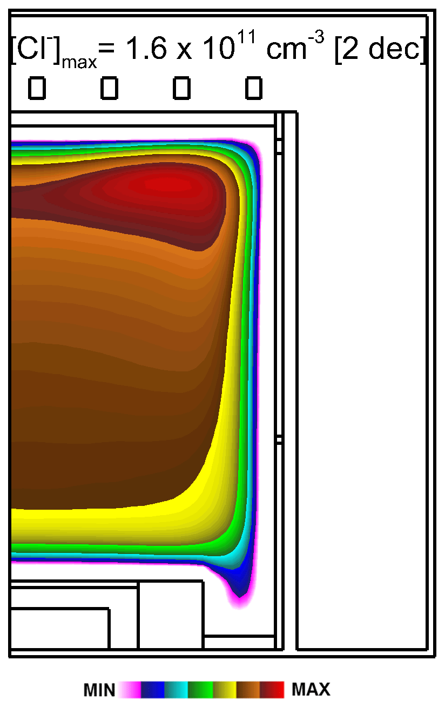
Cl⁻ DENSITY
Peak Cl⁻ density: 1.6 x 10¹¹ cm⁻³, electronegativity around 2.8.
[Cl⁻] does not significantly vary during pulsed cycle.
High dissociative attachment of Cl₂ and Cl₂(v) leads to a high Cl⁻ density.
High ionization rate and electron detachment of Cl⁻ during high-power period.
University of Michigan
Institute for Plasma Science & Engr.
ICOPS_2018

Slide 10
SPATIAL ELECTRON PROPERTIES
[e], T_{e} at r = 1.85 cm, 2-12 cm cm above wafer.
Note different scales of figures.
Spikes of T_{e} at the top with gentle modulation at bottom,
Close to the power source (coil) at 12 cm, large modulation in [e] in phase with power.
Delay in the increase of [e] from low-to-high power at 2 cm due to finite transport time.
University of Michigan
Institute for Plasma Science & Engr.
ICOPS_2018

Slide 11
EXPERIMENTAL MEASUREMENT
Experimental results are measured about 2 cm above the wafer.
The PRF is 400 Hz in the experiment which is smaller than the simulation (5 kHz).
2 different operating pressures: 10 and 20 mTorr.
Only a slight oscillation can be observed on all the plasma properties.
University of Michigan
Institute for Plasma Science & Engr.
ICOPS_2018

Slide 12
RAMPING TIME
The high-to-low ramping time is varied from 10 to 80 µs.
Longer the ramping time, higher the average power.
Electrons are consumed by Cl₂ through dissociative attachment during low-power
Short ramping time introduces spiking in T_{e}.
The spike lasts longer but with smaller magnitude when the ramping time is long.
e + Cl₂ → Cl⁻ + Cl
University of Michigan
Institute for Plasma Science & Engr.
ICOPS_2018

Slide 13
RAMPING TIME
Dominate ions: Cl₂⁺, Cl⁻
High Penning ionization and charge exchange rate for Cl₂⁺ production, but low Ar input.
Ionization threshold Cl₂⁺: 11.5 eV.
Increase in T_{e} during the low-to high leads to an increase of Cl₂⁺.
Small oscillation Cl⁻ since Cl₂ is a highly attaching gas.
Cl⁻ density is strongly related to the prior pulses and gas temperature.
Decrease of ion densities due to depletion of Cl₂ at plasma center caused by high gas temperature.
University of Michigan
Institute for Plasma Science & Engr.
ICOPS_2018

Slide 14
LOW-POWER
Constant high-power, vary low-power. Average power: 96 – 160 W
Plasma takes less time to stabilize during low-to-high than high-to-low power transitions.
A low [e] leads to a high T_{e} during the high-power half despite the same power density.
The T_{e} spike magnitude decreases monotonically with increasing low-power.
T_{e} is more stable during the high-power period.
University of Michigan
Institute for Plasma Science & Engr.
ICOPS_2018

Slide 15
LOW-POWER
At top of the reactor, Cl₂⁺ density oscillates around “steady state” value produced by spike in T_{e}.
High electron and Cl⁻ densities produce the decrease of Cl₂⁺ during high-power period through recombination.
If the period is long enough, the Cl₂⁺ density should approach 160 W case at the end of the high-power period.
Higher power leads to higher [e] thus results in lower Cl⁻ density.
Cl⁻ is lost through neutralization and electron detachment reactions.
University of Michigan
Institute for Plasma Science & Engr.
ICOPS_2018

Slide 16
DUTY CYCLE
The duty cycle (DC) is calculated with only low and high-power period (no ramping time included).
Shorter duty cycle, lower the [e] due to smaller average power.
Need at least 30% DC for steady state during high-power.
High DC has higher seed electron density for the next pulse.
The magnitudes of the T_{e} spikes have little difference even though the DC and the average power are different.
High [e] results in low T_{e} despite a high power input.
University of Michigan
Institute for Plasma Science & Engr.
ICOPS_2018

Slide 17
DUTY CYCLE
Larger DC, lower Cl₂⁺ density in both high and low-power.
With same high-power (160 W), low [e] leads to a high T_{e}.
Density of Cl₂⁺ is limited by the fraction of high energy electrons instead of the average power input.
A small DC leads to a high Cl⁻ density.
High Cl₂⁺ and low [e] at low power with low DC results in high Cl⁻ for charge neutrality.
A low [e] reduces the Cl⁻ detachment reaction rate.
University of Michigan
Institute for Plasma Science & Engr.
ICOPS_2018

Slide 18
PULSE REPETITION FREQUENCY
Lower frequency means longer time for the development of the steady state.
Both [e] and T_{e} show similar behavior when frequency is varied.
A little higher [e] when frequency is high due to more seed electrons at the beginning of the pulse.
Smaller fraction of ramping transient with low PRF.
University of Michigan
Institute for Plasma Science & Engr.
ICOPS_2018

Slide 19
PULSE REPETITION FREQUENCY
Quasi-steady state at 1 kHz PRF is the closest to the steady state.
A longer time for recombination leads to a low Cl₂⁺ density during the high-power at 1 kHz.
More time to approach steady state when PRF is low.
Plasma is more stable with a higher PRF.
University of Michigan
Institute for Plasma Science & Engr.
ICOPS_2018

Slide 20
CONCLUDING REMARKS
The influence of the ramping time, power magnitude, duty cycle, and driving frequency on a high-low pulsed power ICP is studied.
The response of the plasma to a pulsed power differs from different measuring points.
Cl₂⁺ is more sensitive to the transient T_{e} due to its high ionization threshold (11.5 eV).
Cl⁻ is more sensitive to the [e] and gas temperature since Cl₂ is a highly attaching gas.
A longer ramping time, higher power during low-power period and a high pulse repetition frequency is preferred to optimize the plasma stability.
University of Michigan
Institute for Plasma Science & Engr.
ICOPS_2018

