Slide 1
PROPERTIES OF BIPOLAR DC-PULSED MICROPLASMAS AT INTERMEDIATE PRESSURES*
Peng Tian, Sang-Heon Song and Mark J. Kushner
University of Michigan, Ann Arbor, MI 48109, USA
tianpeng@umich.edu, ssongs@umich.edu, mjkush@umich.edu
http://uigelz.eecs.umich.edu
Sergey Macheret
Lockheed Martin Corp., Palmdale, CA 93599 USA
Sergey.macheret@lmco.com
PPPS 16 June 2013
* Work supported by DARPA, the DOE Office of Fusion Energy Science and the National Science Foundation.
Notes:
1
Hello everyone, today my topic is properties of bipolar dc-pulsed microplasmas at intermediate pressures. This work is support by DARPA, Doe Office of Fusion Energy Science and the National Science Foundation. First I want to thank my colleague Sang-Heon Song, my advisor professor Mark J. Kushner and Mr. Sergey Macheret for their precious help and advice on this work.

Slide 2
AGENDA
Microplasma Cavities
Description of the model
Ionization sources in the microplasma
Plasma properties:
Excitation voltage
Duty cycle
Pulse Period
Concluding Remarks
University of Michigan
Institute for Plasma Science & Engr.
ICOPS_2013
Notes:
So here is my agenda. I will introduce the motivation of the work, describe our simulation model and conditions and show some interesting results of properties of the microplasmas. This will take about 12 mins.

Slide 3
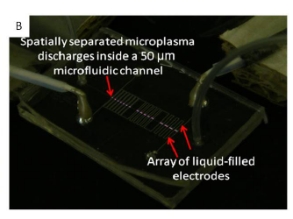
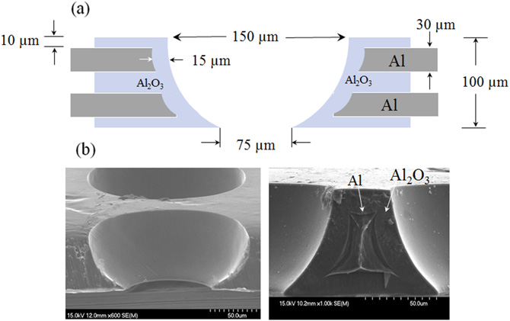
MICROPLASMAS IN CAVITIES
Microplasmas in cavities at intermediate pressure have a wide range of applications (e.g. ion sources, display panels).
Excitation mechanisms and scaling laws are unclear.
Often goals of high plasma density and high power efficiency are mutually exclusive.
[1],[2]
Ref:
[1] H-J Lee, et al., J. Phys. D: Appl. Phys. 45 (2012)
[2] K.S.Kim, Appl. Phys. Lett. 94 011503 (2009)
[3] Endre J. Szili, et al., Proc. SPIE 8204, Smart Nano-Micro Materials and Devices, 82042J (December 23, 2011);
[3]
University of Michigan
Institute for Plasma Science & Engr.
ICOPS_2013
Notes:
Microplasmas in cavities at intermediate pressure have a wide range of applications ranging from ion source, photon sources and display panels.
Here are two applications, the left figure shows a buried electrode cavity from UIUC, aiming at generating active species for chemical reactions. The right figure uses localized microplasmas to modify the inner surface of microchannels in microfluidic devices. .
The excitation mechanisms and scaling laws of such microplasmas are still unclear.

Slide 4
MICROPLASMAS AT INTERMEDIATE PRESSURE
Pressure (Torr)
Short Response Time
Tradeoff:
Response time, Density vs. Uniformity
Operating at 10s-100 Torr, corresponds to cavity of 100’s μm.
Goal is to maximize the time averaged electron density with good uniformity
Excitation by high frequency, DC-bipolar short pulses (~10s ns) at several kV.
1 atm
Maximizing Density
100s
Balance
10s
1s
Uniformity of plasma
University of Michigan
Institute for Plasma Science & Engr.
ICOPS_2013
Notes:
While picking the pressure range for microplasmas devices, there will always be a trade-off between the uniformity of the plasma, which is good at low pressure, and response time density, which is good at high pressure.
An intermediate pressure from 10s to 100 Torr could give a balanced answer to this problem, which by pd scaling corresponds to cavity of 100’s um.
In this work, we investigate the mechanism of microplasmas at intermediate pressure aiming at maximizing the time averaged electron density with good uniformity, which excited by high frequency, DC-bipolar short pulses at several kV of several ns.

Slide 5
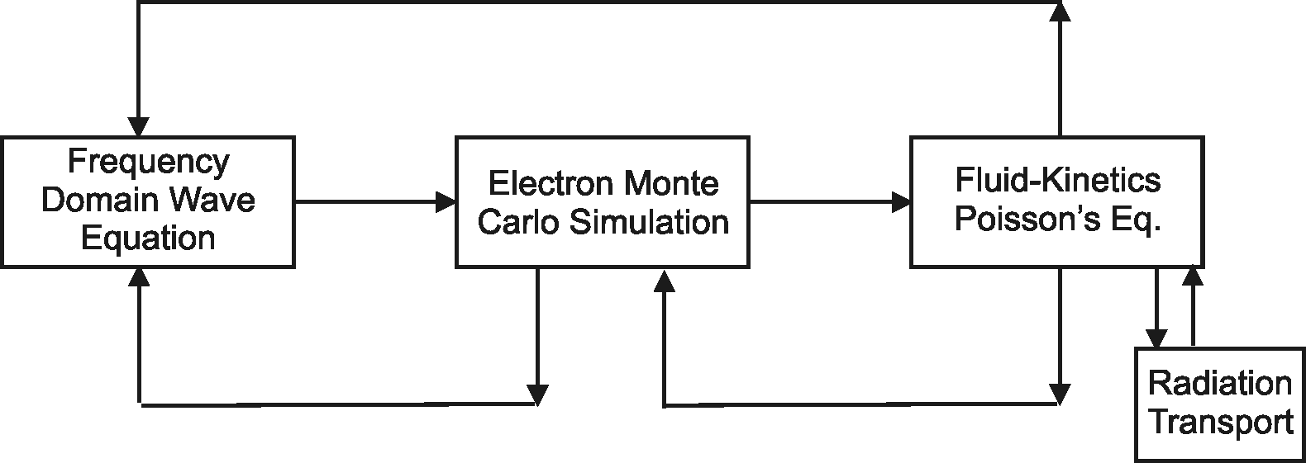
MODELING OF PULSED MICROPLASMAS
The Hybrid Plasma Equipment Model (HPEM) is a modular simulator that combines fluid and kinetic approaches.
Radiation transport is addressed using a spectrally resolved Monte Carlo simulation.
Monte Carlo Ion/Neutral Transport
Surface
Chemistry
Module
Monte Carlo Radiation Transport
University of Michigan
Institute for Plasma Science & Engr.
ICOPS_2013
Notes:
1. The computation tool is Hybrid Plasma Equipment Model, which is a modular simulator combines fluid and kinetic approaches.

Slide 6
MICROPLASMA CAVITY
Non-Floating
Floating
Sealed plasma cavity (no net gas flow).
Bottom powered electrode and top grounded electrode.
In floating configuration, electrodes are covered by dielectric – essentially a DBD.
In non-floating configuration, a small area of powered electrode is exposed.
University of Michigan
Institute for Plasma Science & Engr.
ICOPS_2013
Notes:
This is the geometry for our simulation, which is a sealed cavity of 450 um by 300 um
Electrodes on top and bottom are covered by dielectric, with two setup where powered electrode is fully covered in one, and exposed to the bulk plasma at the bottom in the other. The dielectric cavities functions like DBD.

Slide 7
BIPOLAR DC-PULSING
DC bipolar Gaussian Waveform:
Short pulses (~ 10s ns) heat electrons rapidly at leading edges.
Dielectric cavities function as DBDs.
Bipolar pulses help remove accumulated charge on dielectric walls.
University of Michigan
Institute for Plasma Science & Engr.
ICOPS_2013
Notes:
We use gaussian waveform for the DC-bipolar pulsing, where duty cycle is defined as the 3 sigma region of the waveform.
The 10s ns short pulses heat electrons rapidly at leading edges, where the bipolar pulses help remove accumulated charges on dielectric walls.

Slide 8
GAS MIXITURE, OPERATING CONDITION
Reaction Mechanism: (‘M’ is Ne or Xe)
E-Impact and Recombination
e + M → M* + e, e + M → M⁺ + 2e
e + M* → M⁺ + 2e, e + M⁺ → M*
Spontaneous Emission
M* → M + hv
Penning Ionization, Charge exchange
Ne* + Xe → Ne + Xe⁺ + e,
Ne⁺ + Xe → Ne + Xe⁺ + e, M* + M* → M⁺ + M
Photo-Ionization
hv + M → M⁺ + e, hv + M* → M⁺ + e
Dimer Reaction
M* + M +M → M₂* + M, e + M₂* → M₂⁺ + 2e
e + M₂⁺ → M* + M, M₂⁺ + M → M⁺ + 2M
Penning mixture of Ne/Xe=80/20, 60 Torr
DC-Bipolar pulsing, peak voltage 1.0-2.5 kV
Pulse Period 25-200 ns
Power density is on the order of 10³-10⁴ W/cm³, with energy deposition of several μJ per pulse
University of Michigan
Institute for Plasma Science & Engr.
ICOPS_2013
Notes:
We are using a penning mixture of Ne/Xe=80/20, at 60 Torr, 1-2.5 kV of pulsing voltage, pulse period from 25-200 ns.
Here’re the reactions taken into account in the simulation.

Slide 9
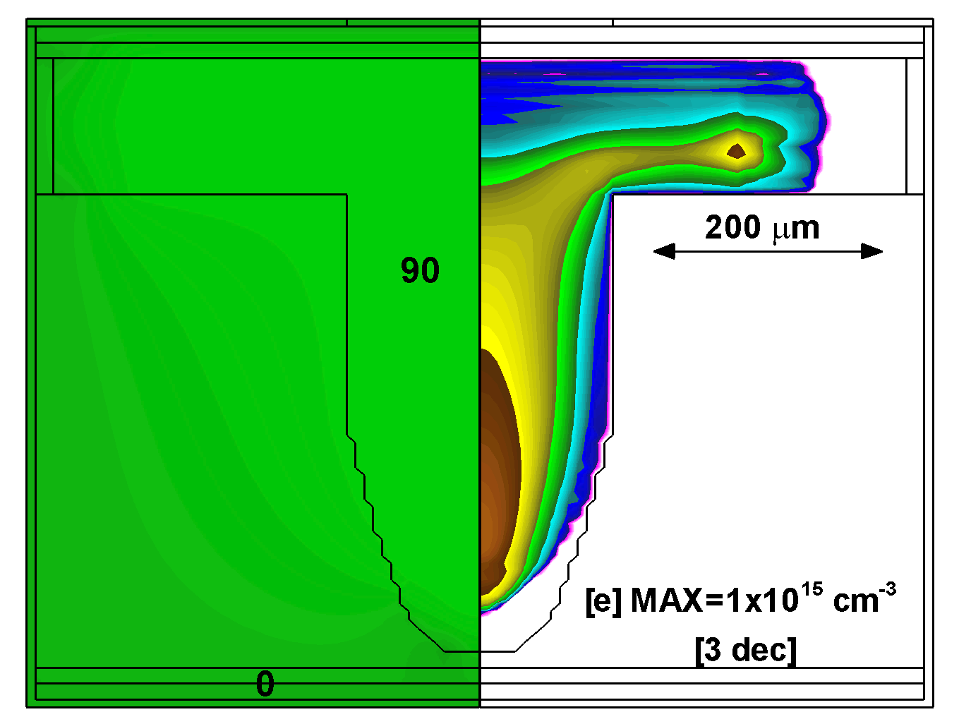
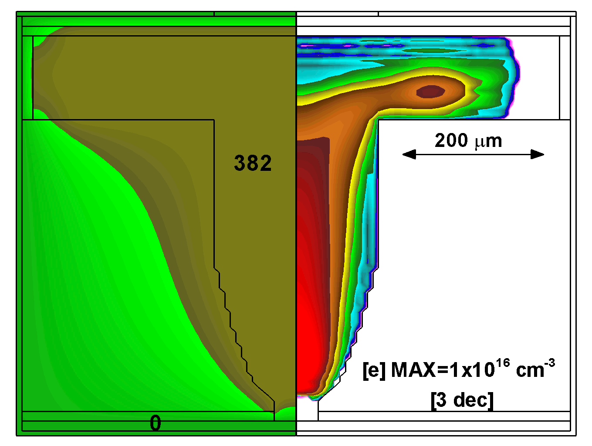
Potential
[e]
POTENTIAL, n_{e}
V_{P} is held above -100 V during negative pulse.
Charging of dielectric on top of electrodes shields voltage from plasmas.
Non-floating conditions produces higher peak electron density.
Ne/Xe=80/20, 60 Torr, PRF=40 MHz, DC=0.3, Pulsing Voltage= -/+2 kV
Floating
Non-Floating
Animation Slide
MIN MAX
Log Scale
University of Michigan
Institute for Plasma Science & Engr.
ICOPS_2013
Notes:
Here is the electron density profile at quasi-steady state. Top figure is floating setup, and bottom is exposed electrode setup. The potential is shown on the left.
The electron density in exposed electrode setup is at least a order of magnitude higher. This is because of charging of dielectric on top of electrodes due to ambipolar diffusion and the starting part of the pulse. Pulse voltage is shielded from plasma by the charges.

Slide 10
PEAK POTENTIAL, AVERAGE n_{e}
Non-Floating
Floating
Plasma potential peaks during anodic cycle during which plasma density increases. Quasi-steady state achieve after a few pulses.
Non-floating produces a higher average electron density.
University of Michigan
Institute for Plasma Science & Engr.
ICOPS_2013
Notes:
Here is the time evolution of electron density and plasma potential averaged in the plasma region.
Plasma density increases during anodic cycle, and reaches steady state after several pulse pairs.
The non-floating geometry prodeces a higher average electron density.

Slide 11
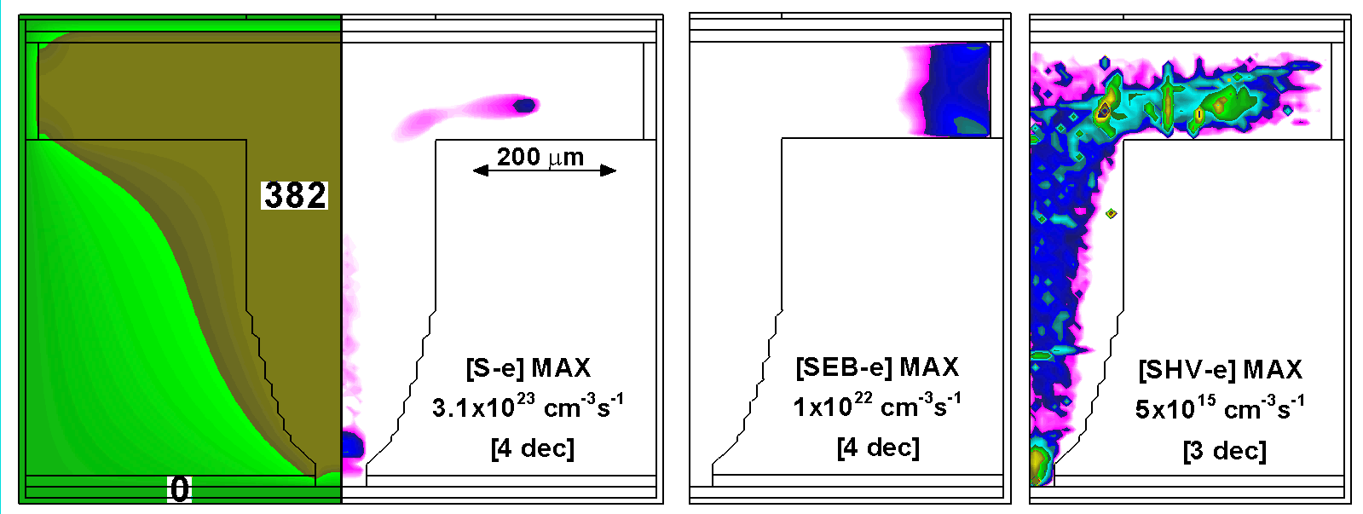
IONIZATION SOURCES
Three major ionization sources (Bulk, E-Beam, Photo-ionization)
Bulk and E-Beam contribute to most of the ionization process.
Potential
Bulk-Source
E-Beam-Source
HV-Source
Animation Slide
MIN MAX
University of Michigan
Institute for Plasma Science & Engr.
ICOPS_2013
Log Scale
Notes:
These electrons comes from three major ionization sources: electron-impact from bulk plasma, ionization by the high-energy secondary electron beam from the side wall, and photon –ionization.
Such three ionization sources are shown in this sample cases, in which we can see the major ionization processes are bulk and e-beam source, while although uniformly distributed in the cavity, photon-ionization is several orders of magnitudes lower.

Slide 12
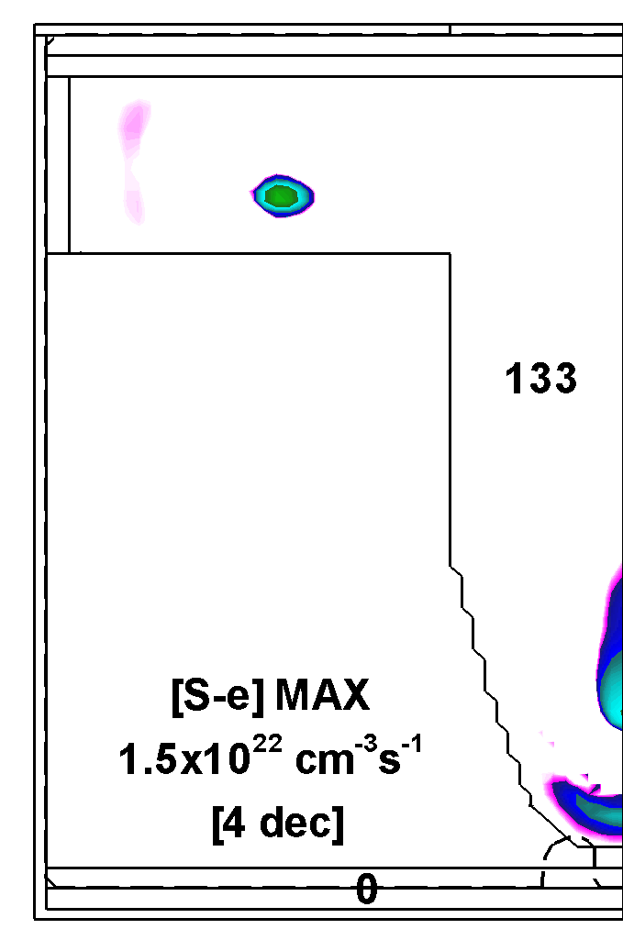
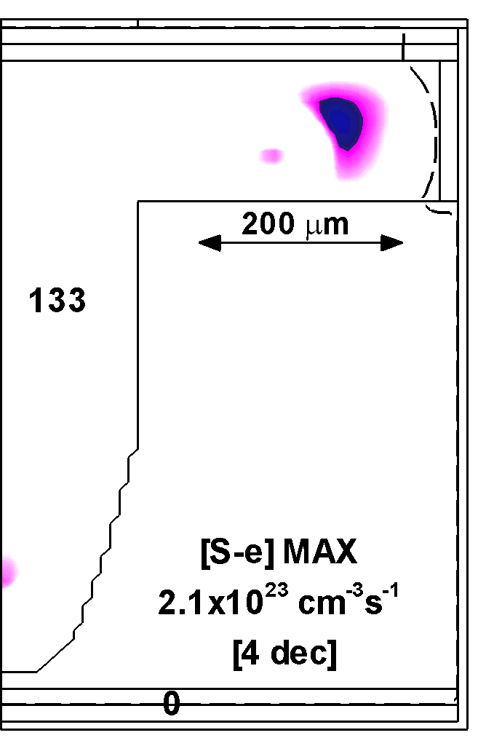
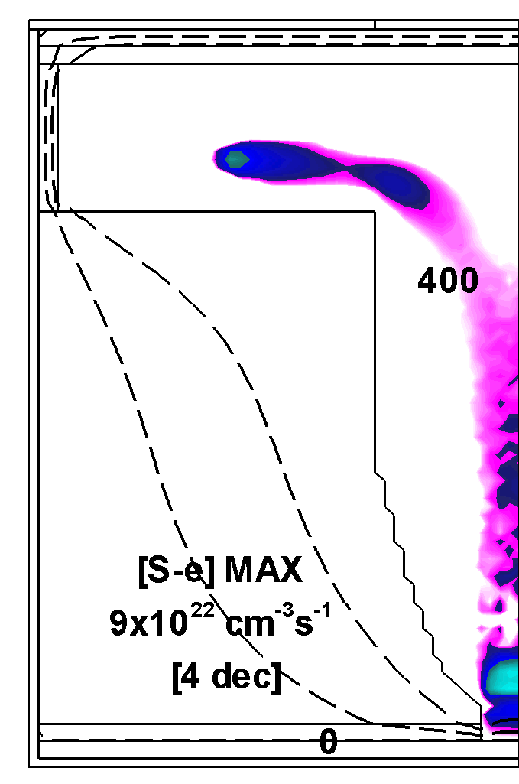
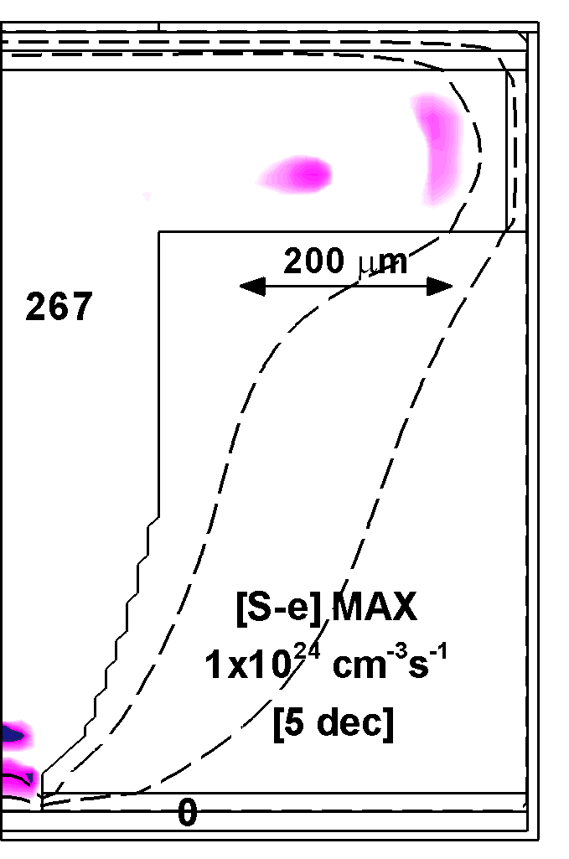
Cathodic
Anodic
BULK IONIZATION
More ionization occurring on the anodic (positive) portion of the cycle.
Small mean free path localizes bulk ionization where potential gradient is high.
Peak ionization is 10x higher with non-floating geometry.
Floating
Non-Floating
Animation Slide
MIN MAX
Log Scale
University of Michigan
Institute for Plasma Science & Engr.
ICOPS_2013
Notes:
First let’s look at bulk ionization in both setup. The number shows on the anodic portion of the cycle, bulk ionization is higher compared with cathodic portion.
Meanwhile, peak ionization is an order of magnitude higher in the non-floating geometry.
It is also worth noting that small mean free path for bulk electrons at intermediate pressure localized bulk ionization where potential gradient is high.

Slide 13
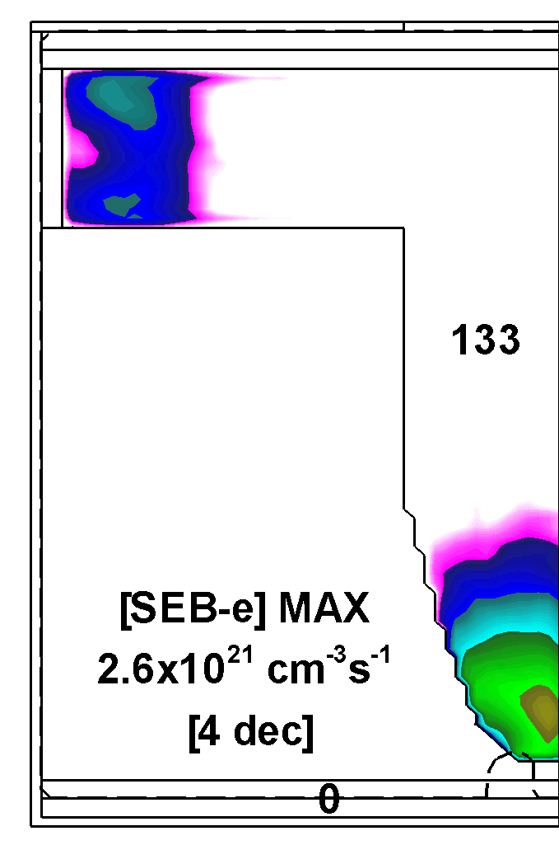
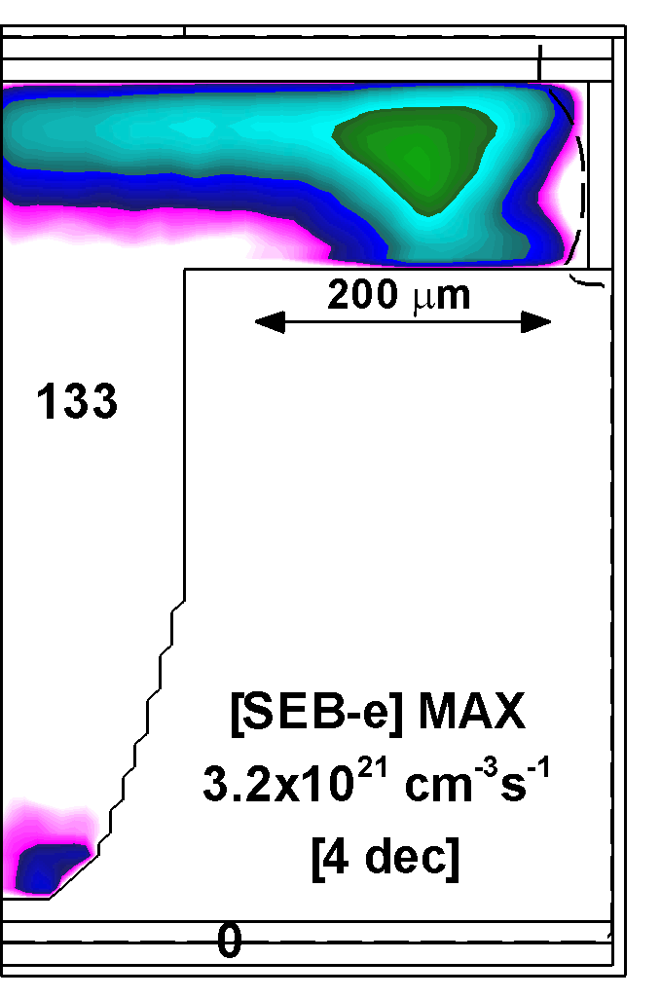
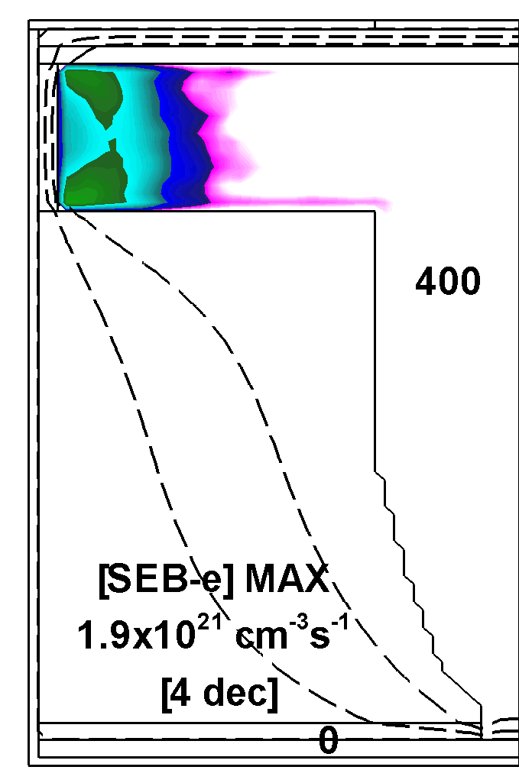
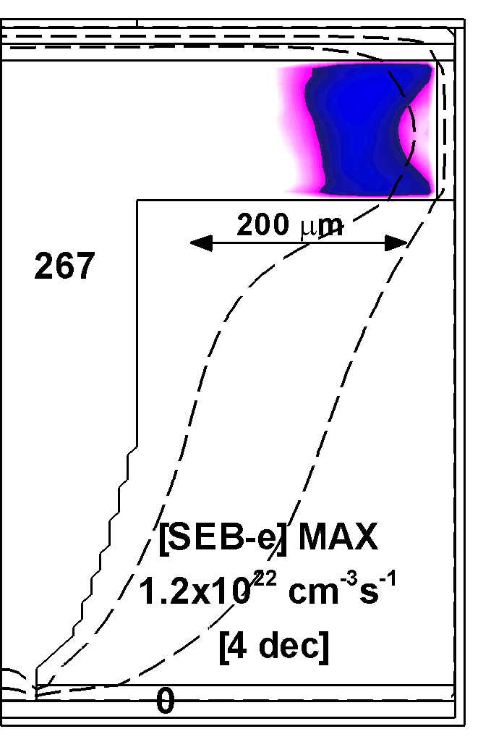
Cathodic
Anodic
E-BEAM IONIZATION
E-beam ionization is more uniform compared with bulk.
Higher energy electrons have longer mean free path.
Peak ionization is 10x higher for non-floating positive pulse.
E-beam ionization is sustained in the afterglow in floating geometry, due to residual charge on the walls.
Floating
Non-Floating
Animation Slide
MIN MAX
Log Scale
University of Michigan
Institute for Plasma Science & Engr.
ICOPS_2013
Notes:
Compared with bulk ionization, the high energy e-beams have a longer mean free path. Thus the ionization from e-beam gets more a uniform distribution.
The high plasma potential at the anodic portion of non-floating setup produces a higher peak ionization, almost an order of magnitude higher.
In the afterglow of floating geometry, the e-beam ionization is sustained by the residual charge on the dielectric.
To find a sweet spot operating this plasma, we did a parametric investigation over voltage, duty-cycle and pulse period. The uniformity of the plasma is quantified by the ratio of average and peak electron density.

Slide 14
n_{e} vs VOLTAGE: FLOATING
Electron density increases with voltage, while uniformity does not significantly change.
Ne/Xe=80/20, 60 Torr, PRF=40 MHz, DC=30%, floating.
[e], Uniformity vs. V
Average [e]
University of Michigan
Institute for Plasma Science & Engr.
ICOPS_2013
Notes:
Here are the results for pulsing voltage from 1.0 kV to 2.5 kV in a floating geometry. The left figure shows time evolution of average electron density. The right figure is the peak and average electron density vs. voltage, together with electron uniformity.
Peak and average electron density increase proportionally with pulsing voltage, while uniformity stays almost unchanged.

Slide 15
n_{e} vs VOLTAGE: NON-FLOATING
Non-Floating geometry produces larger electron density, but lower uniformity compared with floating cases.
Ne/Xe=80/20, 60 Torr, PRF=40 MHz, DC=30%, Non-floating.
[e], Uniformity vs. V
Average [e]
University of Michigan
Institute for Plasma Science & Engr.
ICOPS_2013
Notes:
1.
In non-floating geometry, the densities also increases with voltage, but the uniformity is lower than floating cases.

Slide 16
n_{e} vs DUTY CYCLE: FLOATING
When DC > 60%, plasma is glow-like. Average density decreases as DC increases due to lower dV/dt.
Uniformity increases with DC.
Ne/Xe=80/20, 60 Torr, PRF=40 MHz, 2.5 kV, floating.
[e], Uniformity vs. V
Average [e]
University of Michigan
Institute for Plasma Science & Engr.
ICOPS_2013
Notes:
Next, we vary the duty cycle in floating geometry. As shown in the left figure, at 20-40% duty cycle, the plasma is inductance-like behavior, where the electron density decreases as duty cycle increases. This is due to the smaller dv/dt that drives the bulk ionization.
When the duty increases to 60 % and higher, plasma becomes glow-like. The uniformity increases largely at high duty cycle.

Slide 17
n_{e} vs PULSE PERIOD: FLOATING
Electron density decreases as pulse period increases.
Longer pulse provides better uniformity, mainly due to the longer diffusion time for charged species.
Ne/Xe=80/20, 60 Torr, DC=30%, 2.5 kV, floating.
[e], Uniformity vs. V
Average [e]
University of Michigan
Institute for Plasma Science & Engr.
ICOPS_2013
Notes:
We also changed the pulse period from 25 ns to 200 ns, keeping all other parameters constant.
Due to smaller dv/dt, longer pulse period gets lower electron density.
However, the uniformity increases with period, mainly due to the longer diffusion time for charged species.

Slide 18
CONCLUDING REMARKS
Microplasmas of Ne/Xe Penning mixture at 60 Torr in sealed cavities were investigated, aiming at maximizing the time averaged electron density.
Short DC bipolar Gaussian pulses (a few ns and a few kV) were used to excite and maintain the plasma.
Exposed electrode gains an order of magnitude higher electron density compared with floating electrode.
Increasing pulse voltage increases electron density while uniformity is unaffected in floating geometry.
Increasing pulse period also increases uniformity due to longer diffusion time.
Potential mode change was observed while increasing duty cycle. A glow-like mode provides better uniformity with similar averaged electron density.
University of Michigan
Institute for Plasma Science & Engr.
ICOPS_2013

Slide 19
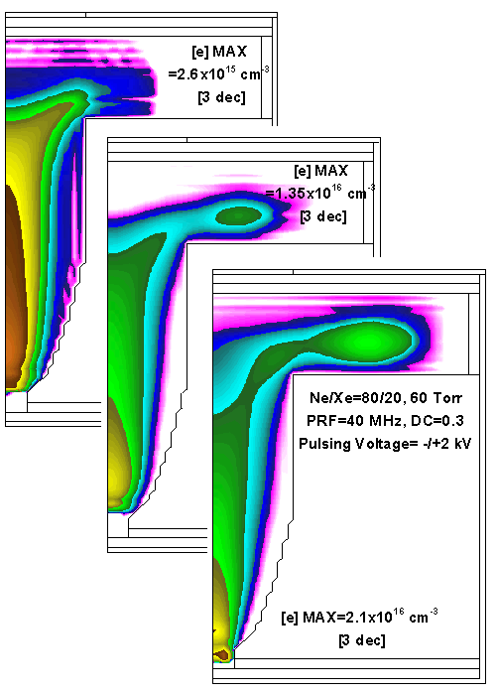
SEE -e DENSITY AND UNIFORMITY
SEE Coef=0
0.05
0.25
An order of magnitude increase in [e] with SEE.
Further increase of SEE coef influence more on uniformity but not much on peak density.
Animation Slide
University of Michigan
Institute for Plasma Science & Engr.
ICOPS_2013
MIN MAX

