Slide 1
CONTROL OF ELECTRON ENERGY DISTRIBUTIONS IN INDUCTIVELY COUPLED PLASMAS USING TANDEM SOURCES*
Michael D. Logue ^{(a)}, Mark J. Kushner^{(a)}, Weiye Zhu^{(b)}, Hyungjoo Shin^{(c)}, Lei Liu^{(b)}, Shyam Sridhar^{(b)}, Vincent M. Donnelly^{(b)}, Demetre Economou^{(b)}
^{(a)} University of Michigan, Ann Arbor, MI 48109
mdlogue@umich.edu, mjkush@umich.edu
^{(b)} University of Houston, Houston, TX 77204
^{(c)} Lam Research Corporation Fremont, CA 94538
June 2013
* Work supported by the DOE Office of Fusion Energy Science, SRC and NSF.
University of Michigan
Institute for Plasma Science & Engr.
ICOPS_2013

Slide 2
AGENDA
Control of electron energy distributions (EEDs)
Tandem inductively coupled plasma (ICP) sources
Description of model and geometry
Plasma Parameters (T_{e}, n_{e}) during pulse period
f_{e}(ε) during pulse period
f_{e}(ε) vs. position
Concluding Remarks
University of Michigan
Institute for Plasma Science & Engr.
ICOPS_2013

Slide 3
CONTROL OF EEDs – TANDEM SOURCES
Externally sustained discharges, such as electron beam sustained discharges for high pressure lasers, control f_{e}(ε) by augmenting ionization so that f_{e}(ε) can be better matched to lower threshold processes.
Based on this principle, the tandem (dual) ICP source has been developed, T-ICP
In the T-ICP, the secondary source is coupled to the primary source through a grid to control the transfer of species between sources.
The intent is to control f_{e}(ε) in the primary source.
Computational results for a tandem ICP system will be compared with experimental data under cw and pulsed power conditions.
Secondary
ICP
f_{e}(ε)
Grid
Primary
ICP
University of Michigan
Institute for Plasma Science & Engr.
ICOPS_2013
Notes:
3

Slide 4
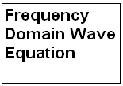
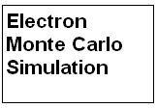
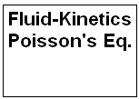
DESCRIPTION OF HPEM
Modular simulator that combines fluid and kinetic approaches.
Resolves cycle-dependent phenomena while using time-slicing techniques to advance to the steady state.
Electron energy distributions are obtained as a function of space, time using a Monte Carlo simulation.
University of Michigan
Institute for Plasma Science & Engr.
ICOPS_2013

Slide 5
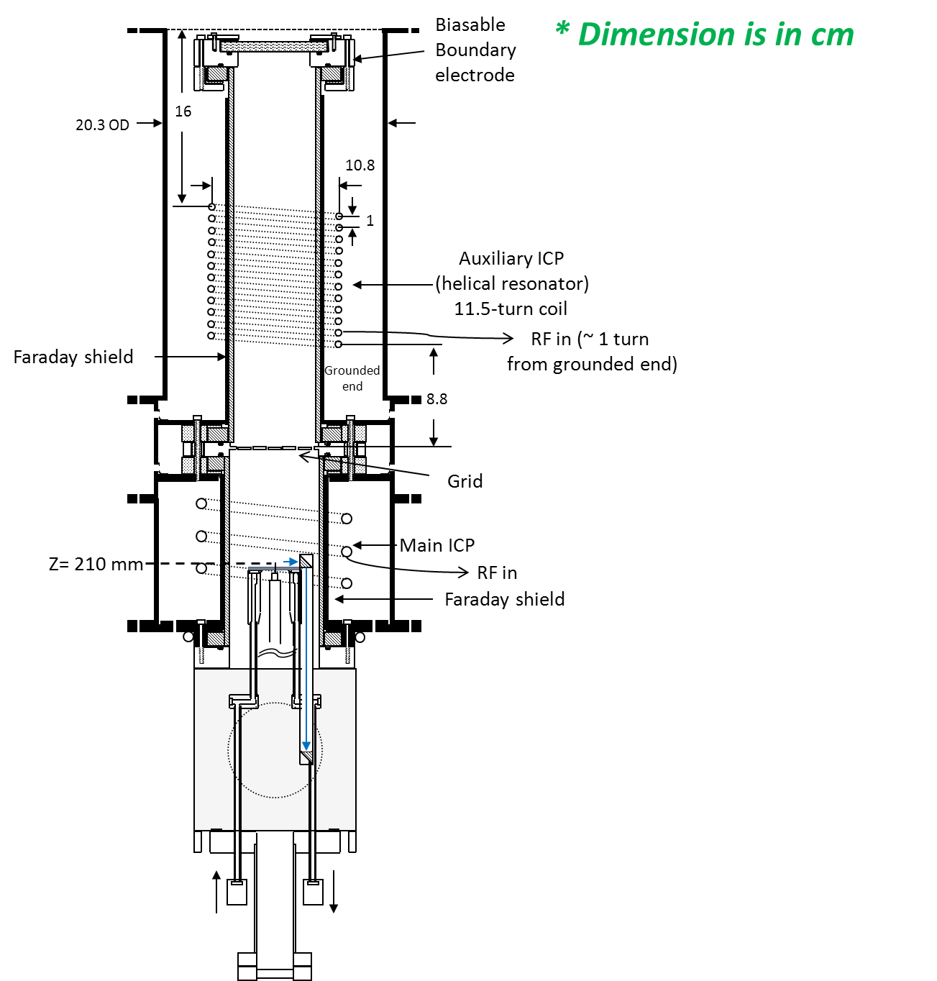
TANDEM ICP (T-ICP): EXPERIMENT
T-ICP has separately powered coils with a biasable grid separating the two source regions.
Primary ICP is the lower source, secondary ICP is upper source.
A biasable boundary electrode is at the top boundary.
Electron, ion densities, temperatures: Langmuir probe
Argon, 10 mTorr, 80 sccm
Dimensions in cm
University of Michigan
Institute for Plasma Science & Engr.
ICOPS_2013
Notes:
5

Slide 6
TANDEM ICP (T-ICP): MODEL
Cylindrically symmetric (mesh 8.7 cm x 58.5 cm)
Operating conditions:
Primary (lower):
90 W (CW)
100 W (pulse average), Duty cycle = 20%, PRF = 10 kHz
Secondary (top)
Power = 100 W or 500 W (CW)
Grounded grid.
Argon, 10 mTorr, 80 sccm
University of Michigan
Institute for Plasma Science & Engr.
ICOPS_2013
Notes:
6

Slide 7
n_{e}, S_{e}, T_{e} (TOP 500 W, CW;
BOTTOM 90 W, CW)
With CW power top and bottom and grounded grid, the characteristics of the plasmas are determined by local coils.
Dominant ionization regions are well separated, though high thermal conductivity of plasma spreads T_{e} between sources.
Grid Spacing: 3.12 mm
Argon, 10 mTorr, 80 sccm
Electron Source
n_{e}
T_{e}
University of Michigan
Institute for Plasma Science & Engr.
ICOPS_2013

Slide 8
T_{e}, n_{e}, V_{P} (TOP 500 W, CW; BOTTOM 90 W, CW)
Presence of grid has noticeable influence on spatial profiles of n_{e}, T_{e}, and V_{P} near grid area.
Grid Spacing: 3.12 mm
University of Michigan
Institute for Plasma Science & Engr.
ICOPS_2013

Slide 9
f_{e}(ε) (TOP 500 W, CW; BOTTOM 90 W, CW): H=10.8 cm
Model
Experiment
ICP (Bottom)
ICP (Top)
ICP (Both)
f_{e}(ε) in middle of bottom ICP is substantially the same with or without top source. Perhaps some lifting of the tail of f_{e}(ε) with top source?
With only top source, high energy tail of f_{e}(ε) persists due to long mean free path of high energy electrons.
Grid Spacing: 3.12 mm
University of Michigan
Institute for Plasma Science & Engr.
ICOPS_2013

Slide 10
f_{e}(ε) (TOP 500 W, CW; BOTTOM 90 W, CW): H=14.8 cm
Model
Experiment
ICP (Bottom)
ICP (Top)
ICP (Both)
As height increases, tail of f_{e}(ε) rises as flux of high energy electrons from top source is larger.
Grid Spacing: 3.12 mm
Ar, 10 mTorr
University of Michigan
Institute for Plasma Science & Engr.
ICOPS_2013

Slide 11
T_{e}, n_{e}, (TOP 500 W, CW; BOTTOM 100 W, PULSED)
20μs
24μs
50μs
98μs
20μs
24μs
50μs
98μs
T_{e} increases slightly in main ICP area late in the afterglow period
Grid Spacing: 3.12 mm
University of Michigan
Institute for Plasma Science & Engr.
ICOPS_2013
ANIMATION SLIDE-GIF

Slide 12
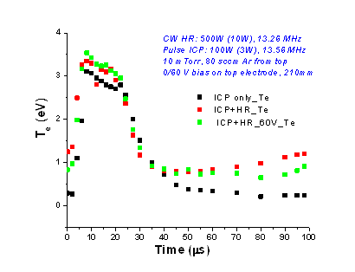
T_{e} (TOP 500 W, CW; BOTTOM 100 W, PULSED)
Model
Experiment
ICP (Bottom)
ICP (Both)
With top ICP, T_{e} increases in late afterglow. As plasma decays in bottom ICP, the constant flux of high energy electrons from top ICP has more influence.
Result is sensitive to presence of grid, which would affect the transport of high energy electrons.
Grid Spacing: 3.12 mm ; 5.46 mm
Ar, 10 mTorr, H = 10.8 cm
University of Michigan
Institute for Plasma Science & Engr.
ICOPS_2013

Slide 13
n_{e} (TOP 500 W, CW; BOTTOM 100 W, PULSED)
Model
Experiment
ICP (Bottom) n_{e}
ICP (Bottom) N_{i}
ICP (Both) n_{e}
ICP (Both) N_{i}
In model n_{e} = n_{i}
n_{e} is little affected by presence of top ICP – changes occur dominantly in f_{e}(ε).
Grid Spacing: 3.12 mm
Ar, 10 mTorr, H = 10.8 cm
University of Michigan
Institute for Plasma Science & Engr.
ICOPS_2013

Slide 14
f_{e}(ε) (TOP: 0 W, 500 W, CW; BOTTOM: 90 W, CW; 100 W PULSED
Effect of top ICP on f_{e}(ε) has some height dependence, with the tail of f_{e}(ε) being raised higher as you move toward the top ICP.
Grid Spacing: 5.46 mm
Top: 0 W
Bot: 90 W, CW
Top: 500 W
Bot: 90 W, CW
Top: 0 W
Bot: 100 W, Pulsed
Top: 500 W
Bot: 100 W, Pulsed
University of Michigan
Institute for Plasma Science & Engr.
ICOPS_2013

Slide 15
f_{e}(ε) (TOP 0 W; BOTTOM 100 W, PULSED)
Model
f_{e}(ε) show expected time dependent behavior for a pulsed, single source system
f_{e}(ε) has long tail at t = 20 μs near the end of the pulse on period
Tail of f_{e}(ε) rapidly lowers in afterglow as high energy electrons are lost.
Little change in f_{e}(ε) in late afterglow between t = 50 μs and t = 98 μs
Ar, 10 mTorr, H = 10.8 cm, PRF = 10 kHz, DC = 20%.
Grid Spacing: 3.12 mm
University of Michigan
Institute for Plasma Science & Engr.
ICOPS_2013

Slide 16
f_{e}(ε) (TOP CW; BOTTOM 100 W, PULSED): H=10.8 cm
Top 100 W
Top 500 W
Top ICP lifts the tail of the bottom f_{e}(ε) during afterglow with effect greatest late in the afterglow.
Threshold of about 100 W in top ICP. (f_{e}(ε) for 100 W top ICP are not that different from 0 W. Some statistical noise at t = 50μs)
Ar, 10 mTorr, H = 10.8 cm, R = 0.5 cm, PRF = 10 kHz, DC = 20%.
Grid Spacing: 3.12 mm
University of Michigan
Institute for Plasma Science & Engr.
ICOPS_2013

Slide 17
f_{e}(ε) (TOP CW; BOTTOM 100 W, PULSED): H=18 cm
Top 100 W
Top 500 W
As approach grid, significant lifting of the tail of the f_{e}(ε) tail for both top ICP 100 W and 500 W
T_{e} of tail of distribution is larger at all times.
Ar, 10 mTorr, H = 18.0 cm, R = 0.5 cm, PRF = 10 kHz, DC = 20%.
Grid Spacing: 3.12 mm
University of Michigan
Institute for Plasma Science & Engr.
ICOPS_2013

Slide 18
f_{e}(ε) (TOP 500 W, CW; BOTTOM ICP 100 W, PULSED)
Model
Experiment
ICP (Bottom) 24 μs
ICP (Bottom) 98 μs
ICP (Both) 24 μs
ICP (Both) 98 μs
Similar trends in model and experiment. Top ICP has little effect when bottom ICP is on but significant effect in afterglow
Ar, 10 mTorr, H = 10.8 cm, R = 0.5 cm, PRF = 10 kHz, DC = 20%.
Grid Spacing: 3.12 mm
University of Michigan
Institute for Plasma Science & Engr.
ICOPS_2013

Slide 19
CONCLUDING REMARKS
The use of a remote (top) ICP in tandem with a primary ICP to modify the electron energy distributions in the primary source was investigated.
When both sources have CW power (>90 W) the EEDs are dominated by the local power deposition. Top ICP power has little effect.
The top ICP is able to modify the EEDs in a pulsed afterglow. The tail of the EED is lifted in the afterglow.
The T_{e} of the tail can be larger than the bulk – perhaps due to transport of less collisional, high energy electrons from the top ICP.
These are also the electrons able to overcome the plasma potential of the top ICP and penetrate the grid.
University of Michigan
Institute for Plasma Science & Engr.
ICOPS_2013

Slide 20
T_{e}, n_{e}, V_{P} (TOP 500 W, CW; BOTTOM 90 W, CW)
Grid spacing has negligible effect on plasma parameters.
Grid Spacing: 3.12 mm ; 5.46 mm
University of Michigan
Institute for Plasma Science & Engr.
ICOPS_2013

