Slide 1
THE INTERACTION OF ATMOSPHERIC PRESSURE PLASMAS WITH LIQUID COVERED TISSUES
Wei Tian^{a)} and Mark J. Kushner^{b)}
^{a)}Department of Nuclear Engineering and Radiological Science
University of Michigan, Ann Arbor, MI 48109, USA
bucktian@umich.edu
^{b)}Department of Electrical Engineering and Computer Science
University of Michigan, Ann Arbor, MI 48109, USA
mjkush@umich.edu
40th IEEE International Conference on Plasma Science
June 2013
* Work supported by Department of Energy Office of Fusion Energy Science
Notes:
1
Good morning everyone, I am Wei Tian, working with Prof. MJK at UMich.
Welcome to my presentation today.
I am going to talk about the discharges in bubble in water, my work title is “THE INTERACTION OF ”
This work is supported by the Department of Energy, Office of Fusion Energy Science.

Slide 2
AGENDA
DBDs in contact with liquids
Description of model
Reaction mechanism
Results
Dynamic of the discharge
Reactions in liquid
Fluences onto the tissue
Conclusion
University of Michigan
Institute for Plasma Science & Engr.
ICOPS_2013
Notes:
2
I will begin with introduction to DBDs in contact with liquids.
The model and reaction mechanism will be briefly described.
The results are shown,
dynamic of
reactions in liquids
fluences onto
Conclusion will be emphasized at the end.

Slide 3
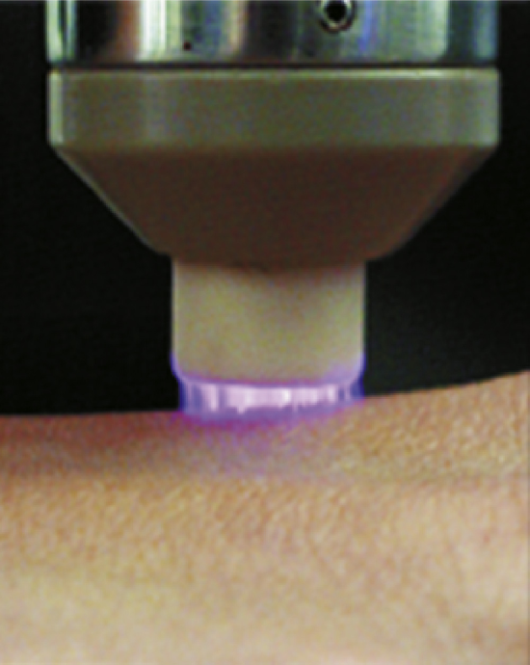
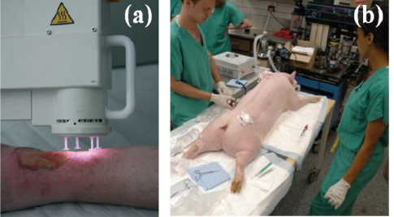
DBDs IN CONTACT WITH LIQUIDS
DBDs in contact with liquids are important for tissue treatment, from sterilization to wound healing
Tissues are often covered by a thin layer of liquid
Plasmas directly interact with the liquid layer
The liquid layer processes radicals and ions prior to their reaching the tissues
G. Y. Park et al, Plasma Sources Sci. Technol. 21 (2012) 043001
S. Emmert et al, Clinical PlasmaMedicine1 (2013) 24
University of Michigan
Institute for Plasma Science & Engr.
ICOPS_2013
Notes:
3
DBDs in contact with liquids are important for tissue treatment, from sterilization to wound healing.
Tissues are often covered by a thin layer of liquid
Plasmas directly interact with the liquid layer
The liquid layer processes radicals and ions prior to their reaching the tissue.
Here are some typical configurations used in experiments.

Slide 4
IN PRACTICE, NON-PRISTINE WATER
Most biological fluids are not pristine water, but with
Dissolved gases, such as O₂ and CO₂
“RH”(alkane-like hydrocarbons).
In this presentation, we present results from a computational investigation of micro-plasmas sustained in water.
Production of reactive species in gas phase.
Transport of reactants into water (solvation).
Production and transport of reactants in water.
Species fluences received by the tissue.
University of Michigan
Institute for Plasma Science & Engr.
ICOPS_2013
Notes:
4
Most biological fluids are not pristine water but with
Dissolved gases, such as O2 and CO2
“RH”(alkane-like hydrocarbons)
In this presentation, we present results from a computational investigation, including
Production and transport of reactive species in gas phase and liquid phase.
Species fluences received by the tissue

Slide 5
MODELING PLATFORM: nonPDPSIM
Poisson’s equation:
Transport of charged and neutral species:
Surface Charge:
Electron Temperature (transport coefficient obtained from Boltzmann’s equation)
Radiation transport and photoionization:
University of Michigan
Institute for Plasma Science & Engr.
ICOPS_2013
Notes:
5
The model, nonPDPSIM, is shown here.
The fundamental equations are solved here,
Poisson’s equation for electric potential,
the continuity equation for the transport of charged and neural species.
the surface charge is also included,
electron temperature is obtained by solving the electron energy equation.

Slide 6
TREATMENT OF LIQUID
Liquid plasma is treated identically to gas as a partially ionized substance.
Higher density
Specified susceptibility/atom to provide known permittivity
Surface tension is addressed by specifying species able to pass through vapor/liquid interface.
Diffusion into water is limited by Henry’s law equilibrium at the surface layer.
Solvated species “stay in liquid”.
Liquid evaporates into gas with source given by its vapor pressure.
O₂ is naturally dissolved in the liquid before the pulse.
Evaporation
Ions
Dissolved
gases
Solvated
Liquid
University of Michigan
Institute for Plasma Science & Engr.
ICOPS_2013
Notes:
6
Liquid plasma is treated identically to gas as a partially ionized substance with Higher density and Specified permittivity
Surface tension is addressed by specifying species able to pass through vapor/liquid interface.
Diffusion into water is limited by Henry’s law equilibrium at the surface layer.
Solvated species “stay in liquid”, cannot go back to gas phase.
Liquid evaporates into gas with source given by its vapor pressure.

Slide 7
WATER REACTION MECHANISM
Plasma
Photons, M*
M⁺
e
M⁻
H,OH,O,O₃, O₂,
Water
R•
RH
H
H₂
H
OH
H₂O⁺
(H₂O)e
O₂⁻
OH⁻
H,OH,O,O₃, O₂
OH
H₃O⁺
O,O⁻
R•
RH
H₂O₂
H₃O⁺
O₃,O₃⁻
R•
RH
O₂
RH
R•
H
HO₂
= reaction with H₂O
University of Michigan
Institute for Plasma Science & Engr.
ICOPS_2013
Notes:
7
Here is a flow chart showing species creation channels.
The plasma produces photons, charged species, and ROS.
Through the reactions with liquid water,
Photons result in OH as well as H3O+
Positive ions go to H3O+
Eons and negative ions go to O2-
The remaining ROS are O3 and O3-
In the presence of RH in water, the reactive species are virtually consumed, leaving R radical in water.

Slide 8
GEOMETRY
DBD, 1.5 mm gap
200 μm thick liquid layer with “plasma water” at the center and “dielectric water” aside.
“Air” (N₂/O₂/H₂O=79/20/1) at 1 atm with H₂O evaporating from the liquid surface. Dissolved O₂ in liquid – 3 ppm
3 x 100 Hz pulses, 1 s afterglow
University of Michigan
Institute for Plasma Science & Engr.
ICOPS_2013
Notes:
8
Here is the geometry, typical DBDs, With gap of 1.5 mm, liquid layer of 200 um thick
The center liquid layer is treated as “real plasma” with reactions in it, aside layers are dielectrics to save the computing nodes.
The under tissue is treated as dielectric, and the fluences onto the tissue are recorded.
“AIR” at 1 atm with H2O evaporating from the liquid surface.
The unstructured mesh is shown on the right.

Slide 9
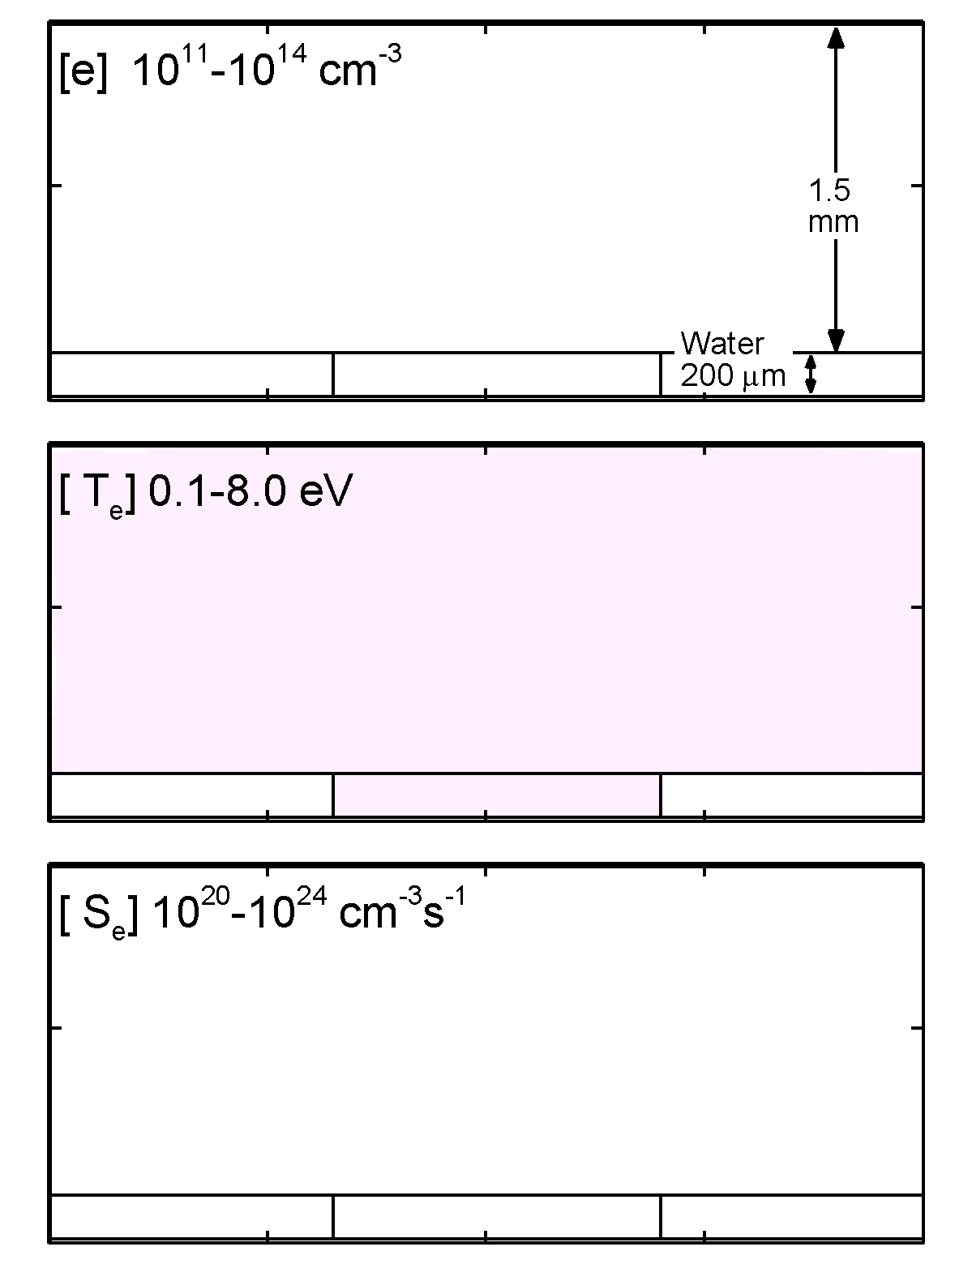
INITIAL AVALANCHE
The filament reaches plasma density of 10¹⁴ cm⁻³ and propagates across the gap in a few ns.
Large space charge creates a large electric field ahead of the streamer.
When the plasma hits the liquid surface, the discharge spreads along the surface in a DBD fashion.
-18 kV
Animation Slide
MIN MAX
Log scale
University of Michigan
Institute for Plasma Science & Engr.
Notes:
9
Let's start by reviewing some dynamics of a single plasma filament interacting with surface. Here is our result of a single plasma filament interacting with liquid layer.
The separation between the applicator and the liquid layer is 1.5 mm, with negative pulse of 15 kV.
The filament reaches plasma density of 10^14 cm-3. It propagates across the gap in only a few nanoseconds. Large space charge creating a large EF ahead of the streamer, where the Te is also high and the ionization source reaches as high as 10^24 cm-3s-1.

Slide 10
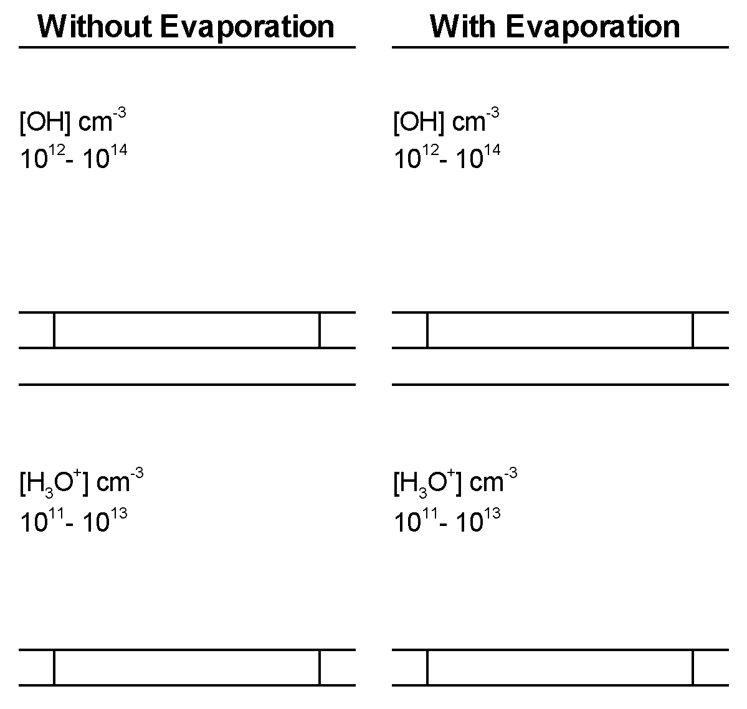
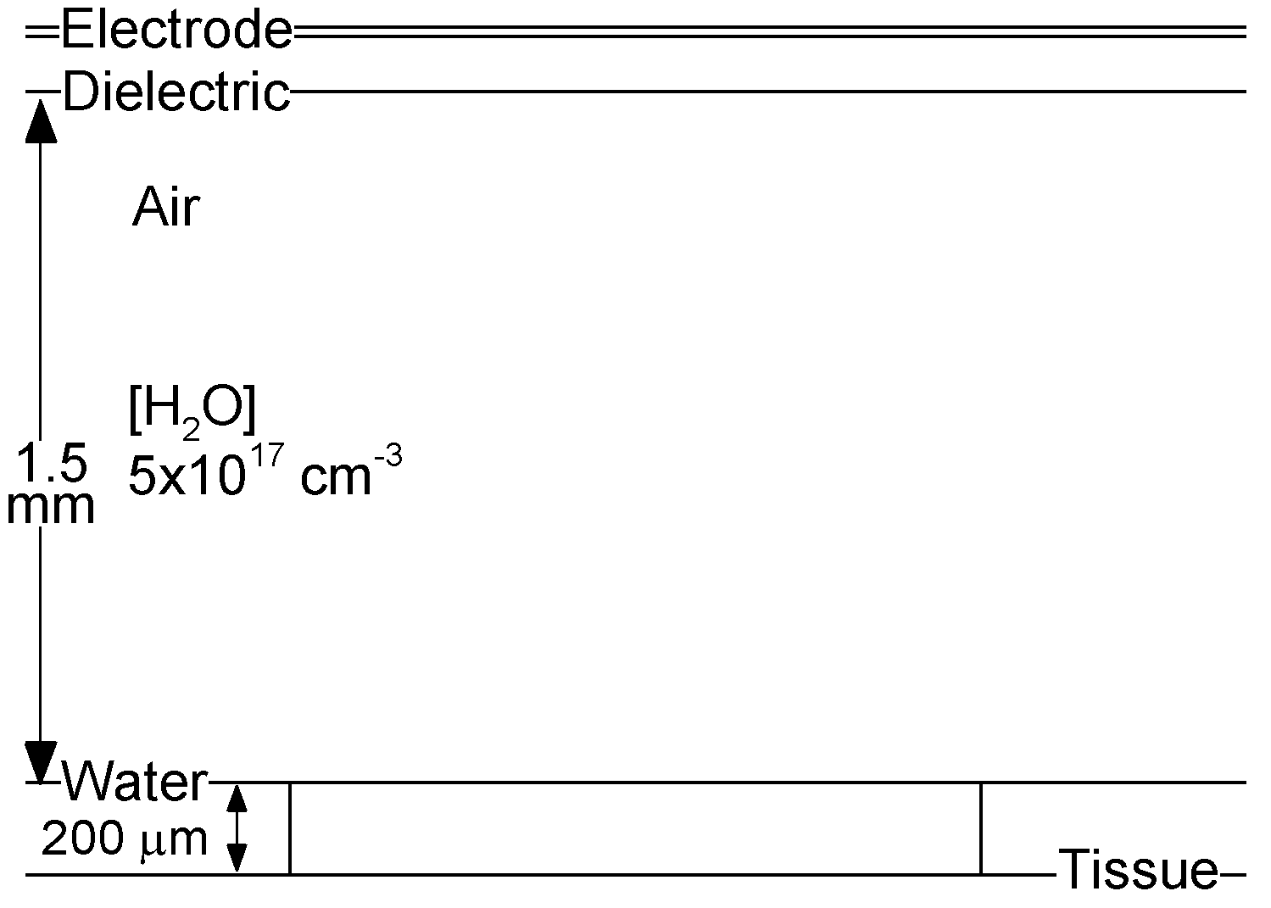
H₂O VAPOR EMISSION FROM SURFACE
Saturated pressure, 27 Torr at 300 K
Evaporation produces dense water vapor layer at surface.
Streamer intersecting with water vapor layer produces significantly different ROS distribution.
Animation Slide
MIN MAX
University of Michigan
Institute for Plasma Science & Engr.
Log scale
ICOPS_2013
Notes:
10
This slide shows the effect of the water evaporation.
In the right figure, evaporation evolves from the boundary for 10 ms before pulse and produces dense water vapor layer at the surface. The saturated pressure at the boundary, 27 Torr at 300 K, shown on the right.
On the left, through the comparison we can see the water evaporation produces a significantly different ROS distribution. The OH and H3O+ are produced near the liquid layer and able to diffuse into the liquid easily.

Slide 11
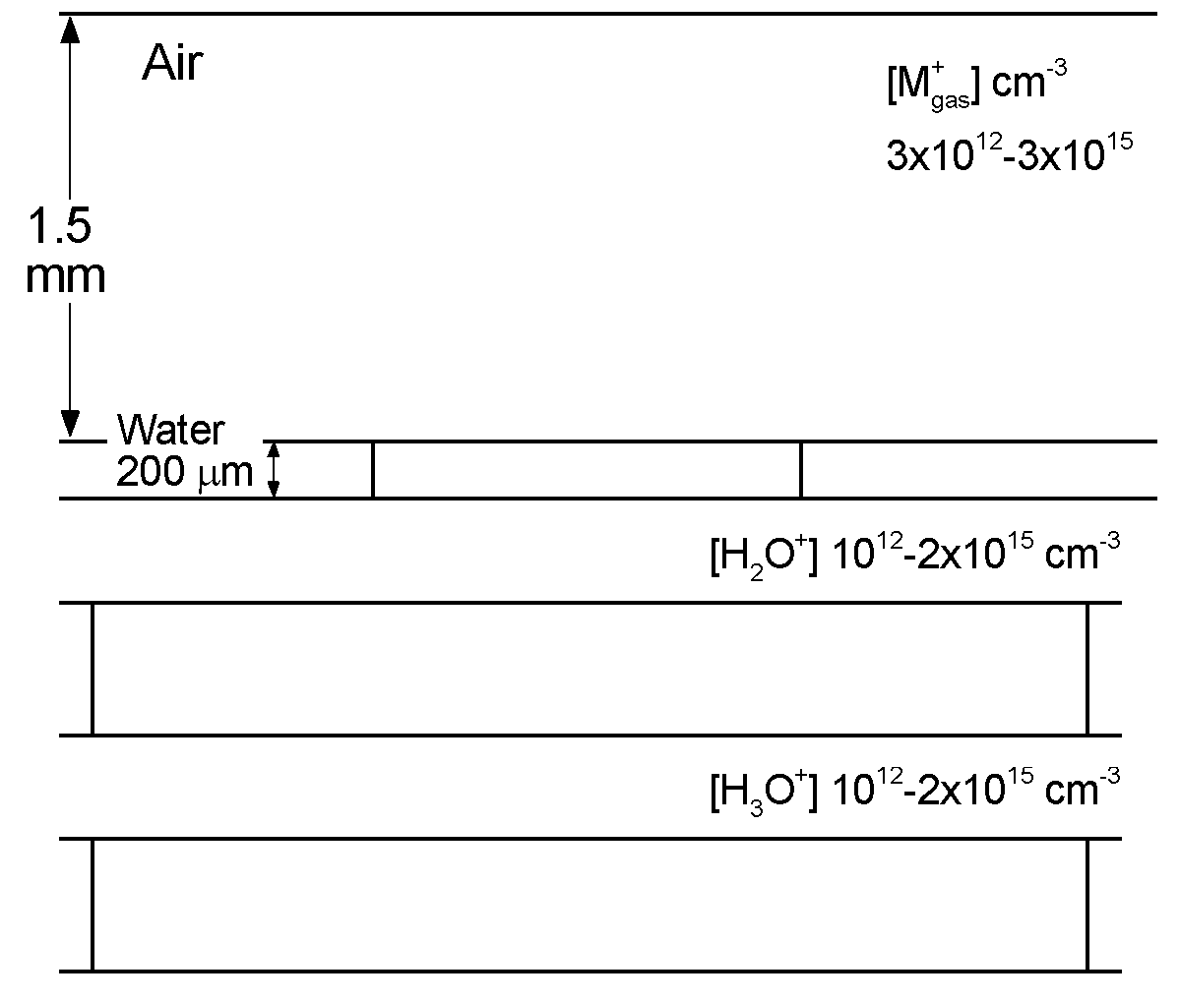
POSITIVE ION CHEMISTRY
Virtually all positive ions striking water charge exchange to H₂O⁺ which is rapidly converted to H₃O⁺, producing OH in the process.
H₃O⁺ participates in equilibrium reactions which maintains its density.
Long lived positive ions in the gas phase are hydronium ions.
Animation Slide
200 μm water layer, O₂ 3 ppm.
-18 kV, 3 x 100 Hz pulses, 1 s afterglow.
MIN MAX
Log scale
University of Michigan
Institute for Plasma Science & Engr.
ICOPS_2013
Notes:
11
Here is the positive ion chemistry.
In the gap, the total positive ions with density up to 10^15 cm-3.
Virtually all positive ions striking water charge exchange to H₂O⁺.
The lifetime of aqueous H2O+ is short. In about microseconds, aqueous H2O+ leads to H3O+ and meanwhile OH is produced.
H3O+ dominates the liquid positive ions and participates in equilibrium reactions, which maintains its density.

Slide 12
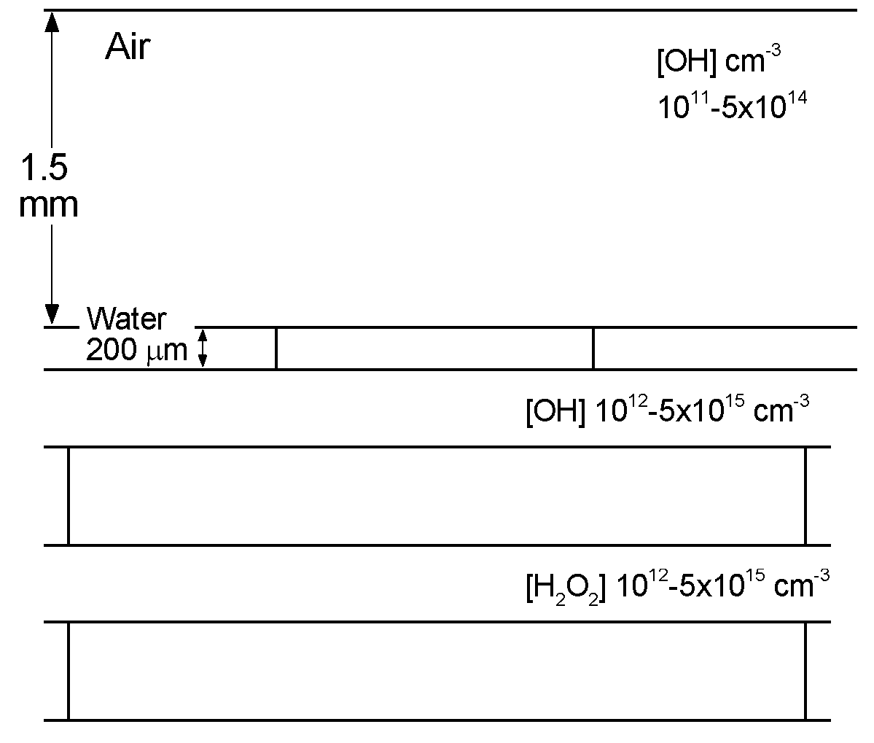
OH, H₂O₂ THROUGH “PURE” WATER LAYER
Majority of gas OH produced above water in vapor layer.
OH produced in water dominated by photodissociation on short time scales. OH diffusion from gas phase in afterglow.
OH rapidly produces H₂O₂, which is fairly unreactive in water and diffuses to tissue.
Animation Slide
200 μm water layer, O₂ 3 ppm.
-18 kV, 3 x 100 Hz pulses, 1 s afterglow.
MIN MAX
Log scale
University of Michigan
Institute for Plasma Science & Engr.
ICOPS_2013
Notes:
12
Here are the oxidizing species. Aqueous OH is produced in many ways.
On short time scales, OH is produced by the dissociation of H2O induced by photon fluxes and charge exchange.
In afterglow, OH is produced through the solvation of the gaseous OH.
OH is too oxidizing to transport further unless it recombines to H2O2, which is less reactive than OH but will go much further to the tissue.
As a result, OH only exists in a very thin layer under the interface.
H2O2 is a common oxidizing radical living very long in liquid water, and finally reaches the tissue.

Slide 13
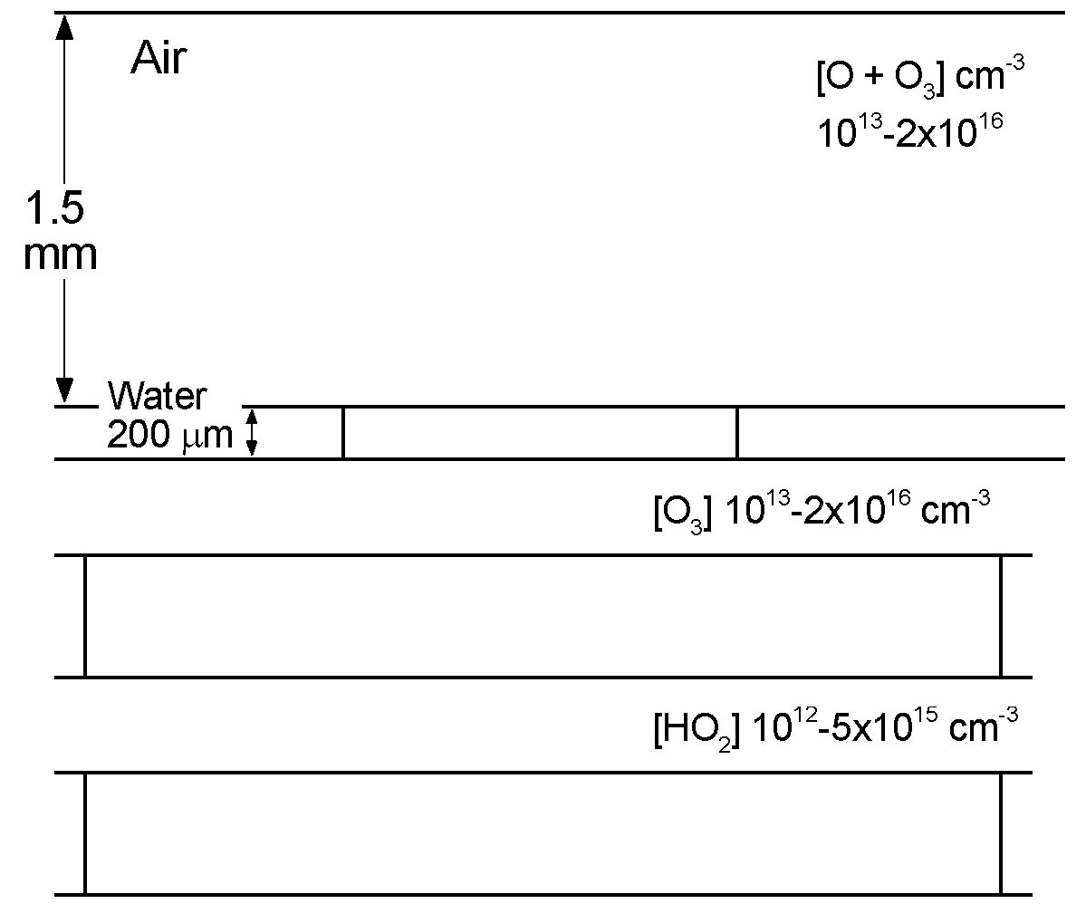
ROS THROUGH “PURE” WATER LAYER
O and O₃ are produced in the gas phase and then diffuse into the liquid.
O quickly converts to O₃ when solvated.
O₃ reaches 10¹⁶ cm⁻³.
H combines with O₂ to produce HO₂, which decomposes to H₃O⁺ and O₂⁻.
Animation Slide
200 μm water layer, O₂ 3 ppm.
-18 kV, 3 x 100 Hz pulses, 1 s afterglow.
MIN MAX
Log scale
University of Michigan
Institute for Plasma Science & Engr.
ICOPS_2013
Notes:
13
ROS production is shown here.
O and O3 are produced in the filament, up to 10^16 cm-3.
O quickly converts to O3 by combining dissolved O2 when solvated.
When solvated, H atoms quickly combine with dissolved O2 to HO2, which later decomposes to H3O+ and O2-.
It is an important source providing hydronium ions.

Slide 14
ROS PRODUCTION w/wo HV AND DISSOVLED O₂
Base Case
Without HV
Without O₂
ROS that trace their origin to OH production are dominated by photodissociation on short times.
O₃ is less sensitive to VUV fluxes as O atoms are not directly produced in large numbers by photolysis.
O₂ aids significantly in production of HO₂.
Animation Slide
MIN MAX
University of Michigan
Institute for Plasma Science & Engr.
Log scale
ICOPS_2013
Notes:
14
Here are the ROS production for different cases. We can see the photodissociation plays a dominant role during the pulse in the OH and H2O2 production. Without photon fluxes, OH and H2O2 densities are reduced by at least 1 order.
O3 is less sensitive to the photon fluxes since O atoms are not directly produced in large numbers by photolysis.
HO2 production is reduced very much in lack of photon fluxes and dissolved O2, since HO2 mainly comes from the H combining with O2.

Slide 15
ROS THROUGH “PURE” WATER LAYER
Without RH
With RH (30 ppm)
200 μm water layer, O₂ 3 ppm.
-18 kV, 3 x 100 Hz pulses, 1 s afterglow.
H₂O₂ reacts with “generic” RH at the equivalent of gas kinetic rates. O₃ reacts less rapidly.
Even small amounts of RH (here 30 ppm) can consume large fraction of ROS, converting reactivity to R•.
May be able to “burn through” RH with more pulses.
Animation Slide
MIN MAX
University of Michigan
Institute for Plasma Science & Engr.
Log scale
ICOPS_2013
Notes:
15
Most biological fluids are not pristine water. The water is likely to contain RH (alkane-like hydrocarbon), in this case, 30 ppm.
In our model, H2O2 and O3 react with RH at the equivalent of gas kinetic rates.
Without RH, the left figure, H2O2 and O3 are able to reach the tissue, while with RH, the right figure, H2O2 and O3 are consumed out before they reach the tissue.
Even a small mount of RH can stop the ROS penetration. But with more pulses, ROS will increase and may be able to “burn through” RH.

Slide 16
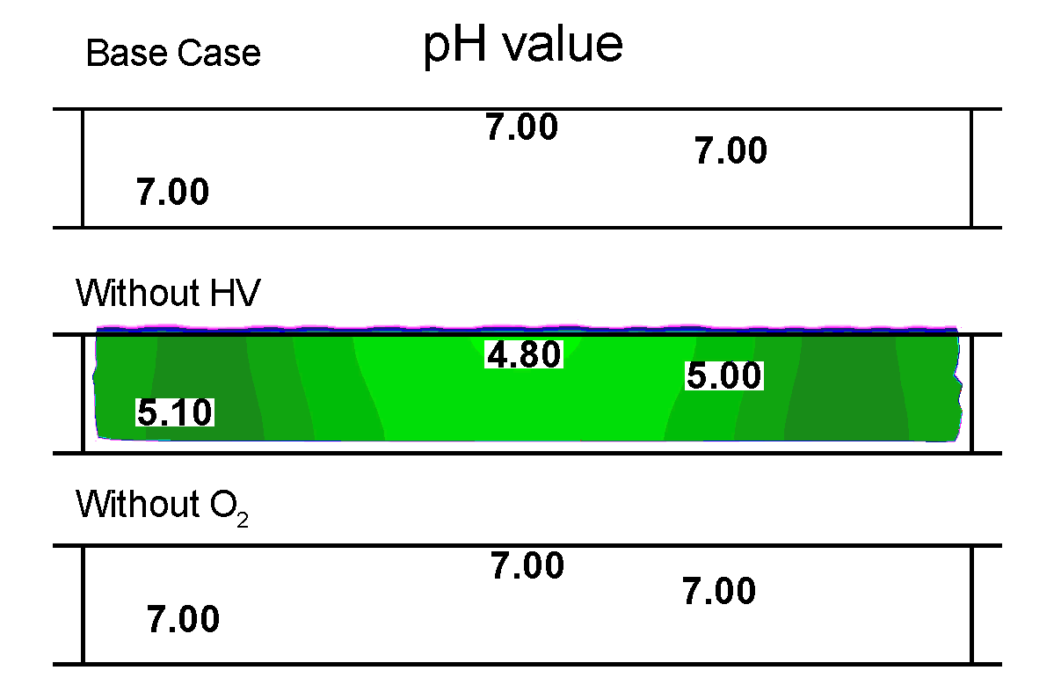
PLASMA ACIDIFICATION
200 μm water layer, O₂ 3 ppm.
-18 kV, 3 x 100 Hz pulses, followed by 1 s afterglow.
The pH is determined by the activity of hydronium ions (H₃O⁺).
The pH reaches 4.4 (acidic) at end of base case. Intermediate pH is lower (more acidic). Without UV/VUV flux or dissolved O₂, pH is higher (less acidic).
The discharge significantly acidifies the liquid.
Animation Slide
MIN MAX
University of Michigan
Institute for Plasma Science & Engr.
Log scale
ICOPS_2013
Notes:
16
The liquid acidification by the discharge is frequently reported in the literatures. Our simulation also shows such effect.
The pH value is determined by the concentration of the H3O+.
The water is assumed to be neutral before the pulse.
In 1 sec after the pulse, the pH value reaches as low as 4.4 at end of the base case. Intermediate pH is even lower. Without photon fluxes or dissolved O2, pH value is higher.
The discharge significantly acidifies the liquid.

Slide 17
SPECIES FLUENCES TO TISSUE UNDER WATER
Fluences decrease for most ROS (except O₃) without UV/VUV.
Without dissolved O₂ – fluences for O₂⁻ and HO₂ decrease resulting in large H•.
RH decreases ROS fluences, replacing with R•.
University of Michigan
Institute for Plasma Science & Engr.
ICOPS_2013
Notes:
17
The fluences o the tissue , including ions and neutrals, are shown here.
The fluences of most ROS are reduced without photon fluxes, except O3.
The fluences of O2- and HO2 are reduced without dissolved O2.
In this case, O2- and O3- together dominate the positive ions in liquid.
The presence of RH reduces ROS fluences, resulting a dominant fluence of R*.

Slide 18
CONCLUDING REMARKS
Water vapor plays a significant role in ROS production adjacent to the liquid layer.
Discharge produced species diffuse onto the water surface and become solvated. The reactive gas phase species are quickly consumed by liquid-phase reactions.
OH, H₂O₂ and ROS are able to diffuse in water for 1 sec and finally reach the tissue. Dissolved O₂ aids in the production of ROS.
The UV/VUV radiation from the filaments induces photoionization and photodissociation of water at the surface.
RH (alkane-like hydrocarbon) consumes radicals rapidly producing large fluxes of R•.
University of Michigan
Institute for Plasma Science & Engr.
ICOPS_2013
Notes:
18

