Slide 1
Electric field emission and local surface heating in plasma packed bed reactors having metal catalyst-impregnated dielectric beads*
Juliusz Kruszelnicki, Kenneth W. Engeling, John E. Foster, and Mark J. Kushner
University of Michigan, Ann Arbor, MI, 48109, USA
jkrusze@umich.edu, kenengel@umich.edu, jefoster@umich.edu, mjkush@umich.edu
71st Gaseous Electronics Conference
Portland, Oregon USA
November 2018
* Work supported by the DOE Office of Fusion Energy Science and the National Science Foundation.

Slide 2
AGENDA
Plasma catalytic systems
Descriptions of the model and experiment
Polarization of catalysts
Electric field emission
Surface fluxes and heating
Concluding Remarks
University of Michigan
Institute for Plasma Science & Engr.
GEC_2018
Notes:
Application for atm discharges

Slide 3
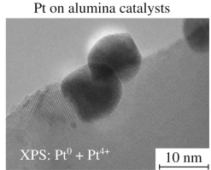
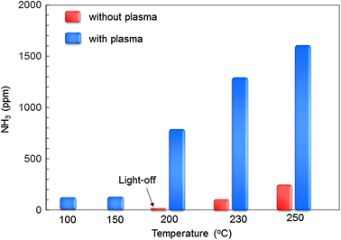
PLASMA-CATALYTIC SYSTEMS
Plasmas in Packed Bed Reactors (PBRs) are used for gas reprocessing.
Dielectric provides electric field enhancement.
The catalysts in PBRs are metal particles (10-100 nm) impregnated onto dielectric beads.
Catalysts enable favorable reaction pathways by decreasing activation energy.
Plasma/catalytic synergy has been observed, but not yet explained.
Kim et al. J. Phys. D. 42, 135210 (2009).
Kim et al. Eur Phys J Appl Phys 55, 13806 (2011)
University of Michigan
Institute for Plasma Science & Engr.
GEC_2018
Notes:
contribution

Slide 4
RESEARCH ISSUES
Plasma discharge dynamics: How does presence of metallic particles affect DBD discharges in PBRs?
Formation of surface discharges: What processes produce additional plasma structures in catalyst-impregnated systems?
Surface fluxes: What species are delivered to the catalyst surface?
Surface heating: How is energy transferred to the catalyst and what are the sources?
X. Tu et al., Trans. Plasma Sci. 39, 2172, (2011).
University of Michigan
Institute for Plasma Science & Engr.
GEC_2018
Notes:
Application for atm discharges

Slide 5
MODEL: nonPDPSIM
Surface Chemistry
and Charging
Neutral Transport
Navier-Stokes
Poisson’s Equation
(gas, liquid and solids)
Radiation Transport
Neutral and Plasma
Chemistry
Electron Energy
Transport
2-D plasma hydrodynamic simulator over an unstructured mesh.
Poisson’s and continuity equations solved implicitly:
Local electron temperatures solved using the Boltzmann Equation:
Includes bulk fluid flow, gas heating, surface interactions, radiation transport and kinetics.
University of Michigan
Institute for Plasma Science & Engr.
GEC_2018
Notes:
5
5

Slide 6
HEATING OF SOLIDS
$$\left(1\right) J\left(\frac{W}{cm^{2}}\right)=S_{ion}+S_{e}+S_{neut}+S_{UV}$$
Heating of solids is included by extending heat conduction term of temperature equation of plasma into solid materials.
Sources of heating of solids are fluxes of plasma produced species onto surface. Contributions by fluxes are:
Ion potential and kinetic energies (2).
Electron kinetic energy (3).
Electron emission (3).
$$\left(2\right) S_{ion}=Γ_{ion}\left(φ_{drop}+\sum_{i}{\left(H_{ion}−H_{i}\right) }\right)$$
$$\left(3\right) S_{e}=Γ_{ion}∗T_{e}−\left(4 eV\right)\left(\sum_{j}{Γ_{j}∗γ_{j}}+Γ_{FE}\right)$$
$$\left(4\right) S_{neut}=Γ_{neut}\left(\sum_{j}{\left(H_{neut}−H_{j}\right) }\right)$$
Neutrals surface reactions (4).
UV (5).
$$\left(5\right) S_{UV}=\sum_{l}{Γ_{l}∗ε_{l}}\left(1−R_{l}\right)$$
University of Michigan
Institute for Plasma Science & Engr.
GEC_2018
Notes:
Dielectric relaxation time of catalysts ~ 9e-15 s.

Slide 7
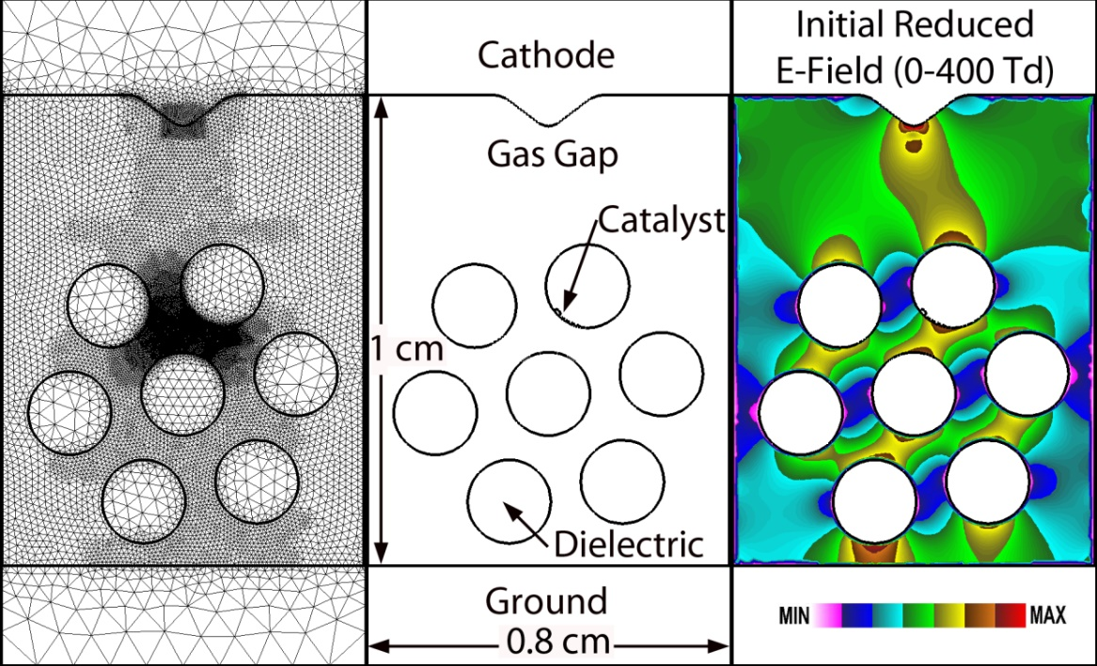
MODEL GEOMETRIES
Reaction mechanism: N₂/O₂/H₂O (78/21/1), 70 species, 1800 reactions.
Photoionization of O₂ by radiation from N₂**.
Mesh:
Full-scale: 13,000 nodes.
Close-up: 8,500 nodes.
Dielectric beads: ε_{r} = 8.
Catalysts: silver
Modeled as a dielectric with high conductivity.
ε_{r} = 10
σ = 100 Ω⁻¹-cm⁻¹
W = 5 eV
q_{thermal} = 4.06 W-cm⁻¹-K⁻¹
C_{p}= 0.023 J-cm⁻³-K⁻¹
Reflectance: 0.4
University of Michigan
Institute for Plasma Science & Engr.
GEC_2018
Notes:
Humidity:

Slide 8
DESCRIPTION OF EXPERIMENT
Work by K. W. Engeling.
2-D Packed Bed Reactor:
Width: 0.8 cm
Length: 1 cm
Pin-to-planar electrodes.
7 dielectric rods.
Unipolar ns pulses.
Silver (Ag) paint used to emulate metal catalysts.
Fast ICCD camera (5 ns exposure).
University of Michigan
Institute for Plasma Science & Engr.
GEC_2018
Notes:
Application for atm discharges

Slide 9
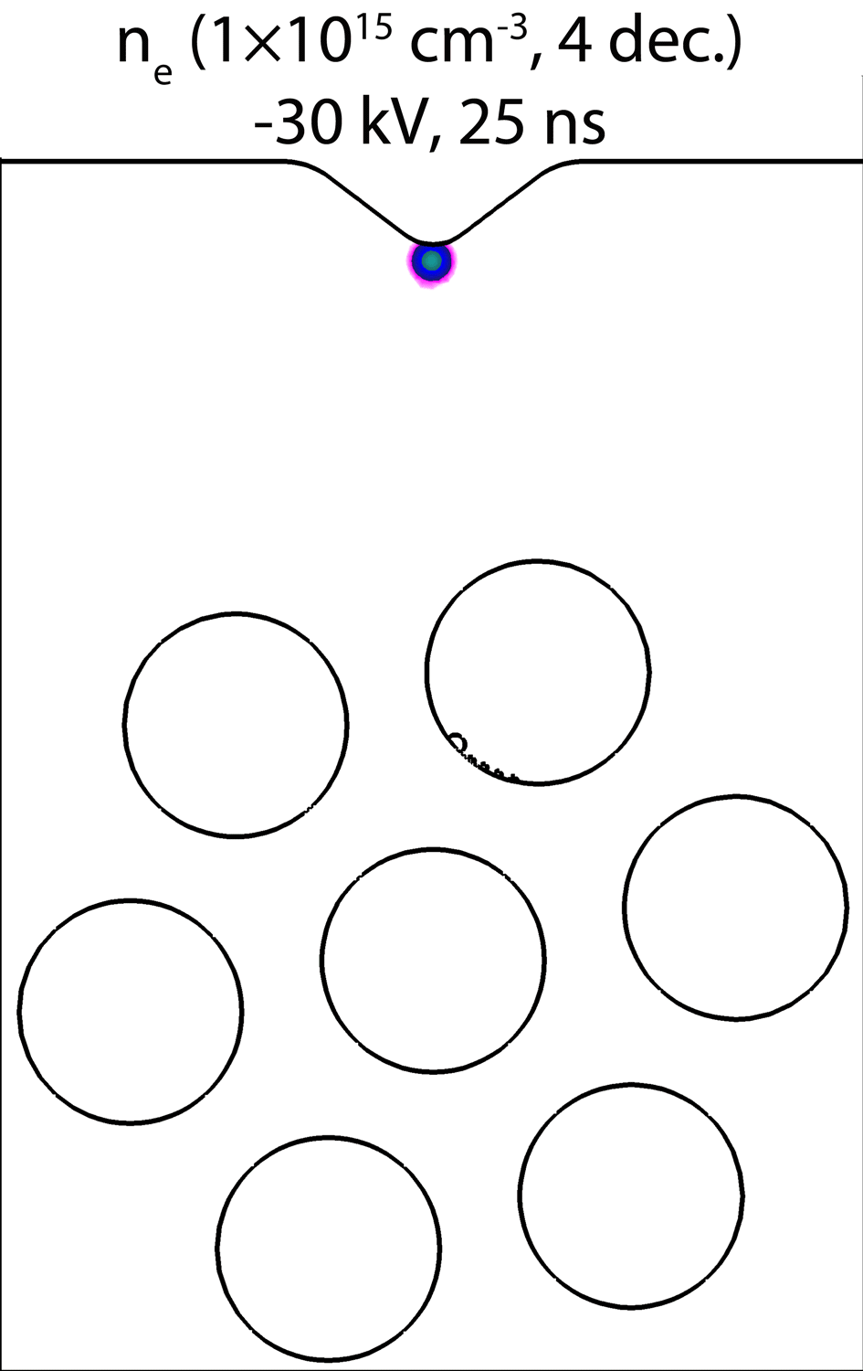
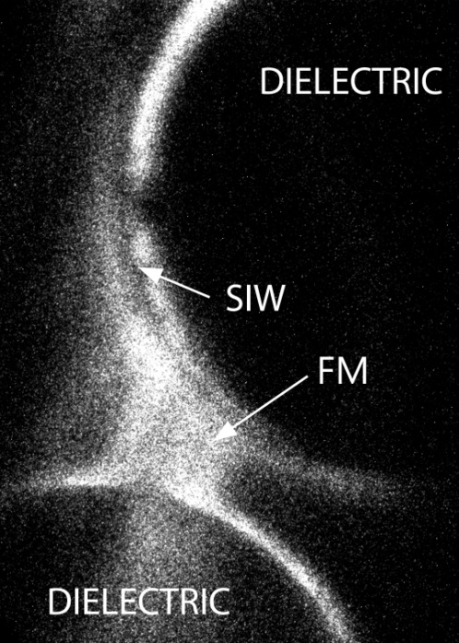
BASE CASE – DISCHARGE EVOLUTION
Plasma initiated at cathode tip.
Initial negative streamer enters lattice.
Dielectric barrier discharge:
Microdischarges form in gaps between beads due to field enhancement.
Surface ionization waves form.
Humid air, 1 atm
Model and experiment (without catalyst)
University of Michigan
Institute for Plasma Science & Engr.
GEC_2018
Animation Slide
Notes:
Humidity:

Slide 10
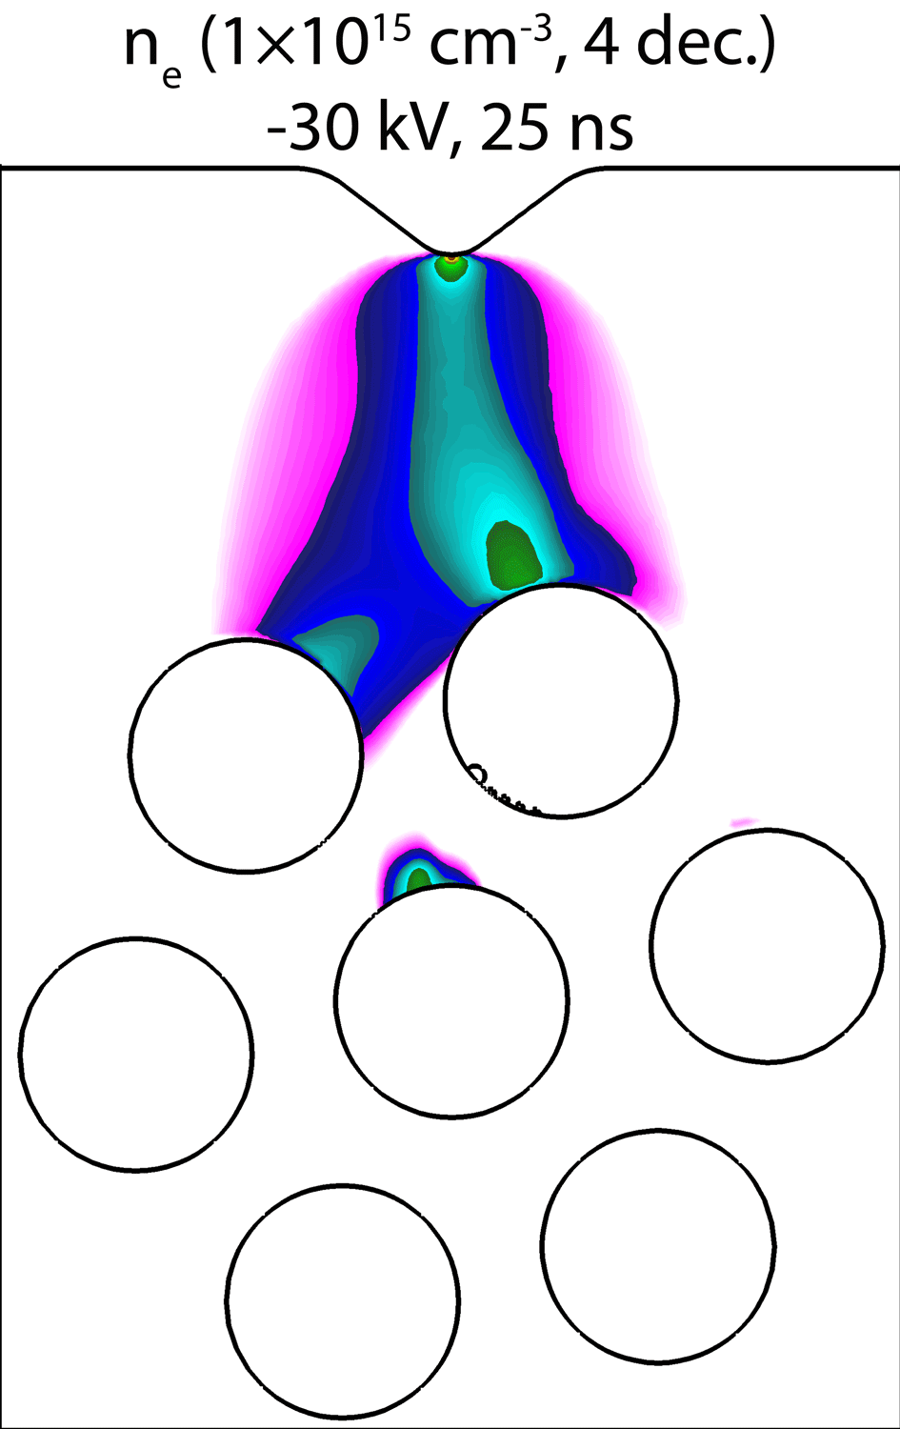
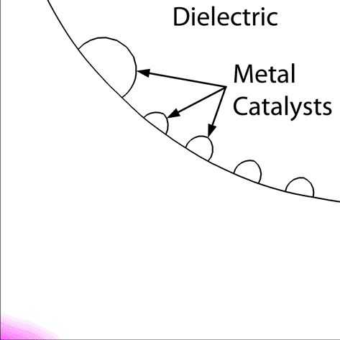
BASE CASE – DISCHARGE EVOLUTION
Gas/metal/dielectric triple points of catalysts produce electric field enhancement.
As microdischarge crosses gap, electrons seed triple point, producing a micro-streamer at the edges of catalyst.
Left: fast camera ICCD imaging of plasma near painted-on silver layers.
Humid air, 1 atm
University of Michigan
Institute for Plasma Science & Engr.
GEC_2018
Animation Slide
Notes:
Humidity:

Slide 11
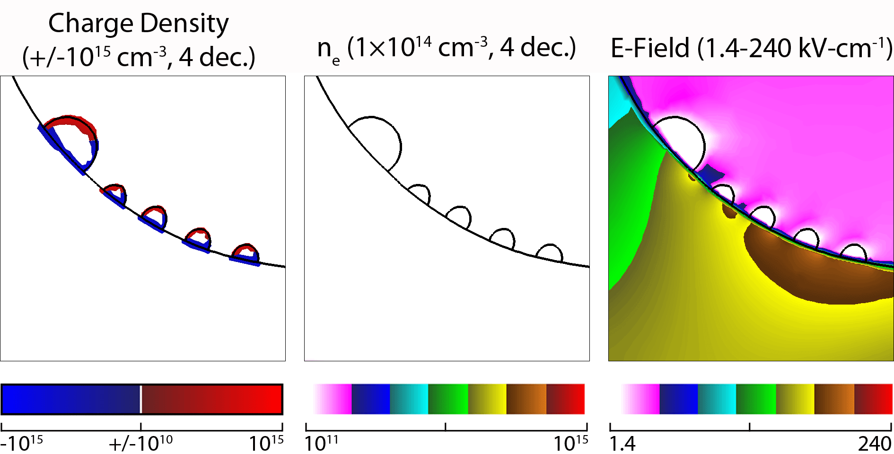
POLARIZATION OF CATALYST PARTICLES
Charges flow through metallic catalysts, accumulate at surfaces and produce additional field enhancement.
Electric fields ‘direct’ streamers towards the triple points.
Electric field between the head of the streamer (+, red at left) and catalyst (-, blue at left) continues increasing (peak ≈ 250 kV/cm).
t = 17-19 ns
University of Michigan
Institute for Plasma Science & Engr.
GEC_2018
Animation Slide

Slide 12
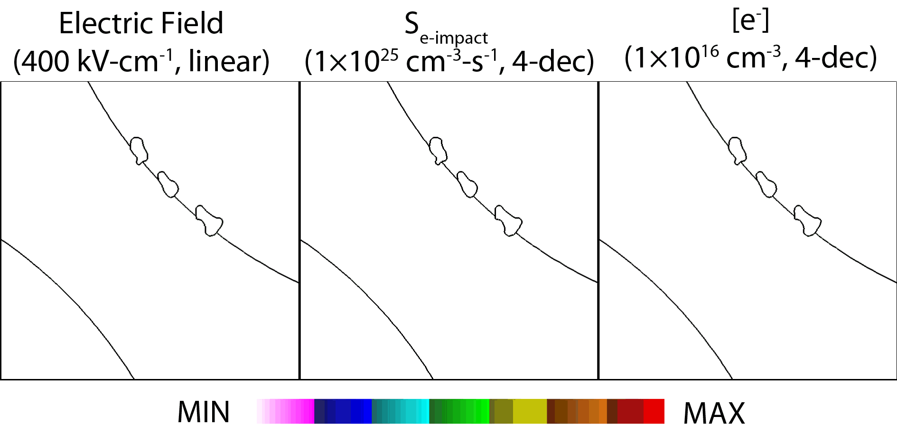
FIELD EMISSION: SHAPE OF CATALYSTS
Sharper protrusions lead to higher local field enhancement.
With protruding catalyst, peak electric field increases from 240 to 400 kV-cm⁻¹.
Higher E-field leads to field emission, seeding electrons for more localized microdischarges.
Anode
_{t = 1.6 ns}
r
d
h
Cathode
$$β=\frac{2\frac{h}{r}}{ln\left(4\frac{h}{r}\right)−2} ·\frac{1}{d}$$
University of Michigan
Institute for Plasma Science & Engr.
GEC_2018
Animation Slide
Notes:
Beta is the analogous to surface roughness.

Slide 13
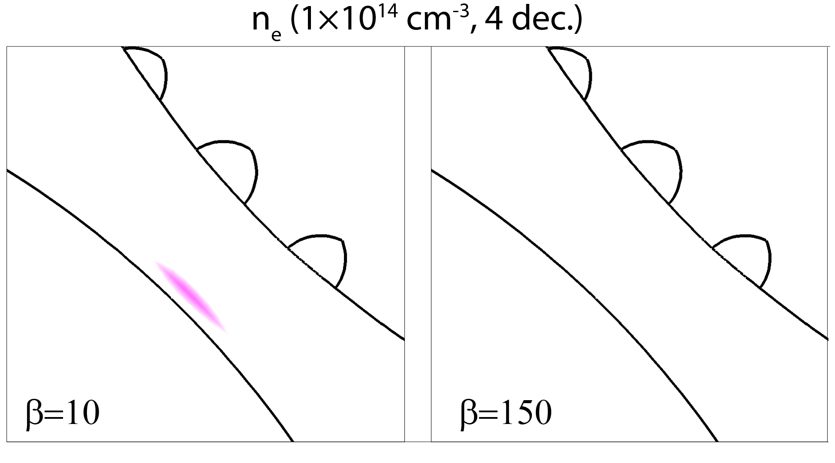
ELECTRIC FIELD EMISSION OF ELECTRONS
Electric field enhancement (1< β <1000s) due to unresolved surface roughness (Fowler-Nordheim).
Electric Fields (up to 1000s of kV/cm) overcome catalyst work function (≈ 5 eV), leading to field emission.
Discharge formation dominated by field emission at high β.
t = 2.0 ns
t = 1.2 ns
University of Michigan
Institute for Plasma Science & Engr.
GEC_2018
Animation Slide
Notes:
Beta is the analogous to surface roughness.

Slide 14
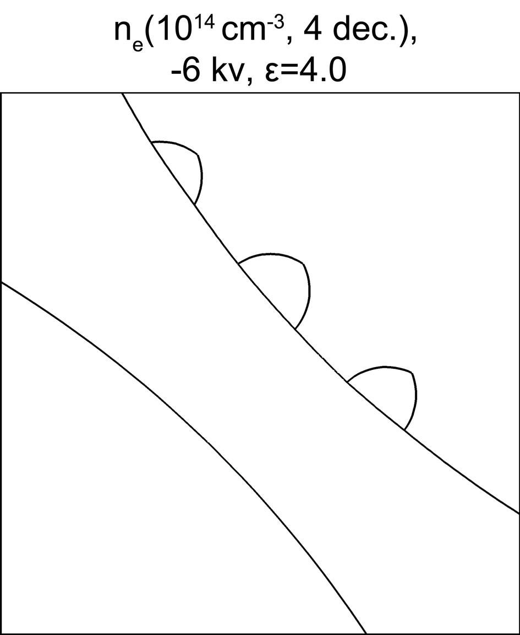
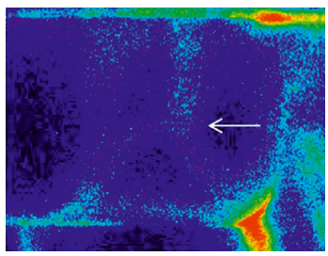
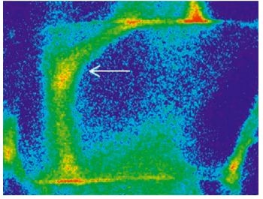
FORMATION OF SURFACE DISCHARGES
E-field emission of electrons into gap can seed micro-plasma filaments when plasma would otherwise not form.
Similar to experimental trends – plasma does not form on surface of pure HY zeolite, but does when HY is impregnated with Ag particles.
t = 6.0 ns
β=150
Zeolite, no catalyst
Zeolite, Ag catalyst
• Kim et al. Plasma Chem Plasma Process 36, 45 (2016)
University of Michigan
Institute for Plasma Science & Engr.
GEC_2018
Animation Slide

Slide 15
FIELD ENHANCEMENT: FLUENCE
Fluence: Time integrated flux.
Values in prentices: fluences (cm⁻²) at β = 10.
Reactive species with highest fluences: UV, e⁻, O₂⁺, N₂⁺, N₂(v), N, O, OH, H.
Higher β leads to higher plasma conductivity, lower electron temperature near catalyst.
Lower dissociation rates produce lower fluence.
Pathway to selectivity: N₂ dissociation, ionization requires higher energy than O₂ – lower relative fluences of RNS than ROS.
University of Michigan
Institute for Plasma Science & Engr.
GEC_2018
Notes:
Beta is the analogous to surface roughness.

Slide 16
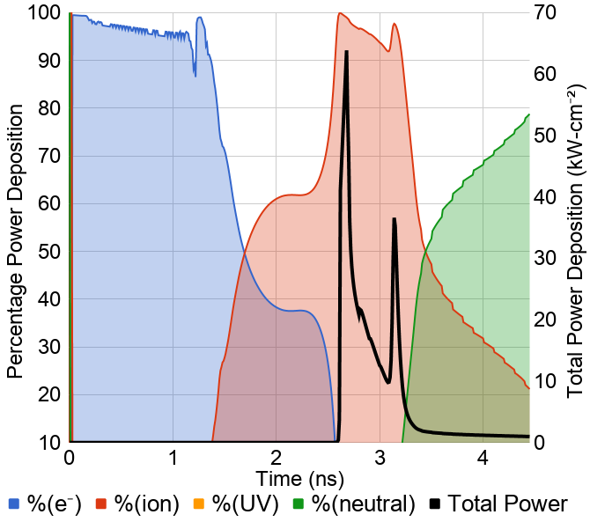
POWER DEPOSITION
Fractional and total power deposition to catalysts due to a single pulse.
Three distinct stages:
Electrons impact catalyst prior to streamer formation.
As streamer reaches catalyst, high potential drop leads to flux of energetic ions.
Neutral reactions dominate as conductive plasma forms near catalysts and in the afterglow.
e⁻
Ion
Neutral
Contributions: Ions > Neutrals > Electrons > UV.
University of Michigan
Institute for Plasma Science & Engr.
GEC_2018

Slide 17
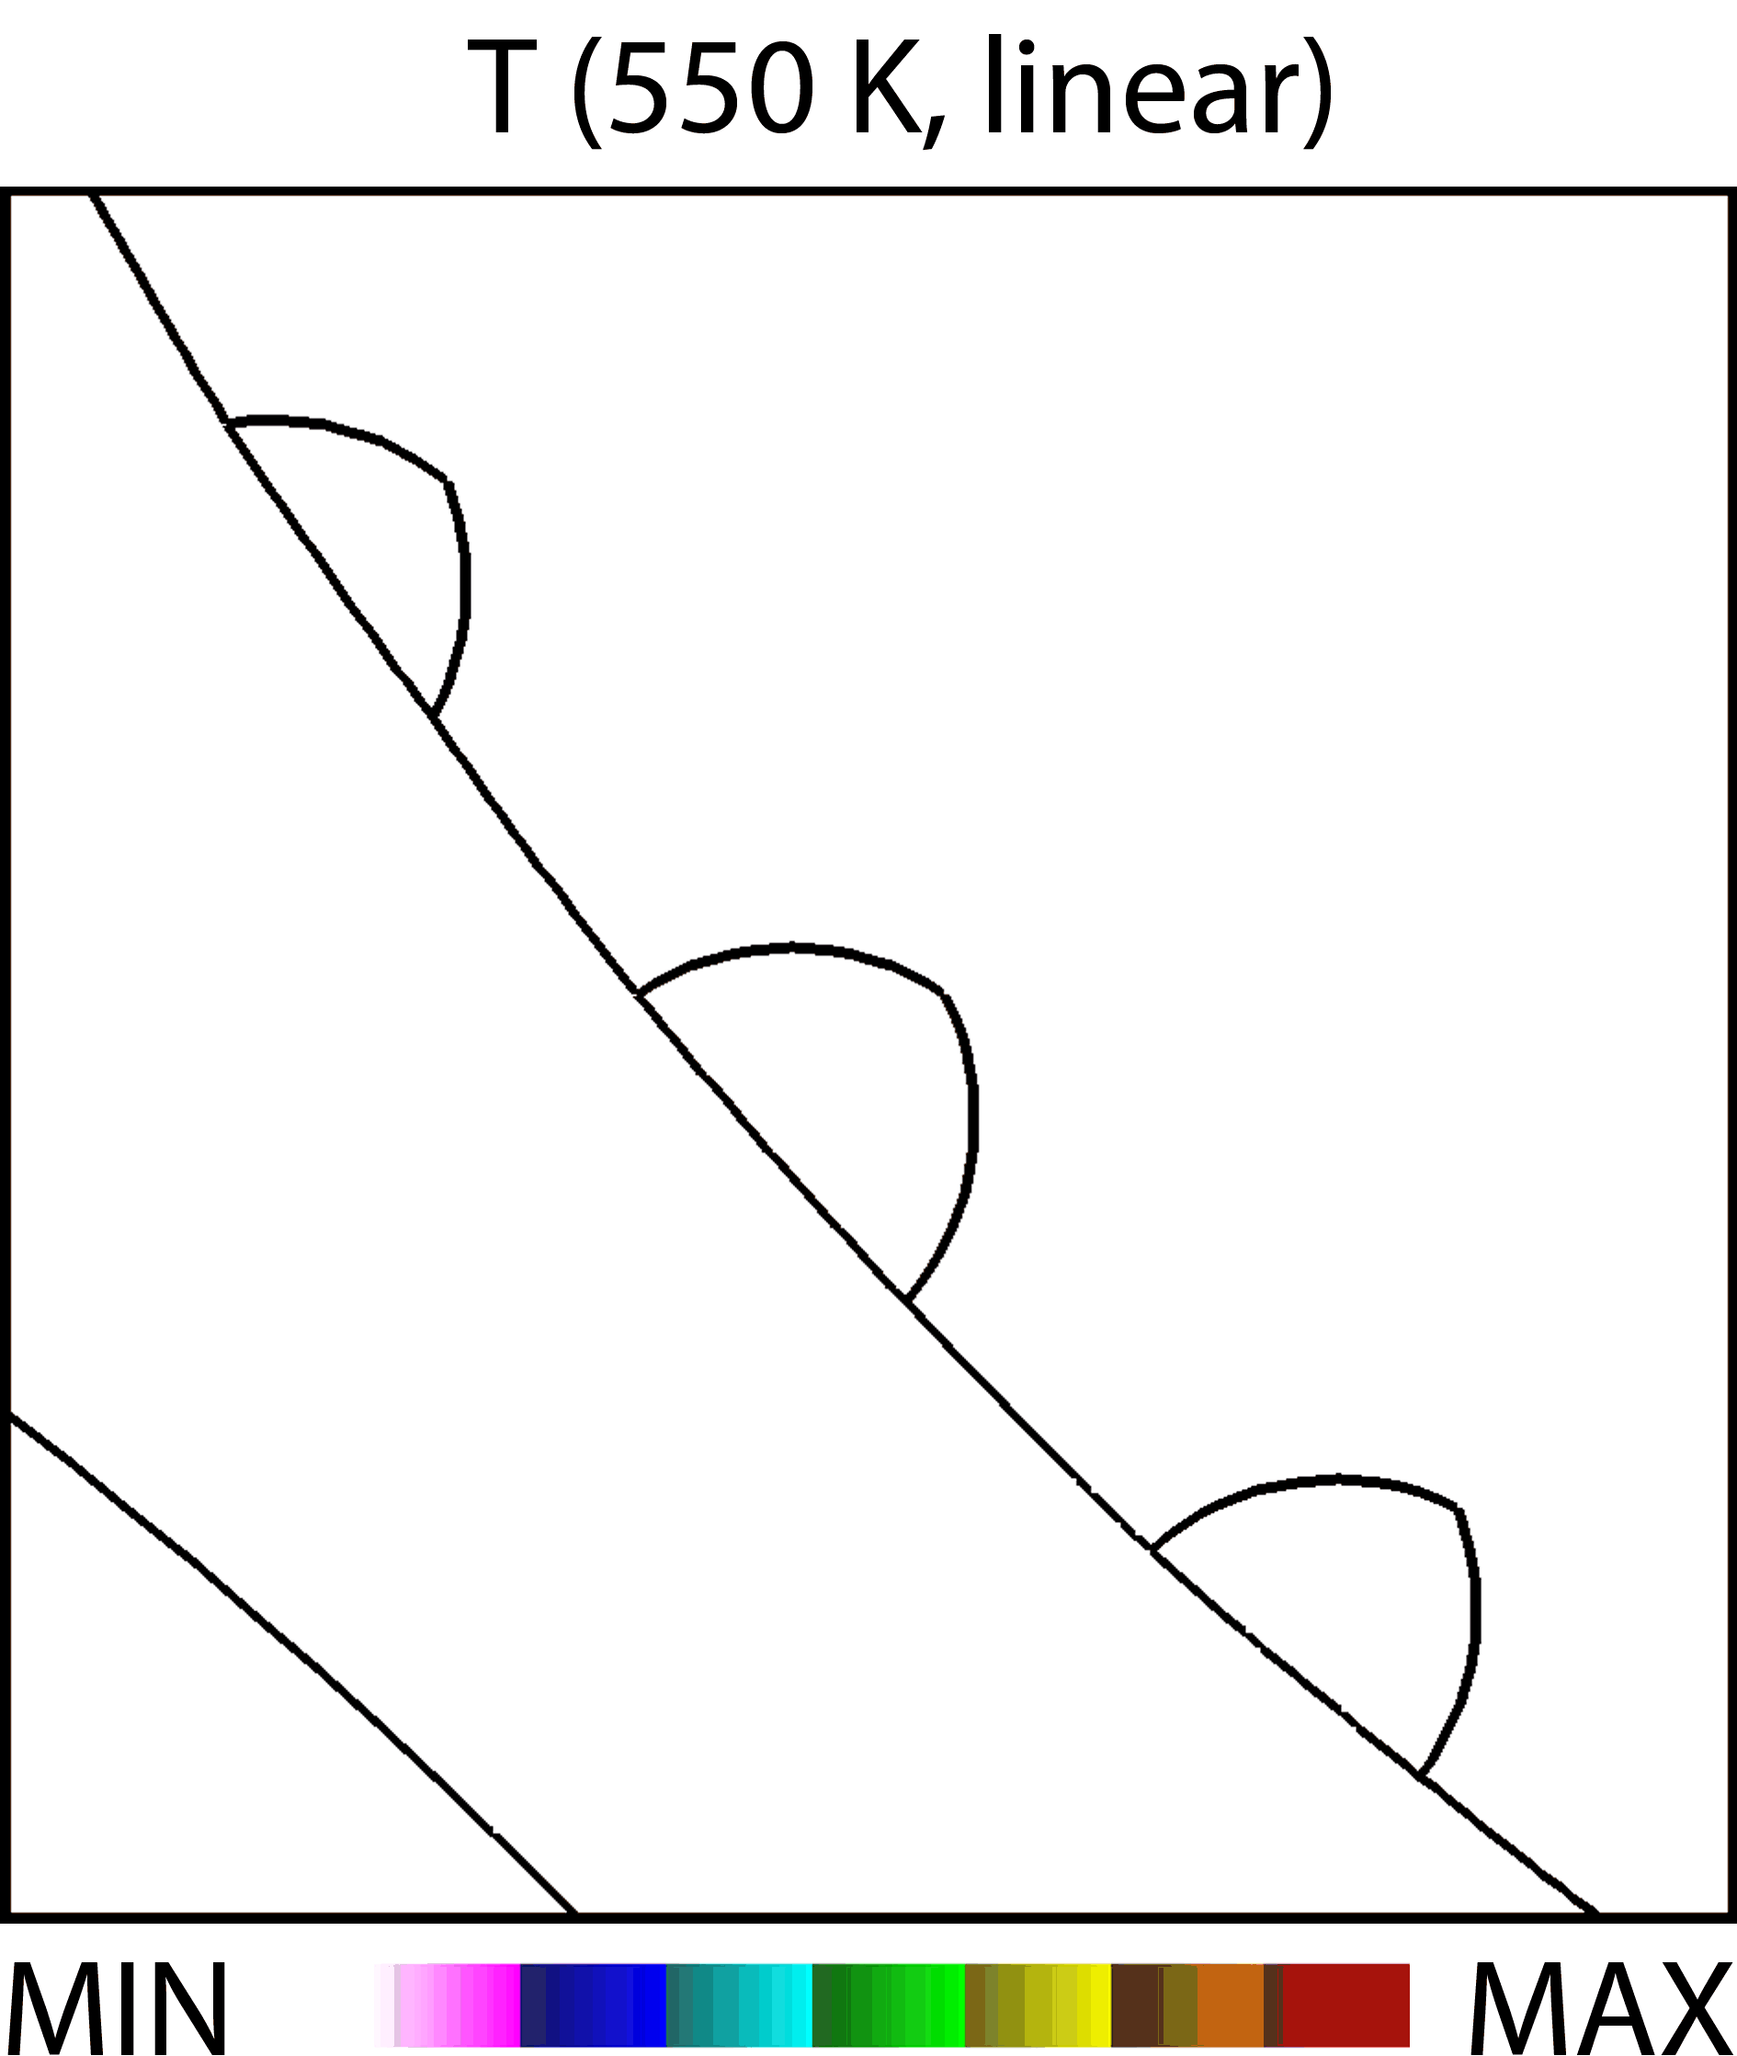
CATALYST HEATING
frequency = 10 kHz
t = 0.15 s
Total energy to catalyst per pulse of 3 μJ produced ∆T ≈ 0.002 K – requires 5×10⁴ pulses for increase of 100 K.
Heating terms increased by x 1,000 to speed computation. Gas temperature reset after each pulse.
Average catalyst temperature equilibrates at ≈ 525 K, typical light-off condition for ammonia production.
University of Michigan
Institute for Plasma Science & Engr.
GEC_2018
Animation Slide

Slide 18
CONCLUDING REMARKS
Charge redistribution within the metal leads to catalysts providing additional field enhancement, guiding discharges toward catalyst.
Field strengths are high enough to induce electric field emission which may explain surface plasmas observed in experiments.
Catalysts protruding from surfaces further increase field enhancement, field emission.
Emitted electrons increase plasma conductivity near catalyst, decrease electron temperature and fluences.
Ions are the main contributors to surface heating of catalysts.
Plasma can bring catalyst temperature above light-off condition for chemical conversion.
University of Michigan
Institute for Plasma Science & Engr.
GEC_2018

