Slide 1
Flux and Energy of Reactive Species Arriving at the Etch Front in High Aspect Ratio Features During Plasma Etching of SiO₂ in Ar/CF₄/CHF₃ Mixtures*
Soheila Mohadesª, Mingmei Wang^{b}, Aelan Mosden^{b} and Mark J. Kushnerª
(a) Department of Electrical and Computer Engineering,
University of Michigan, Ann Arbor, 48109
(smohades@umich.edu, mjkush@umich.edu)
(b) TEL Technology Center America, LLC
AVS 65th International Symposium, October 23, 2018
* Work supported by TEL Technology Center, America, LLC, National Science Foundation and the Department of Energy Office of Fusion Energy Sciences.

Slide 2
AGENDA
Control for HAR etching.
Description of the models
Dual-frequency Ar/CF₄/CHF₃ plasma: characterization of reactive fluxes and ion energy and angular distributions (IEADs) vs.
LF Power
LF Frequency
Pulsed Dual Frequency CCP
Ion and neutral fluxes and energy in etching profiles for continuous wave (CW) and pulsed power
Concluding Remarks
University of Michigan
Institute for Plasma Science & Engr.
AVS_2018
Notes:
2

Slide 3
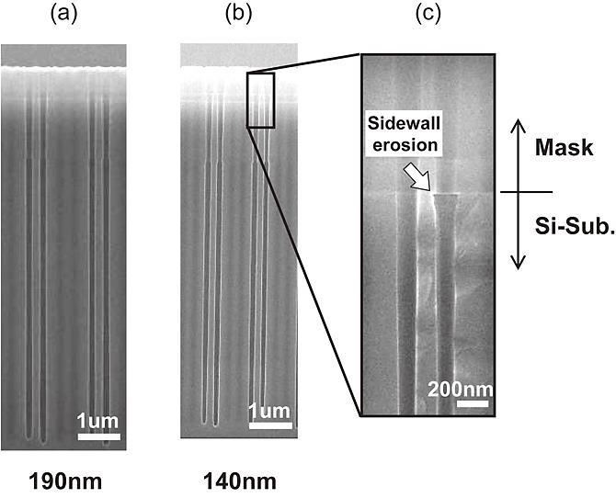
DUAL FREQUENCY CCP SOURCES
Dual frequency capacitively coupled plasmas (DF-CCPs) are widely used for etching and deposition in the microelectronics industry.
DF-CCP are used to better control the ion and radical fluxes with the higher frequency (HF) and the shape of IED with the lower frequency (LF).
Pulsed power is one technique to provide additional means to control IED.
Ion energy distribution (IED) is an important factor in high aspect ratio (HAR) etching.
This computational investigation addresses plasma dynamics and control of IEADs onto wafers for improving CD control of SiO₂ HAR etching.
Itsuko Sakai et al 2018 Jpn. J. Appl. Phys. 57 098004
University of Michigan
Institute for Plasma Science & Engr.
AVS_2018
Notes:
3

Slide 4
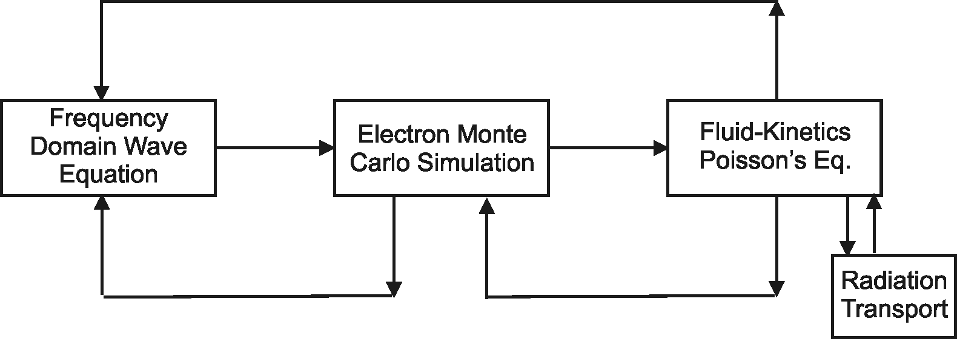
HYBRID PLASMA EQUIPMENT MODEL (HPEM)
Plasma Chemistry
Monte Carlo Simulation
Monte Carlo Feature Profile Model
Surface
Chemistry
Module
Modules used for this research:
Electron Monte Carlo Simulation
Fluid-Kinetics Poisson's Equation
Plasma Chemistry Monte Carlo Simulation
Monte Carlo Feature Profile Model
University of Michigan
Institute for Plasma Science & Engr.
AVS_2018

Slide 5
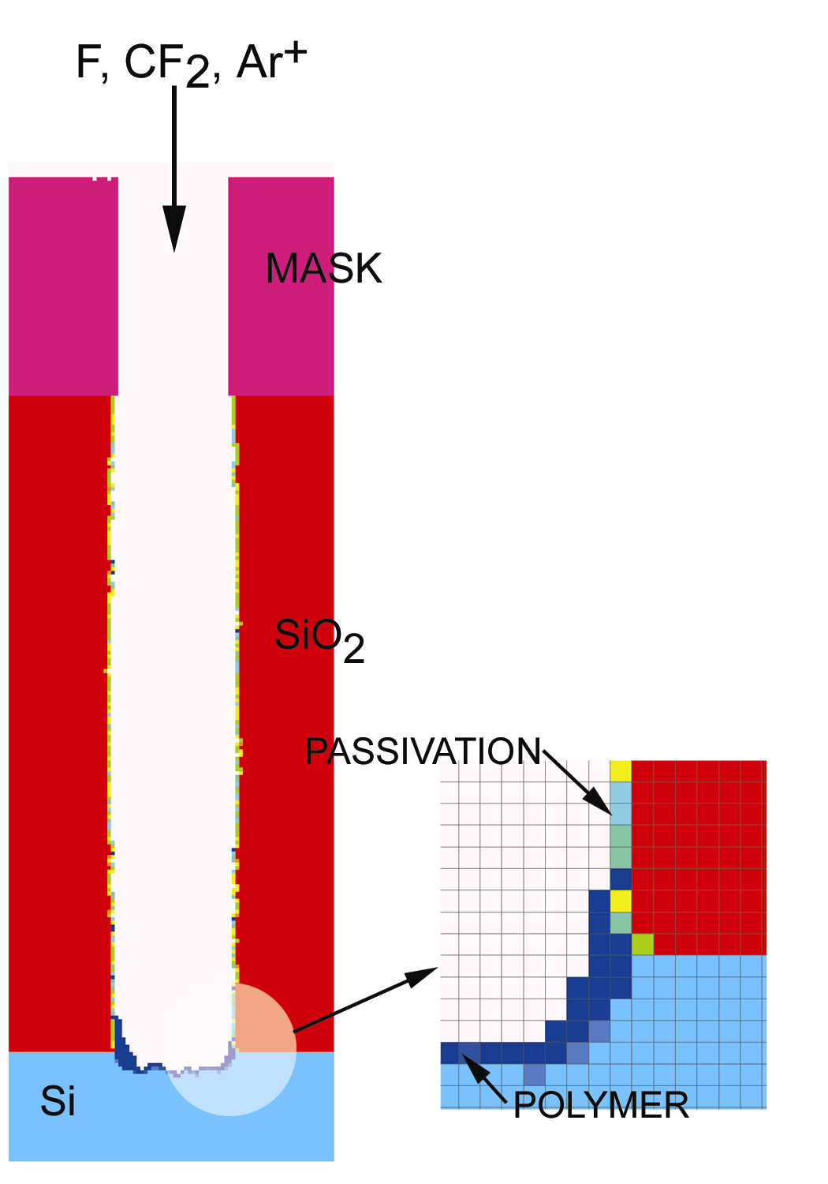
MONTE CARLO FEATURE PROFILE MODEL
Profile is defined on a 2D mesh, with cells representing a material.
Gas phase pseudo-particles are launched with fluxes, energy and angular distributions derived from Hybrid Plasma Equipment Model (HPEM).
Trajectories of particles are tracked until striking solid.
Surface reaction mechanism defines outcome of collisions.
Chemical reaction (material change)
Etching (removing cells)
Deposition (adding cells)
Implantation and mixing
Charging addressed through solution of Poisson's equation.
University of Michigan
Institute for Plasma Science & Engr.
AVS_2018
Notes:
pictures

Slide 6
REACTOR GEOMETERY
Nozzle, Metal
Quartz
Metal Wall
Wafer
Silicon
Biased Substrate
Pressure Sensor
Quartz
Pump
Dual-frequency capacitively coupled plasma (CCP) with both frequencies on bottom electrode.
2D, cylindrically symmetric, gap=3.5 cm
Base case conditions:
Ar/CF₄/CHF₃ = 5/75/20, 500 sccm, 15 mTorr.
HF: 40 MHz, 500 W; LF: 10 MHz, 100 W. Phases are locked.
The voltage is specified for each frequency and applied to bottom substrate: ~ 263 / 170 V, V_{dc-block}=-235 V, V_{dc-sub}=0V.
University of Michigan
Institute for Plasma Science & Engr.
AVS_2018
Notes:
6
Make clear that Vdc-block is the natural dc bias. Vdc-sub is externally applied dc voltage.

Slide 7
PLASMA REACTION MECHANISM – CF₄/CHF₃/Ar
Ar/CF₄/CHF₃ = 5/75/20, 500 sccm, 15 mTorr
Species in gas phase reaction mechanism:
CF₄, CF₃, CF₂, CF, C, F, F₂, C₂F₄, C₂F₆,
CF₃⁺, CF₂⁺, CF⁺, C⁺, F⁺, CF₃⁻, F⁻,
CHF₃, CHF₂, CHF₂⁺, H, HF, H⁺,
Ar, Ar(4s-metastable), Ar (4s-radiative), Ar(4p), Ar⁺,
University of Michigan
Institute for Plasma Science & Engr.
AVS_2018
Notes:
7

Slide 8
SiO₂ POLYMER MEDIATED ETCHING
SiO₂ etching in fluorocarbon plasmas occurs through polymer layer.
Ions energy is delivered to the surface by implantation through the polymer: chemical sputtering, physical sputtering mixing interface.
Radicals react with polymer and with surface after diffusing through the polymer.
Ion activation of SiO₂C_{x}F_{y} complex removes O as COF_{x}.
F diffusion through polymer removes Si as SiF_{x}.
O consumes CF_{x} polymer to mediate thickness.
F atom etching of polymer during diffusion.
Mechanism modified for CHF₃ derived H-containing species.
University of Michigan
Institute for Plasma Science & Engr.
AVS_2018

Slide 9
PLASMA PROPERTIES: BASE CASE
Majority of power deposition that produces ions comes from HF.
LF power deposition is primarily ion acceleration in the sheath.
With large HF power, bulk ionization (S_{e}) is dominant.
Ions distributed uniformly above the wafer.
Edge peaked of electron due to electrostatic edge effect.
S_{e}: 3.7×10¹⁵ cm⁻³, 3 dec
[e]: max=2.6×10¹⁰ cm⁻³, 2 dec
4.6
T_{e}: max=11.5 ev
Ar/CF₄/CHF₃ = 5/75/20, 15 mTorr, 500 sccm,40/10 MHz = 0.5/0.1 kW
[M⁺]:1.2×10^{11,} 2 dec
University of Michigan
Institute for Plasma Science & Engr.
AVS_2018
Notes:
9

Slide 10
RADICAL, ION FLUXES TO WAFER: BASE CASE
CF₂
CHF₂⁺
C₂F₄
CF₃
F
CF₃⁺
CF
Ar⁺
CF₂⁺
Radical Flux (cm⁻²s⁻¹)
C₂F₆
Ion Energy Distribution (eV⁻¹)
CF⁺
CHF₂
F⁺
Energy (eV)
With significant dissociation, radical fluxes dominated by CF_{x} and F.
Reactive radical fluxes exceed ion fluxes by 1-2 orders of magnitudes.
Ion fluxes dominated by CF₃⁺ due to larger mole fraction of CF₄.
CF₃⁺
Ion Flux (cm⁻²s⁻¹)
CF₂⁺
Ar⁺
CF⁺
CHF₂⁺
University of Michigan
Institute for Plasma Science & Engr.
AVS_2018
Radius (cm)
Notes:
10

Slide 11
ION AND RADICAL FLUXES TO WAFER: LF POWER
CF₃ ⁺
H
F
CF₂ ⁺
CF₂
Ar ⁺
CF₃
C₂F₄
HF
CF ⁺
CHF₂⁺
CF
Ion Flux (cm⁻²s⁻¹)
Radical Flux (cm⁻²s⁻¹)
C₂F₆
C ⁺
CHF₂
Power (W)
Power (W)
LF Power: 10, 100, 500 W; 1, 5, 10, and 20 kW. Fluxes to the wafer collected at radius of 6 cm.
Ion sources dominated by HF and so weaker dependence of ion fluxes on LF power up to 1 kW.
Transition of LF to radical generation mode occurs at a few kW when power significantly exceeds that of HF.
Significant increase in C⁺ due to additional fragmentation.
University of Michigan
Institute for Plasma Science & Engr.
AVS_2018
Notes:
11

Slide 12
LF POWER: IEADs
100 W
500 W
1000 W
5 kW
10 kW
20 kW
Dc Bias
-235 V
Energy (ev)
-605 V
-945 V
-1.9 kV
-2.6 kV
-3.5 kV
Angle (deg)
HF/LF = 263/170 V, 605/317 V, 340/1008 V
0.38/2.4 kV
0.42/3.36 kV
0.46/4.49 kV
Total ions, 2-dec
Increasing LF power has little effect on [e] since electron heating scales with ω². Majority of additional power results in ion acceleration.
Increased ion energies and narrower IADs with increasing LF power.
High ion energies required for etching of HAR features.
Narrow ion angular distributions reduce sidewall impacts.
Ar/CF₄/CHF₃ = 5/75/20, 15 mTorr, 500 sccm,
40/10 MHz = 500 W / 0.1 − 20 kW
University of Michigan
Institute for Plasma Science & Engr.
AVS_2018
MIN MAX
Notes:
12
0 w did converge to 0 watt!

Slide 13
LF POWER, IED
Total IED.
Ion energy increases by increasing LF power while energy distribution broadens.
The LF power is mainly deposited into the sheath – the width of IED increases with LF power.
During the negative polarity of LF cycle, increase in sheath potential accelerates ions to higher energy.
During positive polarity of LF cycle, sheath potential is dominated by HF which is unchanged.
Ion Energy Distribution (eV⁻¹)
Energy (eV)
Ar/CF₄/CHF₃ = 5/75/20, 15 mTorr, 500 sccm,
40/10 MHz = 0.5/0.1 − 20 kW
University of Michigan
Institute for Plasma Science & Engr.
AVS_2018
Notes:
13

Slide 14
LF FREQUENCY: IEAD
1 MHz
2 MHz
5 MHz
10 MHz
20 MHz
Ar/CF₄/CHF₃ = 5/75/20, 15 mTorr, 500 sccm,
40/1−20 MHz = 0.5/0.1 kW
Total ions, IEADs, 2-dec
Energy (ev)
V_{dc-block} -197 V
-167 V
MIN MAX
-175 V
-238 V
-235 V
Angle (deg)
HF/LF= 262/211 V 267/206 V 275/200 V 263/170 V 244/175 V
IEAD is broadened by decreasing LF frequency and is shifted to higher energies.
Self DC-bias (most negative at 5 MHz) changes with LF frequency to compensate for change in displacement current and balance the conduction.
Narrow ion angular distribution (< ±4 deg) results in more “anisotropic” etch profile.
University of Michigan
Institute for Plasma Science & Engr.
AVS_2018
Notes:
14
Which is due to thinner sheath width

Slide 15
LF FREQUENCY: IED
Increased number of peaks by decreasing LF frequency: single peak to bimodal.
With longer LF cycle, sheath is then modulated by HF, with the LF sheath appearing to be “DC”.
At higher LF, ion transit time across the sheath is sufficiently longer than the RF cycle reflects a time averaged sheath characteristic.
Ion Energy Distribution (eV⁻¹)
Energy (eV)
Ion and radical fluxes are nearly independent of LF frequency and so negligible change in conduction current.
Ar/CF₄/CHF₃ = 5/75/20, 15 mTorr, 500 sccm,
40/10 MHz = 0.5/0.1 kW
University of Michigan
Institute for Plasma Science & Engr.
AVS_2018
Notes:
15

Slide 16
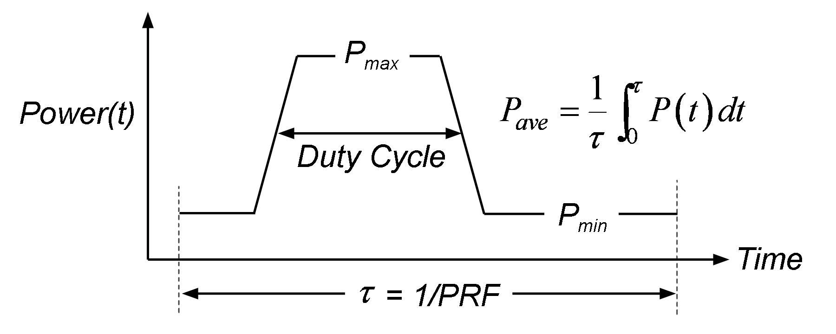
PULSED POWER
Use of pulse power provides a means for controlling IED, and so control etch properties.
Pulsing enables both plasma potential and dc-bias to change beyond the steady state values in CW operation.
Simultaneous pulsing both LF and HF
Duty-cycle = 50%, PRF = 10 kHz, 3 pulses
Constant power= 500 W (HF, 40 MHz), 100 W (LF, 10 MHz)
University of Michigan
Institute for Plasma Science & Engr.
AVS_2018
Notes:
So what we would like to do is to investigate the possibilities of using pulse plasmas as a means to control the distribution functions and etch properties.
We are going to look at pulsed capacitively coupled plasma with the duty cycle which is a fraction of the powers on period and a pulse repetition frequency which is how many times per second will repeat this wave form.

Slide 17
PLASMA PROPERTIES WITH PULSING
[e]: max=5×10¹⁰ cm⁻³
MIN MAX
PULSE
BC = 1 nF
n_{e} and V_{dc-block} increase with pulse rising time due to small blocking capacitance (BC), and drop to CW values at the fall time of pulse.
Total ion fluxes collected at the center of wafer increase following the ionization source and then decrease after pulse is off.
University of Michigan
Institute for Plasma Science & Engr.
Animation Slide
AVS_2018
Notes:
17
high-energy electrons are generated due to an overshoot of
E/N

Slide 18
IEAD EVOLUTION THROUGH A CYCLE
Time (μs)
CW
32
128
248
488
512
536
632
776
800
1000
Energy (ev)
Angle (deg)
Each cycle=1000 μs, 50% duty cycle
IEAD averaged every 3 iterations over the last pulse.
IEAD is highest at the beginning of the pulse following changes in V_{dc-block}, decreases to the lowest energy after power is off then increases slightly due to negative V_{dc-block}.
Not a noticeable change on IAD with pulsing both LF and HF.
University of Michigan
Institute for Plasma Science & Engr.
MIN MAX
AVS_2018
Notes:
18
Which is due to thinner sheath width

Slide 19
HAR ETCH PROFILE, CW
LF power = 1 kW
500
100
Etch rate increases with LF power increase due to higher ion energy.
Low ion energies in base case leads to broad angular distributions and undercutting.
5
PR
4
3
40/10 MHz = 0.5/ 0.1-1 kW
Critical Dimension (CD)= 54 nm
AR=100
Height (μm)
SiO₂
2
1
Si
University of Michigan
Institute for Plasma Science & Engr.
160 nm
Animation Slide
Notes:
19

Slide 20
ETCH PROFILE WITH PULSED POWER
Pulsed
CW, 100 W
PR: Hard mask
Critical Dimension (CD)= 54 nm
Aspect Ratio (AR)= 100
Pulsing CCP can resemble Bosch process: The pulse off cycle is the passivation step where a polymer layer is deposited isotropically on the etch front and sidewall.
During pulse-on cycle, the passivation polymer layer at the etch front is removed while the sidewall passivation remains intact due to the directionality of plasma bombardment.
In this case, pulsing produces more tapered profile.
5
PR
4
3
160 nm
Height (μm)
SiO₂
2
1
Si
Pulsed
160 nm
University of Michigan
Institute for Plasma Science & Engr.
Animation Slide
AVS_2018
Notes:
20

Slide 21
ION AND NEUTRAL FLUXES vs. AR
Fluxes to etch front (cm⁻²s⁻¹)
Decrease in ion fluxes with AR due to decreasing view-angle to plasma.
Higher thermal neutral flux at high AR is due slowing hot neutrals and low conduction to leave feature.
Aspect Ratio
Flux and energy of ions, hot and thermal neutrals to the etch front.
As ions strike sidewall converted to hot neutrals. Energy is “first hit.
Thermal neutrals originate from:
Thermal fluxes from the plasma entering the feature.
Slowing hot neutrals.
If it is difficult to get into the feature, it is difficult to get out of the feature.
University of Michigan
Institute for Plasma Science & Engr.
AVS_2018
Notes:
pictures

Slide 22
ION AND HOT NEUTRAL FLUXES vs. AR
Record of ion energy is “first hit” after which particle is hot neutral.
Decrease in hot neutral flux with AR due to energy loss scattering but are less sensitive to view-angle than ions.
Flux of all hot neutrals decrease with AR – an ARDE effect.
Ions energy drops with AR due to smaller view-angle. Energy continues as “hot neutral” with a smaller dependence on AR.
Hot Neutrals
Fluxes to etch front (cm⁻²s⁻¹)
Aspect Ratio
Energy (ev)
Aspect Ratio
University of Michigan
Institute for Plasma Science & Engr.
AVS_2018
Notes:
22
Launch particles towards surface.
Record fluxes at “etch front”
All ions neutralize on striking surfaces.
Once hot neutrals thermalize deep in the feature, low conductance to top of feature produce “rattling around” of radicals at bottom of feature.

Slide 23
ION ENERGY vs. HAR AND IEAD
Trend in ion energy with AR varies for different ions.
CF₃⁺ and Ar⁺ energy reaching the etch front are less sensitive to HAR while CF⁺ energy drops significantly.
In this case, the difference in ions energy trend can depends on IEAD:
Narrow view-angle at large AR affects IEADs differently having different angular distributions.
CF₃⁺ has narrower angular distribution than CF⁺, and so less sensitive to AR.
Energy to etch front (ev)
Aspect Ratio
Energy (ev)
University of Michigan
Institute for Plasma Science & Engr.
AVS_2018
Angle (deg)
Notes:
23
Launch particles towards surface.
Record fluxes at “etch front”
All ions neutralize on striking surfaces.
Once hot neutrals thermalize deep in the feature, low conductance to top of feature produce “rattling around” of radicals at bottom of feature.

Slide 24
CONCLUDING REMARKS
DF-CCP sustained in Ar/CF₄/CHF₃ with HF /LF =40/10 MHz and IEAD and fluxes parameterized by changing LF power and frequency.
Increasing LF power increases ions fluxes to wafer due to ion acceleration and large self-DC bias voltage.
Broadened IEAD with decreasing LF frequency.
Higher LF power: higher energy, broader IEDs and narrower IADs due to power deposition into sheath, therefore higher etch rate − narrow IAD and high ion energy are important for HAR etching.
Pulsed power provide additional control on plasma by increasing ion energy and fluxes during pulse on period, compared to CW.
Ion and hot neutral fluxes drop with AR while thermal neutral flux maintain its flux deep in the feature due low conductivity.
Ion energy decreases with AR due to narrower view-point. It is observed that the shape of IEAD for each ion affect its energy drop with AR: CF₃⁺ energy does not decrease with AR.
University of Michigan
Institute for Plasma Science & Engr.
AVS_2018
Notes:
24
Decreasing LF frequency broadened IEADs resulted in transition from single peak to a multi-peaks mode.

